Slide 1
The Future of Teacher Education: Reconceptualizing Disability
to Advance Equity
Suzanne Stolz, Ed.D.
University of San Diego
Department of Learning and Teaching
CCTE
San Diego -Fall 2021
Notes:
Suzanne

Slide 2
“...a unified education system in which all children, including students with disabilities, are considered general education students first and foremost.”
--Statewide Special Education Task Force Report (2015)

Slide 3
How do newly adopted poloicies and practices help us reconceptualize disability?
New
“Universal” TPEs
CalTPA grounded in UDL
New Education Specialist Credentials
A new IEP based on student assets
Notes:
“Universal” TPEs
CalTPA grounded in UDL
New Education Specialist credentials

Slide 4
Dual Credentials: University of San Diego
 | Year 1 – Fall Semester | Year 2 – Fall Semester
Foundations | EDTE 500: Diversity, Inclusion, & Schooling EDTE 510: Educational Psychology | EDTE 513P: Positive Behavior Supports for Family, School, and Community Engagement EDTE 5XX: Elective Global Experience
Methods | EDTE 504: Multi or Single Subject Methods I EDTE 501: Methods for Language and Literacy | EDTE 514: Educational Research Methods
Field Experience | EDTE 551: Clinical Practicum 1 | EDTE 553: Clinical Experience 3: Student Teaching I
 | Year 1 – Spring Semester | Year 2 – Spring Semester
Foundations | EDTE 511: Equity and Advocacy in Ed Systems | EDTE 515: Technology and Learning EDTE 5XX: Elective Global Experience
Methods | EDTE 505: Multi or Single Subject Methods II EDTE 512: Methods for English Learners EDTE 517: Assessment | EDTE 515: Capstone Seminar
Field Experience | EDTE 552: Clinical Experience 2: Extended Practicum | EDTE 554F: Clinical Experience 4: Student Teaching II
Notes:
In our previous programs, students took a course in multicultural education and a course in special education. We decided to merge these courses into a two-course sequence on inclusive education. Fall: Diversity and Inclusion in Schools; Spring: Equity and Advocacy in Education Systems

Slide 5
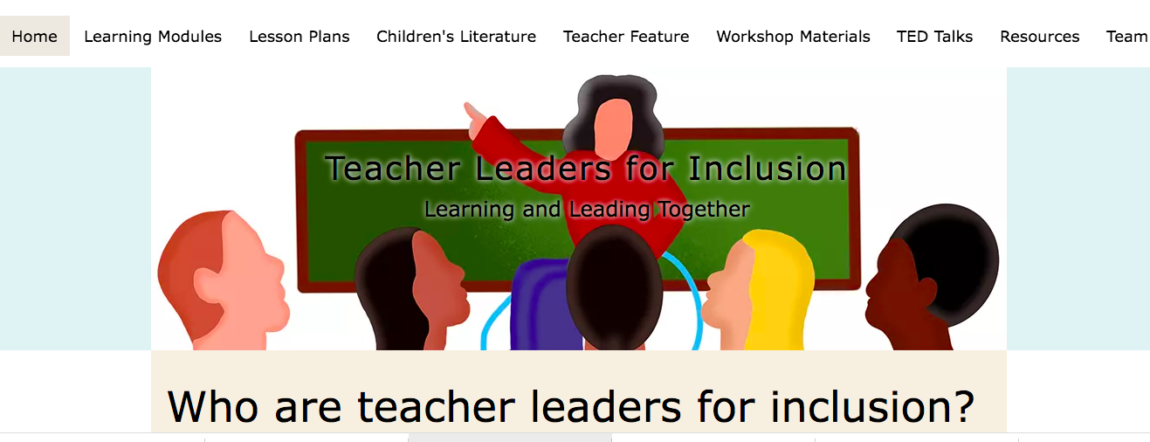
Infusing Disability Studies
Visit https://www.lead4inclusion.com/

Slide 6
“What defines strength in a time of crisis? In the coming decades, humanity must reimagine how to do every damn thing in the world. Disabled people are experts in finding new ways to do things when the old ways don’t work. We are a vast think tank, a bottomless well of ingenuity and creativity.”

Slide 7
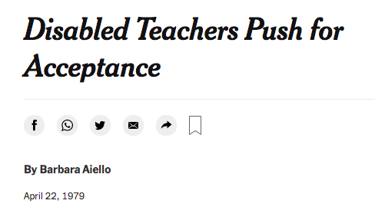
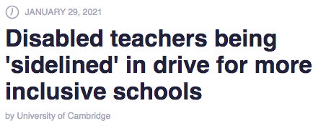
Recruit, support, hire, and retain disabled teachers

Slide 8
Thank You
Email:
sstolz@sandiego.edu

