Slide 1

CTC Exams and Performance Assessments:
What’s Happening
JULIET WAHLEITHNER – juliet.wahleithner@ctc.ca.gov
DIRECTOR, DIVISION OF RESEARCH, EVALUATION, & ASSESSMENT
Notes:
Adam

Slide 2

Agenda
Part 1
Updates on Commission Exams
Part 2
Updates on Performance Assessments
Part 3
Performance Assessment Implementation
Notes:
Adam

Slide 3
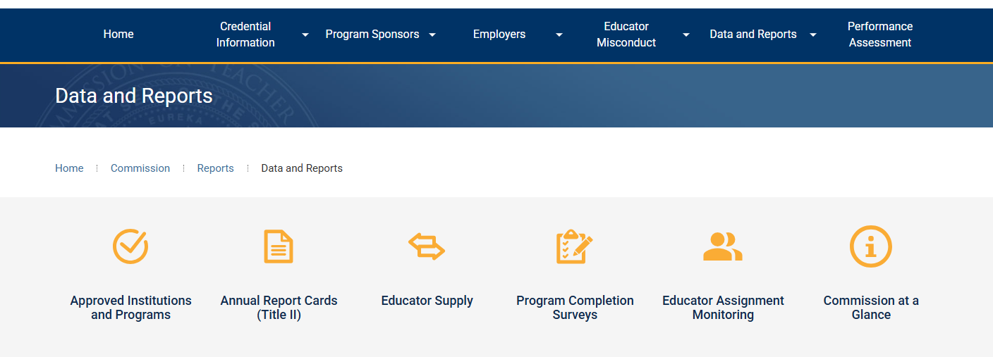
Quick Check In: Commission Dashboards
BUT FIRST!!!!
Public-Facing Commission Dashboards
EPP-Specific Commission Dashboard

Slide 4
Do you use the Commission dashboards? Which? How often? For what purpose(s)?
Notes:
Adam

Slide 5
Part 1: Updates to Commission-Approved Examinations
Notes:
Adam

Slide 6
Reading Instruction Competence Assessment (RICA)
Part 1: Exam Updates
Ends 10/31/25
Candidates whose credential requires RICA but who did not complete RICA have two options
Foundations of Reading
Complete a new TPA with literacy

Slide 7
California Basic Education Skills Test (CBEST)
Part 1: Exam Updates
Was used to measure competencies for Basic Skills Requirement
No longer required for almost all credential candidates
Only required for:
Emergency Substitute Teaching Permit for Prospective Teachers
Exchange Certificated Employee Credential
Sojourn Certificated Employee Credential
Designated Subjects Supervision and Coordination Credentials
Still required in statute
Plan to Update (2025-2026):
Examine existing options to replace
Recommend new exam to Commission

Slide 8
California Subject Examinations for Teachers (CSET)
Part 1: Exam Updates
Measures the Subject Matter Requirements for each credential/authorization
Usage is rapidly declining
Candidates can now meet the Subject Matter Requirement with undergraduate coursework and degrees (AB130, 2021)
Plan to Update (2026-2028)
SMR update, beginning with high-frequency credentials
CSET revision based on revised SMRs

Slide 9
California Teacher of English Learners Exam (CTEL)
Part 1: Exam Updates
Used for a number of pathways to English learner and bilingual authorizations
Required by statute
Plan to Update (2026-2027):
Revise CTEL Knowledge, Skills, and Abilities (KSAs)
Identify existing exams that may align or align with modifications
Recommend new exam to Commission

Slide 10
California Preliminary Administrative Credential Examination (CPACE)
Part 1: Exam Updates
Replaces a preparation program for the Preliminary Administrative Services Credential
Current version of CPACE has been in place since 2017
Plan to Update (2027-2028):
Revision of current CAPEs and CACEs
Identify existing exams that may align or align with modifications
Recommend new exam to Commission

Slide 11
Early Completion Option (ECO) Exams
Part 1: Exam Updates
Used to meet part of the requirements for the early completion option for intern credential candidates
Required by statute
National Evaluation Series (NES) Assessment of Professional Knowledge (APK) is in use for Multiple and Single Subject intern candidates
Plan for ES and PK3 (2026):
Identify existing exams that align with TPEs or align with modifications
Recommend new exams to Commission

Slide 12
Part 2: Updates to Performance Assessments
Notes:
Juliet

Slide 13
Recent Legislation Impacting Perf Assessments
Part 2: SMR Revisions
Part 2: Performance Assessments
SB 488 (2021)
Literacy Performance Assessment
SB 1263 (2024)
Workgroup + Recommendations

Slide 14
SB 488 (2021): Required Literacy Updates
Part 2: SMR Revisions
Part 2: Performance Assessments
Development of Literacy Program Standard & TPE
Development of a Literacy Performance Assessment to replace the RICA that assesses candidates’ skills related to teaching:
(i) The study of organized, systematic, explicit skills including phonemic awareness, direct, systematic, explicit phonics, and decoding skills.
(ii) A strong literature, language, and comprehension component with a balance of oral and written language.
(iii) Ongoing diagnostic techniques that inform teaching and assessment.
(iv) Early intervention techniques.

Slide 15
Approved Literacy Performance Assessments
Part 2: SMR Revisions
Part 2: Performance Assessments
CalTPA: Literacy Performance Assessment (Cycle 2)
Multiple Subject
PK3
Ed Specialist: MMSN; ESN; VI; DHH; ECSE
edTPA:
Multiple Subject Literacy with Mathematics
Ed Specialist, Literacy: MMSN/ESN
FAST:
Multiple Subject
Ed Specialist: MMSN; ESN
PK3 (being field tested)

Slide 16
CalTPA-Specific Changes: MS & ES
Part 2: SMR Revisions
Part 2: Performance Assessments
Cycle 1→Math Cycle
Cycle 2→Literacy Cycle

Slide 17
SB 1263
Part 2: SMR Revisions
Part 2: Performance Assessments
Passed by legislature in September 2024
Required formation of workgroup to review the design and implementation of current TPAs (RDI TPA)
Also called for programs with low passing rates to be
Held accountable
Provided with support to improve passing rates

Slide 18
RDI-TPA Workgroup Charge
Part 2: SMR Revisions
Part 2: Performance Assessments
Ensure assessments are
valid
authentic
formative in nature
embedded in preparation
suitable for beginning teachers
contribute to program improvement through accreditation system

Slide 19
Final Recommendations
Part 2: SMR Revisions
Part 2: Performance Assessments
24 Recommendations aligned with 5 Focal Areas +1 additional recommendation
Focal Areas:
Modifications to Current Assessments (6 recommendations)
Embedding in Programs (4 recommendations)
Accreditation Support for Embedding (10 recommendations)
Local Scoring (2 recommendations)
Program Completer Survey (1 recommendation)
Additional recommendation to study impact of AI
Significant level of support from workgroup members across recommendations (71%---->96%)

Slide 20
Implementation Plan
Part 2: SMR Revisions
Part 2: Performance Assessments
Based on Approved Recommendations
Outlines 3 areas of work spread across 4 phases
Performance Assessment Design
Program Implementation
Commission Supports
Presented to and Approved by Commission in August 2025

Slide 21
Project Area 1: Performance Assessment Design
Part 2: Performance Assessments
Assessment & Rubrics
Redesign tasks/rubrics to emphasize inclusive, asset-based teaching
Allow multiple modalities for candidate evidence
Feedback Systems
Require individualized, rubric-specific feedback
Ensure timely notification of technical issues
Cost Controls
Keep assessment financially accessible
Prohibit passing platform or upgrade costs to candidates

Slide 22
Project Area 2: Program Implementation
Part 2: Performance Assessments
Embedding in Preparation
Integrate tasks into coursework and clinical practice
Orient faculty, supervisors, and partners to revised model
Standards & Accreditation
Revise Program and Common Standards for alignment
Require program monitoring of embedding and local scoring outcomes
Candidate Supports
Structured support for non-passing candidates
Tailored assistance for interns; Use results to inform IDPs and ILPs

Slide 23
Project Area 3: Accountability & Support
Part 2: Performance Assessments
Resources & Tools
Candidate survey on assessment experience
Exemplar submissions and annotated materials
Field Engagement
Statewide learning loops and convenings
Orientation materials for programs and partners
Accountability & Innovation
Criteria and supports for low-performing programs
Expert advisory group to study AI in assessment design

Slide 24
Phased Implementation Plan
Part 2: Performance Assessments
Phase 1 (2025–26): Revise Design Standards; draft Program/Common Standards; define criteria for low-performing programs; launch field engagement. Phase 2 (2026): Adopt Design Standards; set task, content, and platform specifications; complete Program/Common Standards revisions; adopt support framework. Phase 3 (2026–27): Develop and pilot new assessment with select programs; update accreditation processes; release candidate and faculty resources. Phase 4 (2028): Refine and finalize the system; launch statewide field test; implement revised accreditation and accountability processes.

Slide 25
Part 3: Performance Assessment Implementation
Notes:
Juliet

Slide 26
Supporting Candidates: What’s Required?
Part 3: Performance Assessment Implementation
Providing access to guides/handbooks
Explaining TPA tasks and scoring rubrics
Engaging candidates in formative experiences aligned with the TPA
Providing candidates who were not successful with additional support
Program Standard 5B (PK3 6B)
PSA 25-05

Slide 27
Supporting Candidates: What’s Recommended?
Part 3: Performance Assessment Implementation
Guiding discussions about TPA tasks and rubrics
Providing support documents for candidates
Using TPA rubrics on assignments or in clinical practice de-briefs
Asking probing questions about drafted responses
Guiding candidates in how to upload materials
Arranging technical assistance for the video
Program Standard 5B (PK3 6B)
PSA 25-05

Slide 28
General Support: What does this look like?
Part 3: Performance Assessment Implementation
Holding TPA orientations for candidates each term
Providing a webinar to walk candidates through registration/submission
Creating a course/module in the LMS that includes links to guides/handbooks, resources, a suggested timeline
Holding a seminar for candidates who did not pass the TPA
Creating a program-specific timeline that includes TPA tasks, coursework, and clinical practice expectations
Program Standard 5B (PK3 6B)
PSA 25-05

Slide 29
Embedding the TPA: What does this look like?
Part 3: Performance Assessment Implementation
Model assignments after TPA tasks
Support candidates in analyzing student data
Require candidates to identify student assets and integrate them in instructional plans
Support candidates in integrating UDL principles into lessons
Use TPA task rubrics to evaluate candidates
Encourage candidates to collaborate to provide feedback
Program Standard 5B (PK3 6B)
PSA 25-05

Slide 30
Embedding the TPA: What does this look like?
Part 3: Performance Assessment Implementation
Ensure mentor teachers are familiar with TPA tasks/rubrics
Require candidates to record their teaching and support them in analyzing and reflecting on their instruction
Use TPA rubrics to guide reflections
Program Standard 5B (PK3 6B)
PSA 25-05

Slide 31
Questions?
Thank you!
juliet.wahleithner@ctc.ca.gov

