Slide 1
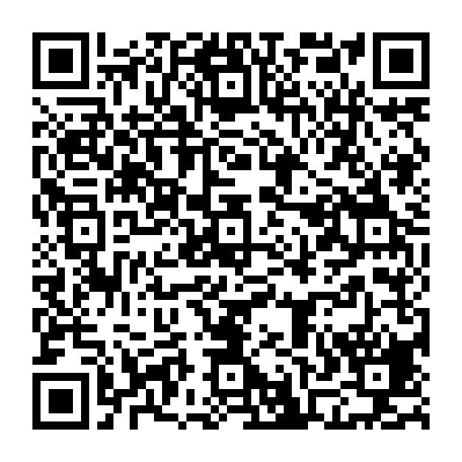
Applying Our Professional Identities & Expertise to Engage in Advocacy
Betina Hsieh, PhD – Endowed Professor of Teacher Education
University of Washington (Seattle Campus)
CCTE Fall Conference

Slide 2

Take a Breath…and Check-In
Before we begin this session, let’s take a moment to breathe collectively and recenter ourselves in our bodies. There are many things for us to advocate for in the world around us, both personally & professionally. To do this advocacy most effectively, we need to stay grounded in our identities, core values, and commitments.

Slide 3

Considering Our Professional Identities
Teacher Educator Professional Identity:
Experiences as Students
K-12 Classroom/ Professional Experiences
Teacher Educator Experiences
Praxis (Theory-informed practices)
Personal Identities (Social Positioning)
Values, Beliefs & Commitments
Opportunities for Identity-informed mentoring
(Gerst & Hsieh, under review; Hsieh, 2015; Hsieh & Nguyen, 2020; Yeh et al., 2022)
Notes:
Initial research on Teacher professional identity – talked about orientations towards three areas of influences which affected the ways that they approached teaching, particularly in terms of pedagogically
Later research focused on our personal identities across intersectional lenses and opportunities for identity informed mentoring and the ways that these shaped the enactment of our values, beliefs & commitments in practice and beyond the classroom
Newer research that I’m currently engaged in focuses on teacher educators themselves and the ways that the identity categories that shape teacher professional identity also shape teacher educator identities in addition to experiences they’ve had in teacher education, particularly in relation to context similarity

Slide 4
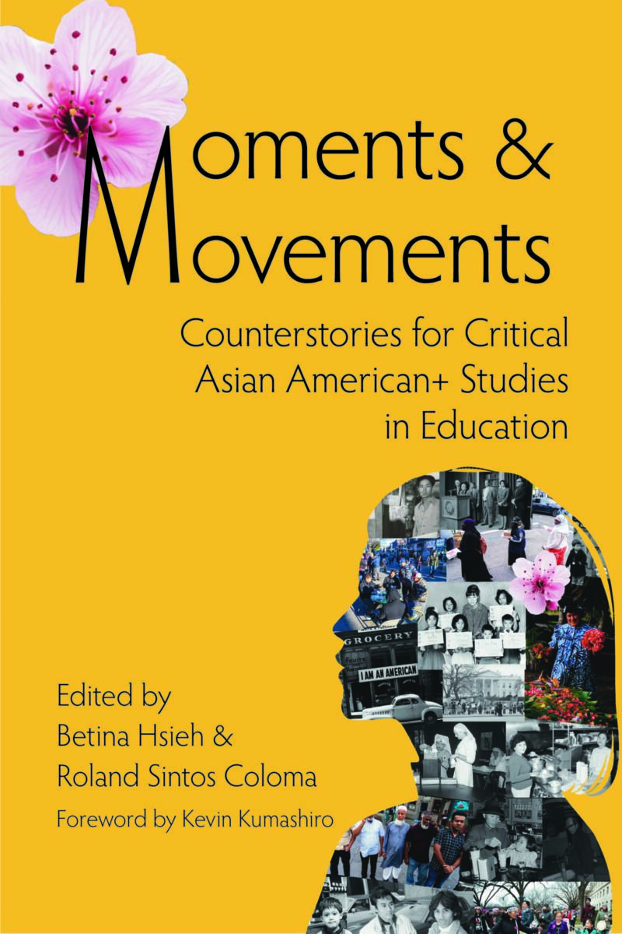
My Own Professional Identity as a Teacher Educator
How do I draw from my…
Experiences as a student: Public school in So Cal suburb
K-12 Classroom/ Professional Experiences: Tutoring (MS English), 2 ST placements; MS Teacher in Bay Area City; BAWP co-director
Teacher Education/ Educator Experiences: 10 years @ CSULB; 1 year at ULV; 2 years at UW
Praxis (Theory-informed practices): Freire, hooks, Schon, Vygotsky
Personal Identities (Social Positioning): 2nd gen AsAm Woman, MotherScholar,
Values, Beliefs & Commitments: Each child being seen & cared for; belonging, educational opportunity
Opportunities for Identity-informed mentoring: CSULB

Slide 5
Considering Our Professional Identities
How have these areas shaped your teacher educator professional identity? In what way does your teacher educator professional identity shape your work in and beyond the classroom?
Experiences as Students
K-12 Classroom/ Professional Experiences
Teacher Educator Experiences
Praxis (Theory-informed practices)
Personal Identities (Social Positioning)
Values, Beliefs & Commitments
Opportunities for Identity-informed mentoring

Slide 6

Considering Our Professional Expertise
As teacher educators, we have/ develop expertise in relation to a variety of areas. For example:
Teacher education/ development
Content area/ area of specialization
Developmental stage
Pedagogies
Communities
Policy
We can develop these areas of expertise through study, practice, professional experiences, work in/ with communities

Slide 7


My Professional Expertise
My expertise:
Asian Americans in Education
Teacher Education (Secondary English/ Content Literacies)
Professional Learning for teachers and teacher educators
How I developed it:
Research/ Theory
Teacher Education Experiences
Facilitating Professional Learning
Why it’s important:
Demographic imperative/ disparities
Teaching as a complex profession
Teaching teachers ≠ teaching students
Notes:
If I were to be asked by someone outside of education,I would describe :
Your area(s) of expertise
How you developed that expertise
Why your expertise is important

Slide 8
Considering Our Professional Expertise
If you were to be asked by someone outside of education, how would you describe (briefly):
Your area(s) of expertise
How you developed that expertise
Why your expertise is important

Slide 9

Considering Current Contexts & Possible Futures
Teacher Educators operate within systems and must consider:
Institutional, District, Local/Regional, State, National contexts
Policy & socio-political contexts
Leveraging our personal/ professional identities & professional expertise, how can we adapt our visions and advocacy in these current contexts?
What are possible futures you can imagine that you feel compelled to advocate for?

Slide 10
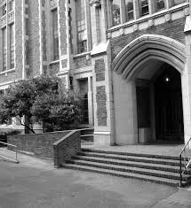

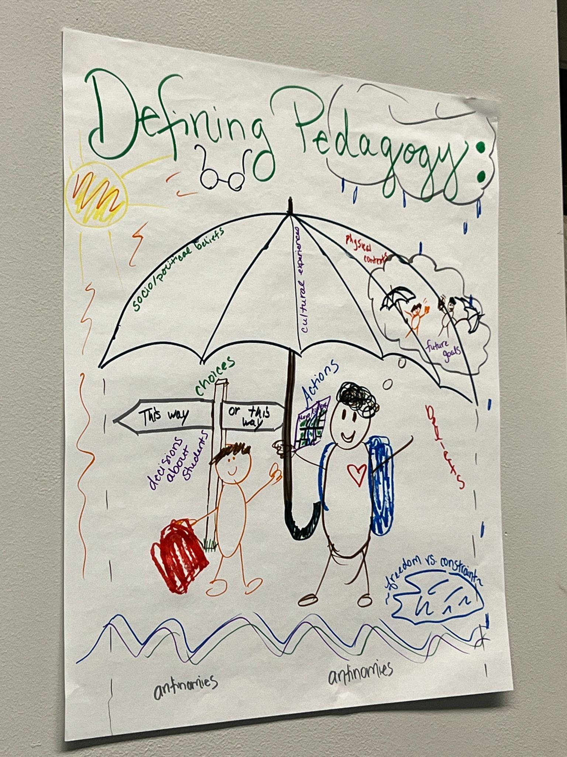
How I Consider Current Contexts & Possible Futures
Contextual considerations:
Washington state public education dependence on federal funding
Washington P-12 Dual Language for All Initiative (2030)
Diversifying Educator Workforce Initiative
Leveraging my professional identities/ expertise:
Teaching in multilingual settings; parenting across dual language settings
TE Work at CSULB – Caminos Project
CCTE Leadership
Possible Futures:
Teaching & Teacher Education Professionalized
A teaching force where students can see themselves & feel belonging
Notes:
Teacher Educators operate within systems and must consider:
Institutional, District, Local/Regional, State, National contexts
Policy & socio-political contexts
Leveraging our professional identities & professional expertise, how can we adapt our visions and advocacy in these current contexts?
What are possible futures you can imagine that you feel compelled to advocate for?

Slide 11
Considering Current Contexts & Possible Futures
What are some of the institutional, district, local/regional, state, national
policy & socio-political contexts that most impact YOUR work in teacher education and those around you in K-12 schools?
Leveraging our personal/ professional identities & professional expertise, how can we adapt our visions and advocacy in these current contexts?
What are possible futures you can imagine that you feel compelled to advocate for?

Slide 12

Considering Our Spheres of Influence
We can engage in advocacy in many ways, but these ways will vary by the contexts in which we do our work, our work itself, and our strengths, commitments and goals.
Some spheres of influence you may have:
Teacher candidates
Classroom level
Program/ College level
University level
Community level
Systems level
State level
National/ international level

Slide 13
My Spheres of Influence
Teacher candidates
Classroom level: Pedagogies of Teacher Education; Foundations of Teacher Education & Teacher Learning for Justice; Methods courses
Program level: EdD in Teacher Education & Teacher Learning for Justice; EduDesign
College Level: Faculty President
National/ international level: National Service; Research & Advocacy; International Edited Book on Being a Teacher – Research Network

Slide 14
Considering Our Spheres of Influence
What are your spheres of influence? What is the nature of your work at these different levels? How can you engage with/ advocate for/ support individuals across these spheres of influence?
Teacher candidates
Classroom level
Program level
University level
Community level
Systems level
State level
National/ international level

Slide 15

Considering next steps in advocacy
Given your personal/ professional identities, your professional expertise, your contexts & spheres of influence:
Where are you uniquely poised to be the change you wish to see?
Where else might you advocate? (Collaboratively, a stretch)
What supports might you need and how can you reach out for those supports?
How and by when can you take your first next step?
Notes:
My next steps

Slide 16
My next steps in advocacy
Where are you uniquely poised to be the change you wish to see?
Research
EdD program
College
Where else?
State/ National Organizations
With partners in the college
What supports might you need and how can you reach out for those supports?
Time & space to collaborate
How and by when can you take your first next step?
Signing onto professional petitions (ongoing)
EdD Recruitment/ Curricular Design (now)
Notes:
My next steps

Slide 17

Next steps in advocacy
At your table group, discuss 1-3 next steps that you can take in relation to advocacy, considering your professional identity, expertise, and spheres of influence.
Where are you uniquely poised to be the change you wish to see?
What supports might you need and how can you reach out for those supports?
How and by when can you take your first next step?
Share your next steps here —---->
Notes:
My next steps

Slide 18
THANKS!
I look forward to advocating alongside you!
bychsieh@uw.edu
@profhsieh.bsky.social
Please keep this slide for attribution

Slide 19
References
Gerst, T. & Hsieh, B. (Under review) Transitioning from teaching to teacher education: The role of context and orientation in the development of teacher educator of color professional identity. Submitted to Action in Teacher Education.
Hsieh, B. (2015) The Importance of Orientation: Implications of Professional Identity on Classroom Practice and for Professional Learning. Teachers and Teaching: Theory and Practice, 21(2), 178-190
Hsieh, B. & Nguyen, H.T. (2020) Identity-informed mentoring to support acculturation of female faculty of color in higher education: An Asian American female mentoring relationship case study. Journal of Diversity in Higher Education, 13(2), 169-180.
Yeh, C., Agarwal-Rangnath, R., Hsieh, B. & Yu, J. (2022) The Wisdom in Our Stories: Asian American MotherScholar Voices in Teaching and Teacher Education. International Journal of Qualitative Studies in Education. https://doi.org/10.1080/09518398.2022.2127010

