Slide 1
March 11-12, 2024

Slide 2
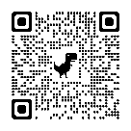
SPAN 2024 Sponsors
CCTE Annual Sponsors
Become a sponsor of SPAN and CCTE.

Slide 3
Welcome to
Day One!
CCTE President
Betina Hsieh
SPAN Co-Planners and
Conference Overview

Slide 4
The Vision and Goals of SPAN
SPAN will position CCTE as the key teacher education resource poised to impact research, practice, and policy for quality teaching.
The goals of SPAN will be to:
build relationships and expand CCTE’s policy network;
develop members’ skills as partners, advocates, and communicators;
affirm CCTE’s expert influence at the state level.
Notes:
Cynthia

Slide 5
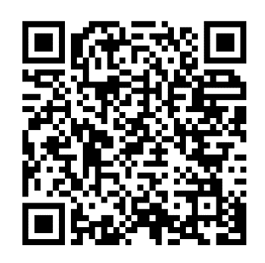
SPAN 2024 Schedule At a Glance
We’re paperless for the first time!
Monday March 11
Preparing: Talking Points
Advocacy Lunch with Dr. Marquita Grenot-Scheyer
Research Roundtables & Deans’ Meeting at the Capitol
Associated Group Meeting
CAIS Policy Summit
Networking Reception
Tuesday March 12
Team Breakfast
Legislative Visits
Advancing Policy Lunch & Debriefing
CTC Information Session
Closing Session with Election Results
Notes:
Nicol

Slide 6
A brief orientation to Sacramento:
The Capitol Building: Deans’ Meeting here:
Room 444
.5 mile, 12 minute walk, allow time for finding the room
The Swing Building: all the Legislative Visits will be here:
1021 O Street
.4 mile, 10 minute walk, allow time for finding the offices
Notes:
Cynthia

Slide 7
Preparing for the Legislative Visits
10:15 - 12:00
Introduction to the 2024 CCTE Talking Points
We’re taking a new approach: building consensus around specific issues;
At the 2023 CCTE Fall Conference Policy Session we began discussing ideas;
The Policy Committee met several times to hone down and refine, practicing our consensus-building approach;
Now we have three Talking Points to use in our Legislative Visits
Notes:
Pia

Slide 8
Each Talking Point has:
A statement
A rationale
Two stories
Printed Handouts for your own reference
Printed Leave-Behind summary sheet for legislative offices

Slide 9
CCTE 2024 Talking Points
Legislative Visits
Spring Policy Action Network
in Sacramento, March 12, 2024

Slide 10
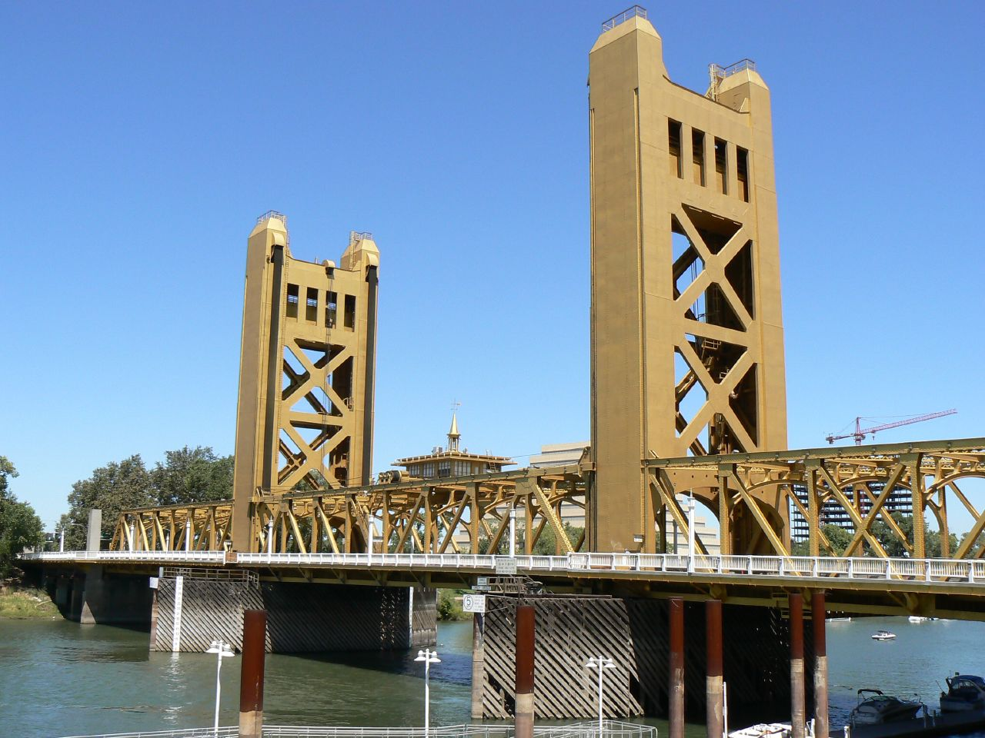
Sharing the Talking Points with Legislators/Staff
Introduce everyone in the group, and the Lead
Lead gives some background about CCTE, and of how we’ve prioritized these talking points this year; and about SPAN;
Walk through the Talking Points according to your team’s plan.
State the talking point
Share the rationale - OK to elaborate on this if you’ve agreed as a team.
Share 2 stories related to the Talking Point, pre-selected as a team.
Leave a couple of minutes for questions and discussion.
Move to the next Talking Point.

Slide 11
Other legislation that may come up
*It is better to circle back with info rather than speak without facts or accuracy.*
SB 1263 (Newman) This is a proposal to repeal the teaching performance assessments.
Here is the EdSource piece on SB 1263.
Here is a link to the new CTC Secondary Passing Standards for Performance Assessments, allowing programs flexibility.
Here is the CCTE Policy Committee One-Pager, not for distribution (yet).
_________________________________________________________
AB 2222 (Rubio, B.) This is a proposal to mandate the teaching of the Science of Reading in Teacher Education Programs.
Here is the EdSource piece.

Slide 12
1. Investments in the teacher pathway are essential and have made a big difference for future teachers. We support maintaining or expanding funding for the Golden State Teacher grant, Teacher Residency Programs, and exam fee waivers. Include CCTE in thinking about the future of these supports for the teaching profession.
Rationale:
CA has made historic investments in teacher education in the last five years. Funding for teacher residency programs and direct supports to future teachers through the paraprofessional grants, the Golden State Teacher Grant, and exam fee waivers are bright spots in addressing the teacher shortage. They have sent a clear message to a diverse group of people that the teaching profession is attainable. We note that almost 15,000 future teachers have received Golden State Teacher Grants (2020 to present).
Various institutions have now identified effective protocols for publicizing these opportunities and built processes and relationships necessary for seamless recruitment and resource distribution. The rate of grant distribution has exponentially accelerated with a 18X increase from 2020 to 2023. To make sure that these funds truly act as core investments in the Educator Workforce, we need long-term sustainability. We must normalize this level of support in order to fully address persistent staff shortages.

Slide 13
1. Stories of future teachers: These are prompts, teams can use their own.
Student Teacher:
Long-time early childhood educator
Completed BA in Child Development part-time over 6 years due to family and work obligations
Residency and GSTG made it possible for her to give up FT employment and enter the credential program
Receiving high marks as a student teacher
Deeply committed to serving her community as a teacher (low income, African American)
Undergraduate Student:
Year 3, Biology BS
Switched from dental school aspirations to pursuing teaching
Is bilingual and wants to be part of starting a bilingual HS track at his alma mater HS
Regularly sees College of Education advisors
Is counting on current levels of support so that enrolling in the credential program is financially feasible for him
Notes:
RECAP: With a plan for long term sustained funding, state policy makers can count on CCTE members to fine-tune this support structure for future teachers, including strategies to braid funding sources, frameworks to assist Financial Aid office staff, and tools for students to complete applications and other steps.

Slide 14
2. The Ethnic Studies requirement and Model Curriculum are an important first step, and it’s time for the related infrastructure around teacher preparation and teacher support to be built out and funded.
Rationale:
The Ethnic Studies requirement is already benefiting our students and communities greatly, but the overall workforce development plan must be developed, implemented, and well-supported. We advocate for:
A credentialing structure that would ensure high quality instruction of this new required course (e.g., an added authorization, a new credential area, etc.).
Regional technical assistance centers, preferably as collaborations between Ethnic Studies and Education departments at universities, to support high school teachers teaching the course and the administrators at their school (who may have to defend the course). These centers can also curate a state-wide repository of promising lessons (e.g., the CA Department of Education’s Brokers of Expertise model).
Notes:
Dead Assembly Bill AB1255 ES Task Force https://leginfo.legislature.ca.gov/faces/billTextClient.xhtml?bill_id=202320240AB1255&search_keywords=ethnic+studies

Slide 15
2. Stories of Ethnic Studies: These are prompts, teams can use their own.
Story 1:
A student teacher is completing his student teaching with a teacher that has been assigned a section of Ethnic Studies. Though he has a History degree with additional social science coursework, he never took any Ethnic Studies courses. He sees how in-depth and dynamic the discussions are during this class, but fears he doesn’t have the content knowledge to teach the class effectively, even if he would just be teaching it as a student teacher.
Story 2:
A history/social studies teacher was assigned to teach Ethnic Studies. She’s in her second year of teaching and this will be the 4th new class she has had to learn to teach. Though she is pursuing (and funding) her own professional learning plan (books, articles, podcasts, short courses, etc.), she still feels like she is in a crash course on Ethnic Studies. She remains very worried about her own background knowledge for Ethnic Studies. As a newer teacher, she is still fine-tuning her classroom management strategies, so she’s also anxious about how to keep students engaged in ways that are positive and deepen a sense of belonging and engagement. She is stressed!
Notes:
Story of the social studies teacher who is assigned to teach ES, with no preparation.

Slide 16
3. Mentor teachers are essential in the learning-to-teach continuum, and it’s time to recognize, support, and compensate them within our P-12 and higher education systems.
Rationale:
Mentor teachers model best practices, coach candidates, and help candidates understand the complex ecosystems of classrooms and schools. They are essential partners to university-based pre-service teacher preparation programs.
Mentor teachers are not formally recognized in the contract, are rarely compensated beyond a very small stipend from the university program, and cannot be used to advance on the salary scale. The infrastructure to support mentor teacher selection, professional learning for the role, and recognition of the role is currently haphazard, at best.
The State places importance on mentors in Residency Programs, in induction programs, and in Peer Assistance and Review-PAR Programs. All of these teacher leadership roles also increase retention and a sense of efficacy for teachers.
It is time to formalize the important role of mentor teacher!

Slide 17
3. Stories of mentor teachers: : These are prompts, teams can use their own.
Story 1: This mentor accepted an invitation to be part of a Residency program, and receives a stipend of $1500 per year that allows her to participate in summer professional learning sessions and a community of practice for mentor teachers. With compensation, she is able to take the time to stay very connected to the Residency program, leading to some valuable coaching strategies for her teacher candidate. As a result, she has had more success integrating her student teacher into her classroom routines - she feels that her students now have 2 teachers in the classroom, which truly benefits them and their learning.
Story 2: This mentor got word she’d have a teacher candidate the week before school started, with no compensation offered. Given this, it’s hard for her to find the time to invest in this role. She let her principal know she is a serving as a mentor teacher but they haven’t had any follow up conversations. She is committed to supporting her student teacher, but is struggling to balance many demands on her time and expertise.
Student teachers in these two host classrooms are having very different experiences. With formal recognition and support for the mentor teacher role, Story 1 could be the norm for all student teachers.
Notes:
Upholding the mentorship model where the district mentor is involved, with input in evals of the candidate, an active part of the model of preparation. Without compensation, MTs might not have the time or bandwidth… Teacher leadership needs supporting, funding, acknowledgement… They are the bridge between the district and the program…

Slide 18
Team Leads Stand Up
Scan the room, figure out who you’d like to team up with.
Try to distribute the team membership evenly!

Slide 19
Practicing the Talking Points in Teams
10:45
Sit with your Team and Team Lead.
Gather at your table, and practice together; decide which stories you’ll use with high relevance being a key criterion.
Practice staying on message, focusing on positives and benefits.
Make a plan for Tuesday team breakfast for one last rehearsal

Slide 20
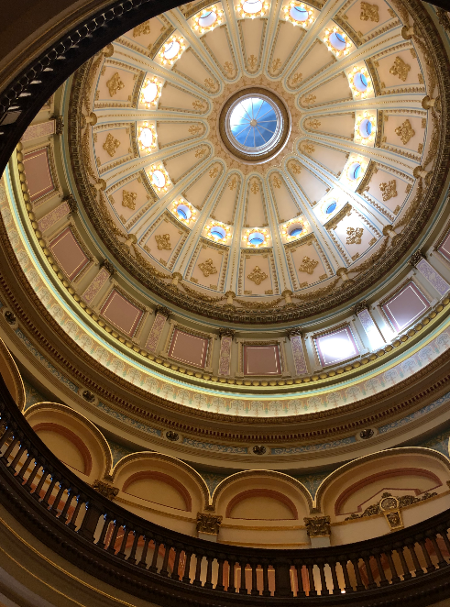
California Policy Priorities
11:30
With Chelsea Kelly
Consultant to the
Assembly Education Committee
Notes:
Pia introduce Chelsea

Slide 21
Advocacy Luncheon
12:00 - 1:00
12:30 Dr. Marquita Grenot-Scheyer
Chair of the Commission on Teacher Credentialing
Chair of the AACTE Board of Directors
Co-Sponsored by:
CSU Office of Educator Preparation and Leadership Programs, Assistant Vice Chancellor Shireen Pavri
UC Office of the President, Educator Programs, Executive Director Claudia Martinez
AICCU Association of Independent California Colleges and Universities, President Kristen Soares
Notes:
Cynthia

Slide 22
High quality and supported mentoring of the next generation of teachers: Rationale and strategies to support the continuum of teaching and learning
Marquita Grenot-Scheyer, Ph.D.
Spring Policy Action Network (SPAN) Conference, CCTE, Sacramento
March 11, 2024

Slide 24
California Commission on Teacher Credentialing
Educator preparation in which we set rigorous standards, accredit EPPs, develop and maintain performance assessment and examinations, and administer and monitor grants
Educator licensure which includes monitoring educator assignments and investigating educator misconduct and taking appropriate actions
Reporting on key education issues including educator supply and credentialing

Slide 26
CCTC Strategic Plan: Goal 4
Goal 4:
Induction programs support the entry of new educators into the profession, strengthen their practice through directed and meaningful mentoring and professional development, and increase the likelihood of their retention in the profession
Two primary strategies to meet this goal:
Set and maintain rigorous standards to ensure induction programs effectively support new educators as they move through professional development and mentoring to earn their clear credential
Strengthen the connection between initial preparation and induction into the profession through individualized mentoring and professional development

Slide 27
Mentors/Cooperating teachers are essential partners
Maintaining conceptual and structural coherence within and across program courses and clinical experiences will improve preservice teacher preparation
High quality mentoring and support is critical for all beginning teachers
Novice teachers are disproportionately placed in schools serving low-income families and students of color, therefore there is a disproportionate impact on these students
New teachers who receive little mentoring are twice as likely to leave the classroom than those who are “well-mentored”
Induction and mentoring are high impact investments

Slide 28
Guidelines and funding to support high quality mentoring
Guidelines
CSTP (revised 2024)
Continuum of Teaching Practice (2010)
Teaching Performance Expectations
Funding
Varies greatly across districts
Residency grants have some specified funding
Funding needed at both the district and IHE levels
State grants and policies

Slide 29
Effective Retention
Positive and safe school climate
Supportive working conditions
Support for beginning teachers
Ample opportunities for collaboration and shared leadership
On-going opportunities for professional growth and learning
Career advancement opportunities
Effective and supportive leadership
Competitive & equitable salaries

Slide 30
Potential allies in this work….
California Commission on Teacher Credentialing (CCTC)
Association of California School Administrators (ACSA)
California Teachers Association (CTA)
(Respective) Advocacy and government relations staff
American Association of Colleges of Teacher Education (AACTE) and the Advisory Council of State Representatives (ACSR)

Slide 31
Resources
CCTC 2023 Strategic Plan https://www.ctc.ca.gov/docs/default-source/commission/files/ctc-strategic-plan.pdf?sfvrsn=baef20b1_12
Continuum of Teaching and Learning https://www.ctc.ca.gov/docs/default-source/educator-prep/ca-ti/final-continuum-of-teaching-practice.pdf
Education Commission of the States (https://www.ecs.org)
Teaching Playbook https://www.teachingplaybook.org/

Slide 32
Thank you!
Marquita.grenot-scheyer@csulb.edu

Slide 33
Concurrent Afternoon Sessions
1:00 - 2:45
1:30 Deans’ Meeting at the Capitol
Deans and Directors, meet in the Lobby at 1:00
Capitol Room 444
1:15 - 2:45 Research Roundtables
Note: 2:00 Legislative Visit

Slide 34
Research Roundtables
1:15 - 2:45
Metropolitan Terrace:
Roundtables 1 & 3
Quorum Room:
Roundtables 2 & 4
SPAN Schedule listing Research Roundtables

Slide 35
Concurrent Associated Group Meetings
3:00 - 4:00
ACCCTEP Yea Room
AICCU-Ed Metropolitan Terrace
CABTE Nay Room
CAPSE-TED Quorum Room

Slide 36
California Alliance for Inclusive Schooling
CAIS Policy Summit
4:15 - 5:30
Cultivating Inclusive Educators:
Embracing Intersectional Disability Equity and Justice

Slide 37
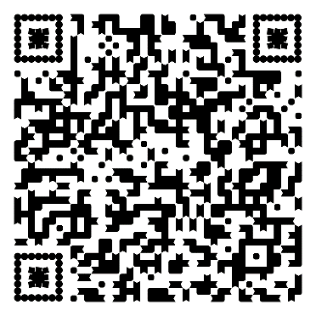
Information about bills shared by Chelsea Kelley
.

Slide 38
Join us for the
Networking Reception
Co-sponsored by
Sacramento State University,
Welcome from Dean Deidre Sessoms

Slide 39
Welcome to SPAN
Day Two

Slide 40
Team Breakfast and Visit Orientation
8:00 - 9:00
Meet with your Visit Team
Go over your plans
Make sure you have walking directions and office location; plan on a 20 minute walk but check Maps;
Head out!

Slide 41
Legislative Visits
9:00 - 12:00
Teams walk to meeting locations
Visit the Capitol Building if you have time;
Be back for 12:00 Lunch & Debrief

Slide 42
Advancing Policy Lunch
12:00 - 1:15
Debriefing our Visits with Erin Gabel
CA Assembly, Staff to Subcommittee on Education Finance
Co-Sponsored by the University of Redlands, School of Education
Notes:
Cynthia facilitate

Slide 43
CTC Information Session
1:30 - 2:45
Cheryl Hickey, Administrator of Accreditation
David DeGuire, Director of Professional Services Division
Erin Sullivan, Administrator, PSD

Slide 44
SPAN 2024 Feedback Survey
Let your voice be heard!

Slide 45
Closing Session
2:45 - 3:00
Outgoing President Betina Hsieh
Incoming President Karen Escalante
Election Results Announced
Fall 2025 Conference Information
SPAN Closing Comments and Survey

Slide 46
Thank you!
See you in San Diego in October 2025

