Slide 1
CCTE Spring 2024 SPAN Conference
Updates from the
California Commission on Teacher Credentialing
March 12, 2024 Sacramento, CA
Notes:
David – Open and introduction

Slide 2
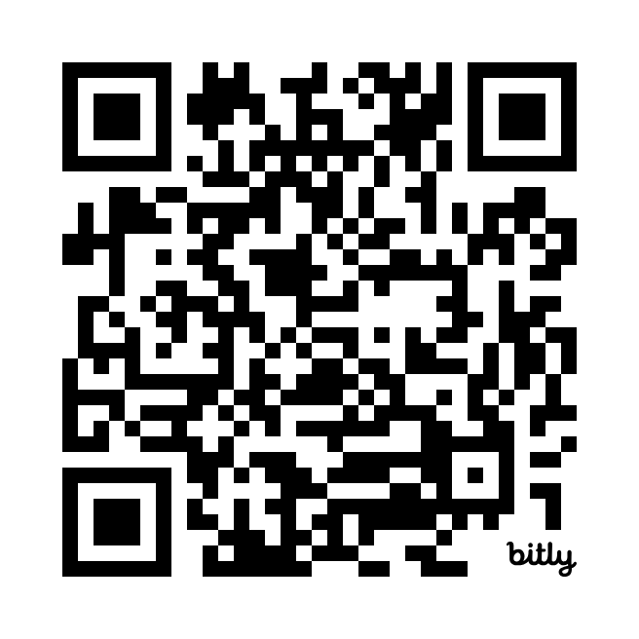
QR Code

Slide 3
Agenda
Literacy Standard and TPEs
Implementation
Certification
Literacy Performance Assessment
PK-3 Early Childhood Education Specialist Credential
Child Development Permit Workgroup
Grants
CSTP
Subject Matter Requirement for Integrated Programs
2024-25 Accreditation deferral
Glimpse into future PSD work

Slide 4
Literacy Standard & TPEs Implementation
Timeline
2021 SB 488 is passed
2022-2023 New Literacy Standards (Standard 7) and Teaching Performance Expectations (Domain 7) developed, vetted with the field, and adopted
2023-July 1, 2024 Institutions to review their programs, make changes, institutional approval processes
July 1, 2024 All MS, SS, Ed Specialist, PK 3 credential programs must be aligned to the new literacy standards and TPEs
June 30, 2025 RICA is retired
July 1, 2025 New Literacy Performance Assessment mandatory for all MS, PK-3, and Ed Sped candidates

Slide 5
Literacy Standard & TPEs Implementation
Program Sponsor Alerts
PSA 22-15: Adoption of revised Literacy Standards and TPEs
PSA 23-03: Transition Plan for RICA

Slide 6
Literacy Standard & TPEs Certification
Timeline
February 2024 Literacy Instruction Certification Process released for MS, Ed Specialist, PK-3
April 26, 2024 –
October 4, 2024 Window to submit documentation for Certification
July 1, 2025 Programs must be certified in order to continue operating
Program Sponsor Alert (PSA) 24-01

Slide 7
Literacy Standard & TPEs Certification
Things to keep in mind
Purpose is to ensure that candidates leave with solid skills in effective reading strategies, and that they are prepared for the required LPA in 2025.
Focused on Key Aspects of the New Literacy Standards/TPEs outlined in 44259 (b)(4)(A) and (B)
Clear Alignment with ELA/ELD Framework
Science of Reading – Not explicitly mentioned in the law, but clear intent
Foundational Skills front and center
Systematic, Explicit, Direct Instruction
Dyslexia Guidelines must be incorporated = Required reading/clinical practice.

Slide 8
Literacy Standard & TPEs Certification
Things to keep in mind, cont.
Nearly impossible to meet all the standards and TPEs with only one literacy course
Syllabi must be very clear – how are candidates getting the content (learning goals/objectives are not sufficient), where are they practicing the concept, where are they being assessed?
Focus on evidence-based, effective strategies
Important that K-12 partners understand the new focus of this law (clinical practice expectations)

Slide 9
Literacy Standard & TPEs Certification
Technical Assistance Office Hours
Friday, March 15 from 3:00-4:00 pm
Thursday, March 28 from 10:00-11:00 am
Friday, April 12 from 10:00-11:00 am
Wednesday, April 24 from 10:00-11:00 am
**Zoom links available in latest PSD e-News**

Slide 10
Literacy Performance Assessment
January 2023: Literacy Performance Assessment (LPA) Design Team Workgroup (Design Team) appointed by the Executive Director
March 2023: Design Team met for the first time to begin development on the LPAs for Preliminary Multiple Subject, Education Specialist, and PK-3 credentials for the Commission’s model
The Literacy Design Team has worked with staff on the pilot version of the LPA.
With Commission staff, the LDT will work to revise the pilot version based on feedback and results and prepare for a Spring 2025 field test.
Until a literacy performance assessment is brought to the Commission for approval, candidates for Preliminary MS, Education Specialist, and the PK-3 credentials must continue to take and pass the RICA, as specified in Education Code section 44283(c)

Slide 11
Literacy Performance Assessment Pilot
The pilot study of the LPA will provide an opportunity to collect data about the teaching performance of 236 candidates across a sample of institutions and program types that reflect the diversity of program sizes, candidates served, institutional affiliations, pathways, and service areas in California
For more information, see Item 4B from the August 2023 Commission Meeting, Item 1C from the October 2023 Commission Meeting, Item 1C from the December 2023 Commission Meeting, and Item 2C from the February 2024 Commission Meeting

Slide 12
Literacy Performance Assessment Timeline
Development Year One: 2022-2023
Commission staff works with Design Team and Evaluation Systems group of Pearson (technical contractor) for MS/SS, Education Specialist (MMSN, ESN, DHH, VI, and ECSE), PK-3 ECE Specialist Literacy Performance Assessments
Determine Pilot Programs
Development Year Two: 2023-24
Continue development of LPA (candidate assessment guides, program guides, professional development for pilot programs and assessors)
Conduct Bias Review
Conduct Pilot Tests for MS/SS, Education Specialist (MMSN, ESN, DHH, VI, and ECSE), PK-3 ECE Specialist

Slide 13
Literacy Performance Assessment Timeline
Development Year Three: 2024-2025
Continue development of LPA based on pilot test findings (revise candidate assessment guides, program guides, professional development for programs and assessors)
Determine field test programs
Conduct Field Tests for MS/SS, Education Specialist (MMSN, ESN, DHH, VI, and ECSE), PK-3 ECE Specialist
Spring 2025
Complete final revisions to candidate assessment and program guides based on field test findings
Conduct Standard Setting studies using field test results for MS/SS, Education Specialist (MMSN, ESN, DHH, VI, and ECSE), PK-3 ECE Specialist
Train literacy assessors
Present proposal of recommended passing standards and final assessments to Commission for potential adoption

Slide 14
Literacy Performance Assessment Timeline
Implementation (Year Four): 2025-2026
First operational administration of Literacy Performance Assessment for MS/SS, Education Specialist (MMSN, ESN, DHH, VI, and ECSE), PK-3 ECE Specialist
Manage ongoing administration, scoring, reporting, and maintenance of the Commission’s approved teacher performance assessments

Slide 15
Literacy Performance Assessment Pilot Timeline
Mar. 5 2024
Pilot Website/Systems Launch
Apr. 8 2024
Final LPA Submission Deadline
May 2024
LPA Pilot scoring
Jun. 14 2024
LPA results reported to programs, candidates, and Design Team
Apr. 2024
Focus Groups & Surveys
Aug. 2024
LPA update presented to the Commission
Pilot Webinar #4
Mar.7 2024

Slide 16
Literacy Performance Assessment
For more information
PSA 22-15: Adoption of Revised Literacy Standards and Teaching Performance Expectations for the Preliminary Multiple, Single, and Education Specialist, Mild to Moderate and Extensive Support Needs, and PK-3 Specialist Instruction Preparation Program Pursuant to Senate Bill 488
PSA 23-02: Adoption of Revised Literacy Standards and Teaching Performance Expectations for the Preliminary Education Specialist; Deaf and Hard-of-Hearing, Visual Impairments, and Early Childhood Special Education Preparation Programs, Pursuant to Senate Bill 488
PSA 23-07: Implementation of Literacy Standards and Teaching Performance Expectations
PSA 24-01: Teacher Preparation Program Literacy Instruction Certification Required by SB 488 (Chapter 678, Statutes of 2021)

Slide 17
Requirements for the PK-3 ECE Specialist Instruction Credential
Bachelors or higher degree from regionally accredited institution of higher education
Subject Matter Requirement
24 units in ECE/Child Development OR
BA or above in one of nine specific majors
Completion of Preliminary PK-3 ECE Specialist Instruction Credential Program
Teacher preparation coursework (theory and pedagogy)
Clinical Practice
Introduce/Practice/Assess TPEs
Includes Literacy, Math and DEI (Diversity, Equity, and Inclusion) standards and TPEs
Passage of Commission-Approved Teaching Performance Assessment.
CalTPA, EdTPA, or FAST *
RICA or Literacy Performance Assessment (will be Cycle 2 of CalTPA)*
PK-3 Performance Assessment when available
* in TK-3 classroom until PK-3 ECE TPA is in use

Slide 18
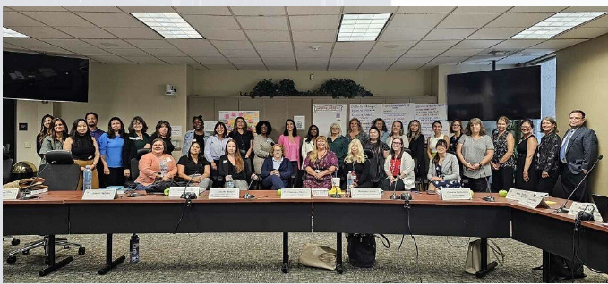
Child Development Permit Workgroup
The Child Development Permit Workgroup charge is to formulate recommendations to the Commission consistent with the Master Plan for Early Learning and Care to ensure that:
Early childhood educators are prepared for their job roles
Early childhood educators have the knowledge and skills needed to meet developmental needs of children
The needs of employers for a well qualified staff are met
The monitoring of quality is addressed in the preparation of the ECE workforce
The competencies (ECE TPEs) align with the MPELC and the proposed new structure for the Child Development Permit
All CDP Workgroup meetings are open to the public
and have an opportunity for public feedback.
An update will be presented to the Commission
in April 2024.
Notes:
Debbi

Slide 19
Early Childhood Education Resources
How find information:
CTC PK-3 ECE Specialist Instruction Credential page
PK-3 ECE Specialist Instruction Credential Handbook
Clinical Practice Guide for PK-3 ECE Specialist Instruction Credential
PK-3 ECE Specialist Instruction Credential FAQ
Subscribe to the ECE News
How to contact the ECE team: ECE@ctc.ca.gov
ECE Office hours
First Tuesdays – 12:00-1:00 pm
Third Tuesdays – 12:00-1:00 pm

Slide 20
Commission-Administered Statewide Grant Programs
Open grant opportunities:
Teacher Residency Capacity
Teacher Residency Implementation and Expansion
School Counselor Residency Capacity
School Counselor Implementation
Statewide Residency Technical Assistance Center
Awarded to Santa Clara County Office of Education with regional hubs at Humboldt COE, Sacramento COE, Tulare COE, and San Diego COE

Slide 21
Commission-Administered Statewide Grant Programs
Classified School Employee Teacher Credentialing Grant Program
Diverse Education Leaders Pipeline Initiative (DELPI)
Computer Science Supplementary Authorization Incentive
Reading and Literacy Supplementary Authorization Incentive
Closed grant opportunities:
Integrated Undergraduate Teacher Preparation Programs (Capacity and Implementation)
Dyslexia Grants to Preparation Programs
Local Solutions to the Shortage of Special Education Teachers

Slide 22
Refreshed California Standards for the Teaching Profession (CSTP)
Refreshed CSTP approved at the February 2024 Commission Meeting
With some minor edits:
Students with Disabilities and Gifted Students
IEPs
English Learner Roadmap
Will be on the consent calendar for April 2024 Commission Meeting
Timeline
Full implementation by August 2026.
Implementation date document due October 1, 2024.
Continuum of Practice development now
Technical assistance in the 2024-25 academic year

Slide 23
Subject Matter Requirement for Integrated Undergraduate Programs
Multiple Subject and Single Subject Precondition 6 and Education Specialist Precondition 3 amended to allow eligible candidates in integrated undergraduate programs to begin daily whole class instruction prior to meeting subject matter competence.
Must meet subject matter before preliminary credential recommendation

Slide 24
Subject Matter Requirement for Integrated Undergraduate Programs
Applies only to candidates who are:
Enrolled in an integrated undergraduate teacher preparation program where the candidate is completing their bachelor’s degree and their teacher preparation program concurrently,
and
Completing a degree major that meets the subject matter competence requirement in the content area for the credential they seek or completing a Commission-approved subject matter preparation program in the content area for the credential they seek.
Does NOT apply to candidates who are:
Completing a post baccalaureate teacher credentialing program.
Enrolled in a teacher intern program.
Completing a degree major that does not meet the subject matter competence requirement for the credential they seek.
Seeking to meet subject matter competence via transcript review of coursework aligned to the Subject Matter Requirements (SMRs).
Program Sponsor Alert (PSA) 24-04

Slide 25
Adjustments to 2024-25 Accreditation Year Activities
December 2023, Commission approved adjusting 2024-25 timeline of accreditation activities to allow program sponsors and CTC staff to focus on thorough, thoughtful implementation of Literacy standards and TPEs and the certification process
Specified accreditation activities for all seven (7) color cohorts are adjusted by one year beginning with 2024-25

Slide 26
Adjustments to 2024-25 Accreditation Year Activities
Exceptions:
Institutions are still required to submit annual data (ADS) for all programs in 2024-25
Institutions in provisional status will still host site visits in 2024-25
Institutions seeking CAEP or AAQEP accreditation may choose to keep their current accreditation timelines.
Blue Cohort institutions with follow up from 2023-24 site visits will still be required to meet those requirements.
Green Cohort institutions with extenuating circumstances may contact us by April 1 to request to keep their 2024-25 site visit dates
Program Sponsor Alert (PSA) 23-08

Slide 27
Glimpse into Future CTC Work
Literacy Certification Process Implementation
Update Reading and Literacy Added Authorization, Reading and Literacy Leadership Specialist Credential
Update the Speech Language Pathology Standards (alignment with ASHA)
Develop new Child Welfare and Attendance standards, implementation of SB 223
Updating the SMRs – greater consistency in format and make more useful for transcript review
During 2024-25, update standards and performance expectations for Administrative Services Credential

Slide 28
Get Involved with Commission Work
Comment on Items During Commission Meetings
Participate in Office Hours and Technical Assistance
Become Involved in CCTE and Other Educational Organizations (CABTE, CAPSE, Induction)
Talk to Staff – We learn from you what the issues are. What are the trends? What are the implications of policy on your programs and candidates?
Propose Solutions. Analyze issues, determine scope, possible options, what is
Become a BIR member and Participate In Accreditation
Letters from Associations/Institutions to Commission staff/Commission
Volunteer! Apply for CTC Work Groups/Panels/Standards Development
Apply to be an assessor for Performance Assessments

Slide 29
Resources
How find information:
Subscribe to the PSD News
Subscribe to the ECE News
How to contact us:
Send us an email
PSDInfo@ctc.ca.gov
ECE@ctc.ca.gov

Slide 30
Thank You!

Slide 31
QR Code

Slide 32
Questions?

