Slide 1
Cultivating Inclusive Educators: Embracing Intersectional Disability Equity and Justice
SPAN 2024 Conference
Monday, March 11, 2024
Notes:
Audri - Introduce Meghan and Audri
Associate Professor of Special Education and Disability Studies at Chapman University
Executive Director, Thompson Policy Institute on Disability

Slide 2
Agenda
Inclusive Educator Prep Survey Results
Welcome
Background
Recommendations and Next Steps
Notes:
Audri
Background including the currents status of access for SWD
This session will present the results of a survey on Inclusive Teacher Preparation and Disability Equity and Justice in Teacher Preparation across the state. The results provide a snapshot of the implementation of the Common Trunk of Teacher Preparation, including through residency and dual-credential models. Moreover, the presentation provides recommendations for further data collection and reports to guide policy changes for a proactive approach towards refining and improving the existing system. and we invite your input/feedback…

Slide 3
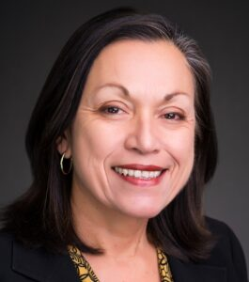
Professor Emeritus, California State Long Beach College of Education
Chair, California Commission on Teacher Credentialing
Chair, American Association of Colleges for Teacher Education (AACTE)
Marquita Grenot-Scheyer, Ph.D.
CAIS Co-Chair
Welcome
Notes:
Audri
Dr. Marquita Grenot-Scheyer is Professor Emeritus in the College of Education at California State University, Long Beach. She served as Assistant Vice Chancellor, Educator Preparation and Public School Programs, for the California State University (CSU), Office of the Chancellor from 2016 to 2021. In this role she was responsible for leading, coordinating, and facilitating system wide efforts to recruit, prepare, and retain teachers, counselors, and school leaders for schools and communities. Prior to this appointment, she served as Dean of the College of Education at California State University, Long Beach from 2008 to 2016. Dr. Grenot-Scheyer serves on the board of directors for the American Association of Colleges for Teacher Education (AACTE) and the WestEd board. She was a member of the American Association of State Colleges and Universities (AASCU) Teacher Education Task Force (2016) on Teacher Preparation, which produced the report, Preparing teachers in today’s challenging context. She previously served two terms as a board member of the Council for the Accreditation of Educator Preparation (CAEP), (2013-17) and served as a commissioner, on the Commission on Standards and Performance Reporting for CAEP, (2012 to 2013).
She earned her Ph.D. in Special Education in 1990 from the joint doctoral program at the University of California, Los Angeles and California State University, Los Angeles. In recognition of her career accomplishments, she was selected as the Distinguished Alumnus, CSULA Charter College of Education, in 2008.

Slide 4
Purpose
The California Alliance for Inclusive Schooling is an intersegmental group of professionals dedicated to the development of inclusive schools for all students.
Our mission is to support, unify and promote efforts to increase inclusive schooling and transition outcomes for students with disabilities in California. The Alliance focuses on practice in schools, policy for state recommendations, and preparation of school professionals and is comprised of three working groups: Practice, Policy, and Preparation.
Notes:
Audri California Alliance for Inclusive Schooling, known as CAIS, is dedicated to the development of inclusive schools for all students. Our initiatives focus on increasing inclusive schooling and transition outcomes for students with disabilities in CA.

Slide 5
Steering & Planning Committees
Marquita Grenot-Scheyer (co-chair) | CSU Long Beach, College of Education
Don Cardinal (co-chair) | Thompson Policy Institute on Disability, Chapman University
Linda Blanton | The Collaboration for Effective Educator Development, Accountability and Reform Center, (CEEDAR), University of Florida
Audri Sandoval Gomez | Thompson Policy Institute on Disability, Chapman University
Mary Vixie Sandy | California Commission on Teacher Credentialing
Victoria (Vicki) Graf | California Association of Professors of Special Education Teacher Education (CAPSE), LMU
Meghan Cosier | Thompson Policy Institute on Disability, Chapman University
Kristin Wright | Sacramento County Office of Education
Sarah-Neville Morgan | Deputy Superintendent of Public Instruction, Opportunities for All Branch at the California Department of Education
Virginia Kennedy | California Council on Teacher Education, CSU Northridge
Notes:
Audri Current steering committee
Some members are here today…
Erica McCray and Kate Adams (CEEDAR)
We invite others who may be interested in this work to join our efforts. We will have our contact information listed at the end of this presentation.

Slide 6
There is no diversity, equity, and inclusion without disability.
disabilityisdiversity.com
Notes:
Audri
We wanted to start today’s presentation with this quote by an organization disabilityisdiversity.com “There is no diversity, equity, and inclusion without disability” as a reminder that DEI efforts with a focus on disability ensures that people with disabilities are seen, heard, and represented. Including disability in DEI efforts is a matter of social justice, advocating for the rights and dignity of individuals with disabilities….
Disabled people continue to live at the intersection of oppression and segregation. These social justice issues remind us that as educators we must ensure that disability remains part of DEI conversations
Historically, the education system has not served students with disabilities well and we continue to segregate these students providing them

Slide 7
Where does California rank amongst all states (+DC) in placement in mostly self-contained settings?
12th
C. 9th
B. 35th
D. 1st
Notes:
Meghan

Slide 8
Wyoming | 4.62
Vermont | 4.74
Colorado | 4.76
Nebraska | 5.54
South Dakota | 5.63
Iowa | 6.47
Kansas | 6.57
West Virginia | 6.57
North Dakota | 6.63
Oklahoma | 6.71
Wisconsin | 6.91
Alabama | 7.39
Connecticut | 7.42
Indiana | 7.88
Kentucky | 8.33
New Hampshire | 8.38
Utah | 8.44
Missouri | 8.6
Oregon | 8.89
Idaho | 9.05
Montana | 9.86
Pennsylvania | 9.89
Minnesota | 9.93
Michigan | 10.02
Rhode Island | 10.54
Alaska | 10.81
Virginia | 10.87
Maine | 11.22
Tennessee | 11.28
Mississippi | 11.35
Ohio | 11.48
Maryland | 11.5
North Carolina | 11.55
Arkansas | 11.56
Washington | 11.65
Florida | 12.6
Illinois | 13.02
Louisiana | 13.4
Massachusetts | 13.41
Texas | 13.54
Arizona | 13.62
South Carolina | 14.85
Delaware | 15.11
New Jersey | 15.48
Nevada | 15.7
New Mexico | 16.03
Hawaii | 16.22
District of Columbia | 17.02
Georgia | 17.37
New York | 17.61
California | 18.6
Closest Measurement of Exclusion: 40% or more of the school day separated.
National Avg: 10.72
Source: U.S. Department of Education, EDFacts Data Warehouse (EDW): “IDEA Part B Child Count and Educational Environments Collection,” 2021-22. Data extracted as of July 6, 2022 from file specifications 002 and 089.
Notes:
Meghan

Slide 9
Where does California rank amongst all states (+DC) in placement in mostly general education settings?
25th
C. 2nd
B. 39th
D. 15th
Notes:
Audri

Slide 10
Alabama | 83.81
Vermont | 81.06
Nebraska | 80.86
Colorado | 79.37
Mississippi | 78.82
Florida | 78.12
Indiana | 77.87
Oregon | 77.06
Wyoming | 76.72
Oklahoma | 75.65
Kentucky | 75.54
South Dakota | 75.52
Wisconsin | 75.5
New Hampshire | 75.42
Iowa | 74.73
North Dakota | 73.16
Tennessee | 72.9
Texas | 72.57
Utah | 72.13
Rhode Island | 71.89
Maryland | 71.75
Michigan | 71.71
Kansas | 71.3
North Carolina | 69.63
Virginia | 69.22
Arizona | 68.73
Alaska | 68.33
Connecticut | 68.01
Louisiana | 67.85
Massachusetts | 66.16
Ohio | 65.61
Idaho | 65.2
West Virginia | 65.18
Delaware | 64.95
South Carolina | 64.07
Minnesota | 62.72
Washington | 62.37
Nevada | 62.15
Pennsylvania | 61.81
Georgia | 61.76
California | 60.82
Arkansas | 59.81
District of Columbia | 59.71
New York | 58.76
Missouri | 56.53
Montana | 56.1
Maine | 55.27
Illinois | 53.19
Hawaii | 52.54
New Mexico | 52.43
New Jersey | 44.2
Closest Measurement of Inclusion: 80% or more of the school day in general ed.
National Avg: 68.41
Source: U.S. Department of Education, EDFacts Data Warehouse (EDW): “IDEA Part B Child Count and Educational Environments Collection,” 2021-22. Data extracted as of July 6, 2022 from file specifications 002 and 089.
Notes:
Audri
Unfortunately,

Slide 11
True or False: Access to general education across California is the same across race/ethnicity of students.
FALSE
Notes:
Audri

Slide 12
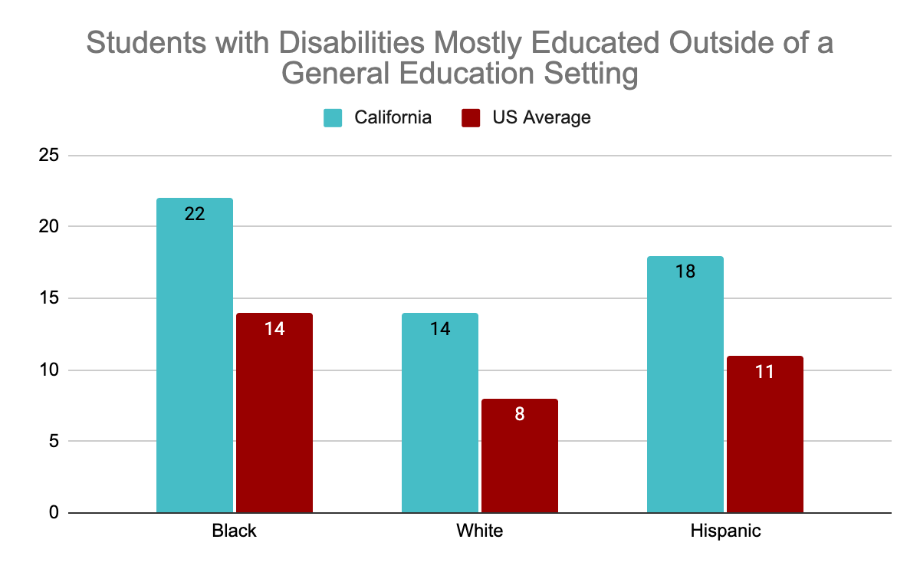
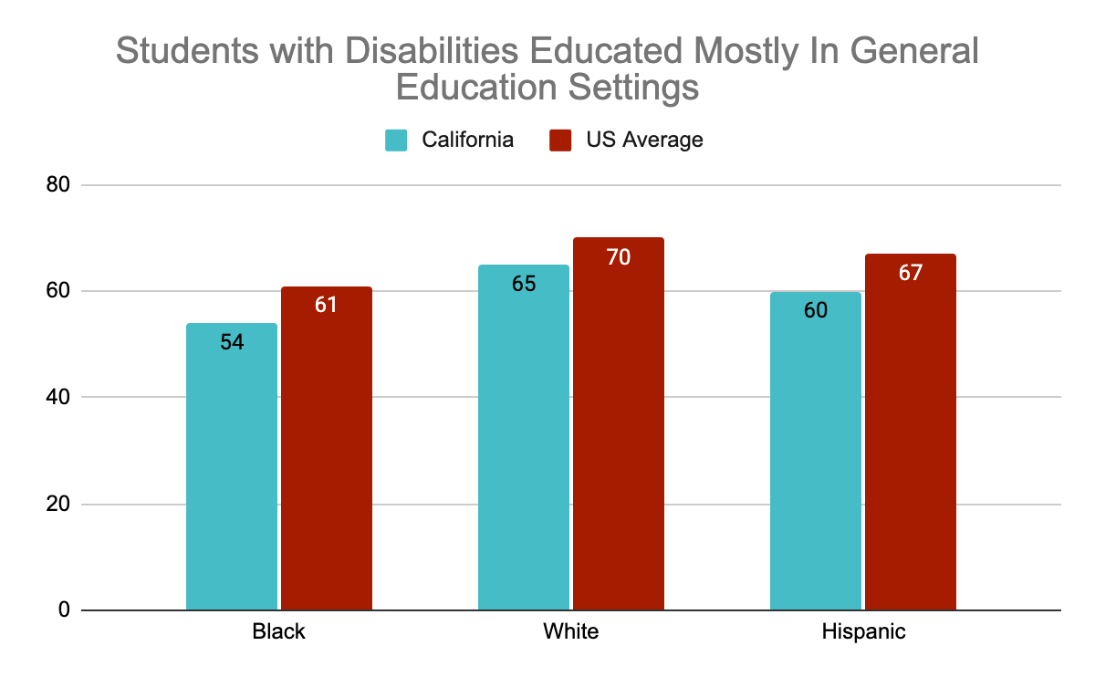
Race and Access to General Education
Notes:
Audri US Department of education most recent IDEA Data 2021-22
Students of color with disabilities mostly educated outside of a general education setting in CA which is significant from the US national average
White Students with disabilities are included in general education settings at higher rates.
-As we all know, teacher education plays a role in ensuring that all teachers are prepared to teach all students. Unfortunately, most students who spend time outside of the general education classroom due to their disability, spend more and more time outside of the gen ed setting as they age up because their access to high-quality core instruction becomes less…and
At CAIS, we are interested in assessing what is happening in teacher education across the state that focuses on disability equity and inclusion.

Slide 13
Students with disabilities achieve more when they are educated in general education settings alongside their peers without disabilities.
(e.g. Bui, Quirk, Almazan, Valenti, 2010; Cosier et al., 2013; Gee et al., 2020)
Special Education can act as a “school-to-prison nexus” (Annamma, 2019), for multiply marginalized disabled students.
Students with disabilities, are first and foremost, general education students, who may receive special education supports and services.
Disability Equity and Justice is Not a Special Education Issue…it is an issue for everyone across all credentials.
Notes:
Meghan
Before we start, we wanted to ground the work in the assumptions about disability equity and justice in teacher education.

Slide 14
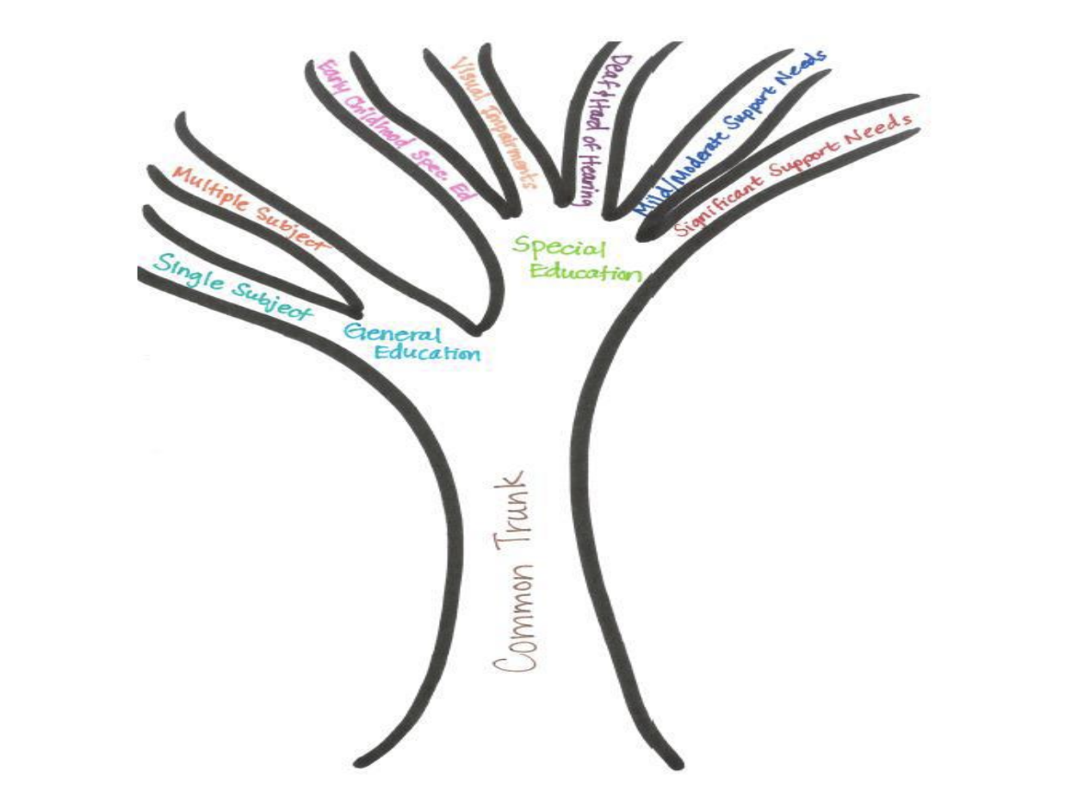
Common Trunk of Teacher Preparation
Notes:
Meghan
Given the common trunk that was built of the new General Education TPEs in 2016, The impetus for this work were the calls for action by the Educator Excellence Taskforce, the Teacher Preparation Advisory Panel and the Statewide Special Education Task Force. All general education teacher preparation programs began full implementation of the revised standards that include enhanced preparation to teach a diverse range of students in the fall of 2017.
Given that its been 7 years since the common trunk recommendation, coupled with the recent funding for residencies in 2021 for $350M, CAIS felt it was important to assess the landscape of inclusive teacher education, and inclusive educator preparation programs.

Slide 15
Meghan E. Cosier, Ph.D.
Audri Sandoval Gomez, Ph.D.
Charlotte Achieng Evensen, Ph.D.
Chapman University
Nicol Howard, Ph.D.
Adriana Alvarado, Ph.D.
University Of Redlands
Notes:
Meghan
Thanks to Drs. Adriana Alvardo and Nicol Howard Co-Directors of Race in Education Analytics Learning Lab in the School of Education at University of Redlands
As a high level overview, this survey is constructed based on research associated with best practices in teacher education, including LEA/District Partnerships, quality year long clinical placements, high quality and well aligned curriculum, program recruitment practices,

Slide 16
Notes:
Meghan

Slide 17
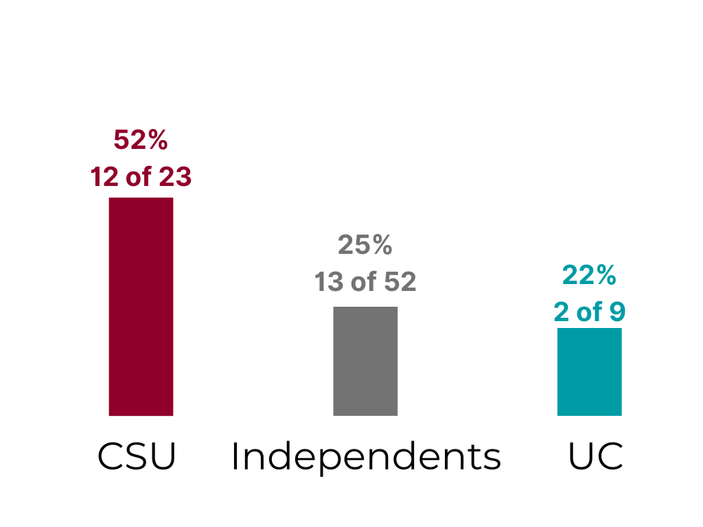
Rate of Return
27 of the 84 EPPs responded, representing a 32.14% rate of return as of 3/6/24
Notes:
Meghan 32% rate of return at this point is great, CSU best return rate so far. A call to action for others.

Slide 18
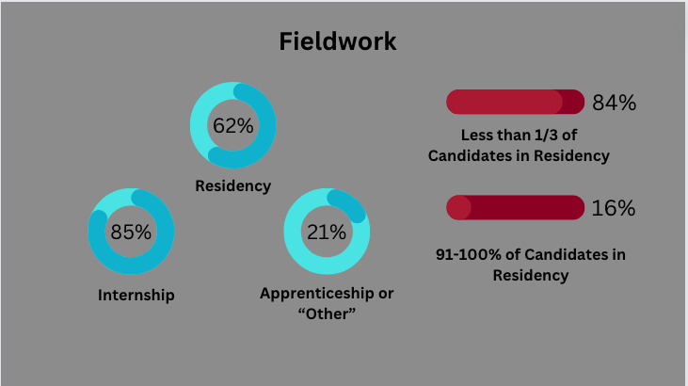
Notes:
Meghan

Slide 19
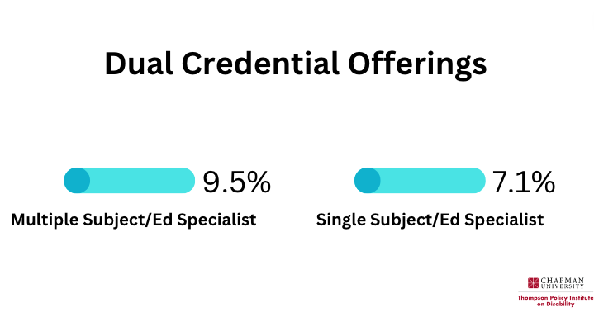
Notes:
Meghan

Slide 20
Notes:
Audri
Overall, A high percentage of agreement in recruitment plans focusing on diverse groups of students; however, we see a significant decrease including a focus on candidates with disabilities.
We have included the neutral and disagreement percentages

Slide 21
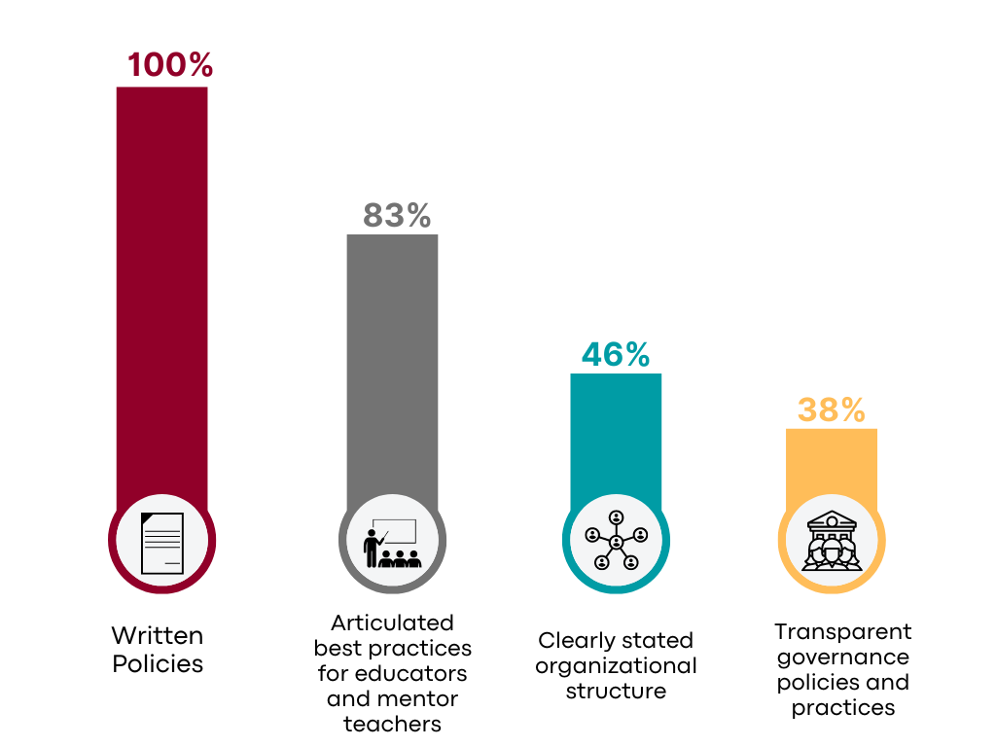
What do you have in place to support EPP/LEA partnerships?
(of 24 respondents)
Notes:
Audri
Positive to see of the 24 responses, 100% indicated that there are written policies in place to support EPP/LEA partnerships, but as you see these percentages decrease substantially

Slide 22
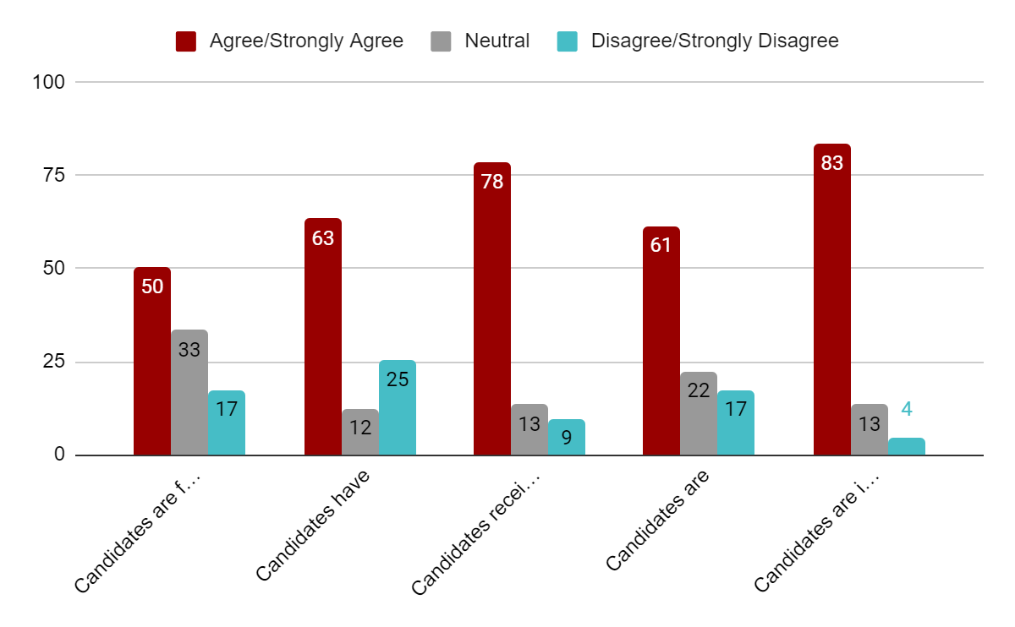
Pre-Service Candidates
Candidates are fully engaging inclusive practices in their classrooms
Candidates have the necessary resources to
create effective lessons to support students with
disabilities
Candidates receive support for addressing students' social-emotional well-being
Candidates are able to attend to the needs of
students who have disabilities or learning
differences
Candidates are implementing culturally responsive pedagogy in their classroom or practice
Notes:
Audri
50% agree/strongly agree that candidates are fully engaging inclusive practices in their classrooms with only 61% feeling as though they are able to attend to the needs of SWDs. 63% Candidates have the necessary resources to create effective lessons to support students with disabilities.
Highest percentages focused on Candidates receive support for addressing students' social-emotional well-being at 78% and 83% Candidates are implementing culturally responsive pedagogy in their classroom or practice
Higher percentages of agreement focused on practices outside of supporting inclusive pratcices or teaching

Slide 23
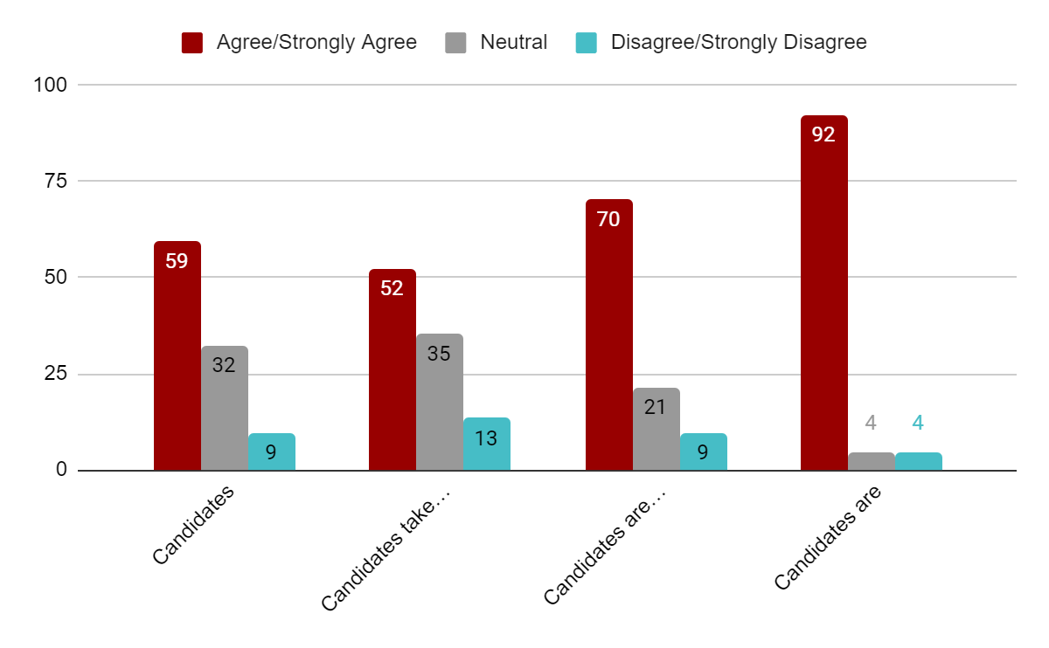
Pre-Service Candidates (Cont.)
Candidates celebrate the neurodiversity of students
Candidates take active steps to become aware of their unconscious bias related to disabilities
Candidates are well prepared to implement anti-racist and anti-bias practices
Candidates are supported with delivering instruction/content that includes more diverse experiences, perspectives, and information
Notes:
Audri
Note that the highest agreement is on prompts that DO NOT refer to disability, while the lowest agreement scores go to prompts that specifically mention disability. This could indicate that EPPs are less confident in their prep in their candidates being fully prepared for inclusive classrooms.

Slide 24
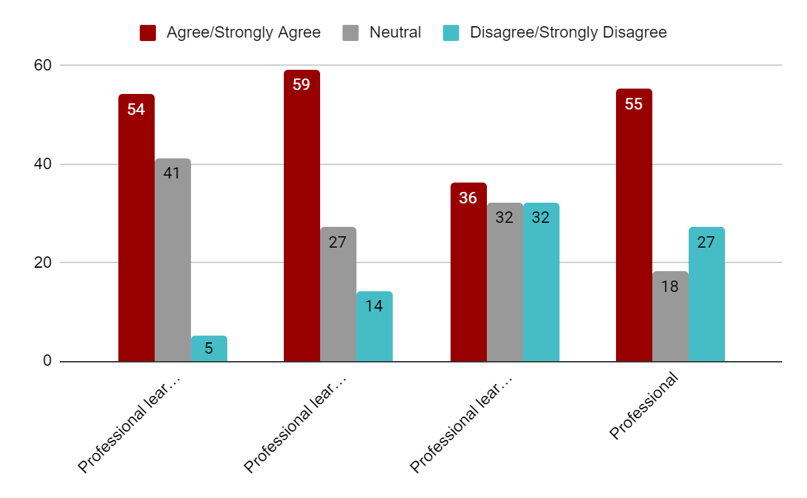
Inservice teachers at school site have access to:
Professional learning opportunities to support learning about inclusive curriculum development
Professional learning opportunities to support learning about different pedagogical strategies to support students with disabilities
Professional learning opportunities to support growth as an anti-ableist educator
Professional learning opportunities to support growth in using accessible
multimedia/technological tools to enhance learning for students with disabilities
Notes:
Audri
These responses focused on the development of of inservice teachers to support all students. As you can see not very high percentages in the agreement whether that is supporting inclusive curriculum, knowing strategies to support SWD, and using accessible multimedia tech tools to enhance the learning for SWD.
-Less agreement with practices to actively disrupt ableist practices.
High neural responses here related to professional learning opportunities supporting inclusive curriculum, supporting learning different pedagogical strategies to support SWDS.

Slide 25
Comments on Promising Practices
Budget and Finances
If you want a partnership to happen at the LEA, you need to have a budget that supports a funded position that is focused on partnerships.
Shared Goals and Collaboration
It's important to come to common goals and shared values when working together so that when there are challenges that come up you can lean on a common value set to keep the work going.
We collaborate with an LEA to provide professional development on co-teaching. This is our fifth year at this school site. We collect data on the progress (or not) that we are making. We have used this data for conference presentations and articles. This professional development is offered free of charge.
Regular meetings with stakeholders from both sides are essential. We have bi-weekly meetings between IHE and LEA and often have LEA staff teaching in our program.
Consistency, and an organized structure of communication is key to maintaining a partnership.
Offering Opportunities to See Best Practices
For our EdSp MMSN, residents have a chance every other week to visit the classrooms and learn from the best ed specialists in the county in a wide range of contexts. Their fieldwork residency keeps them in one school, but that program gives them a view of best practices across contexts.
Notes:
Meghan

Slide 26
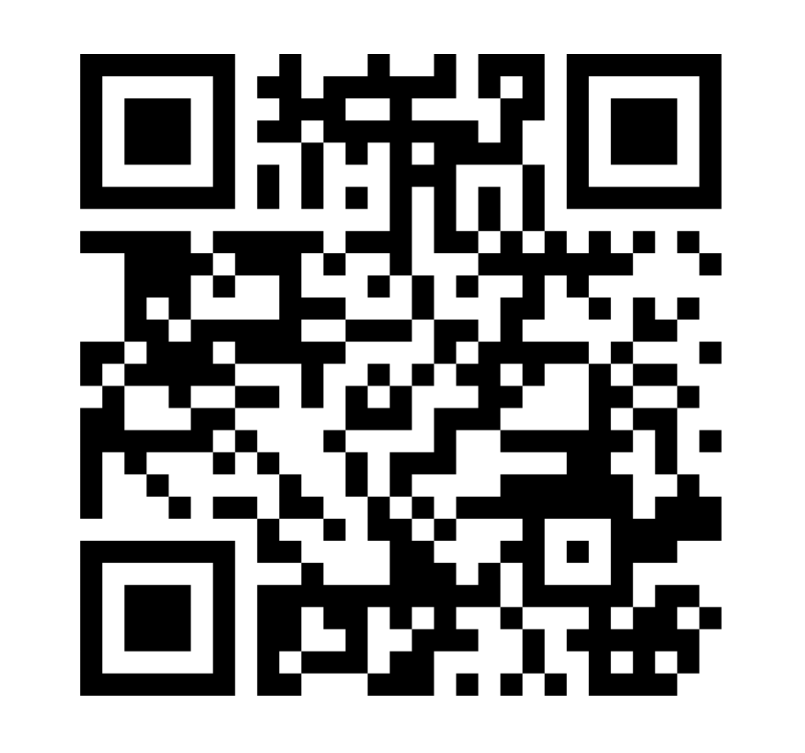
Call to Action
What resonated with you about these preliminary results?
What policy recommendations or changes do you have that would support more inclusive or disability equity and justice-minded programs?
What is the role of teacher residencies in ensuring the recruitment and retention of a diverse teacher workforce that is prepared to teach all students?
https://www.menti.com/algb547atczx
Notes:
Meghan What are some ways that we can begin to ensure that our programs are aligned with the common trunk?

Slide 27
Implications for Policy
Funding for cross collaboration, site visits, and demonstration sites
Structural support from CDE on inclusive strategies for low incidence populations is needed.
For example, personnel prep programs constantly respond to legislative mandates but do not have access to the same supports given to high incidence programs.
TA around designing and implementing residency must focus on inclusive practices and teaching all students–”special education residencies” should not be siloed
Incentives for designing and implementing inclusive pathways
Development and Implementation of Sustainable Paid Teacher Residency Models
Notes:
Meghan

Slide 28
How can Educator Preparation Programs partner with LEAs & Districts to develop sustainable financial models for supporting residents for programs that center equity and access?
Notes:
Meghan

Slide 29
Strategic Staffing: Supports
The development of a robust, diverse and effective “grow your own” teacher pipeline
Ensuring new teachers are well prepared for Day 1 of teaching
Efforts to retain new and veteran educators by creating opportunities to develop and advance in the roles of teacher, mentor and scholar
mutually beneficial, reciprocal partnerships between LEAs and EPPs
***This is accomplished with no additional cost to the district, since roles are funded by reallocating existing dollars.***
Notes:
Meghan

Slide 30
Notes:
Meghan

Slide 31
Notes:
Meghan

Slide 32
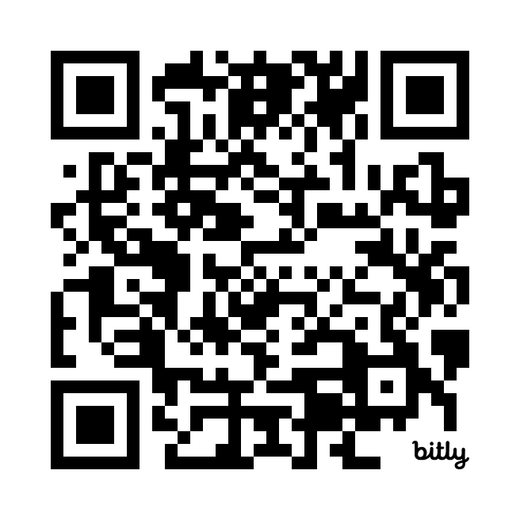
Interested in Ways Financially Supporting Residents?
CCTC Teacher Residency Grants
Braiding Funds
Registered Apprenticeship
District Re-allocation
https://bit.ly/43aM5MI
Notes:
Meghan

Slide 33
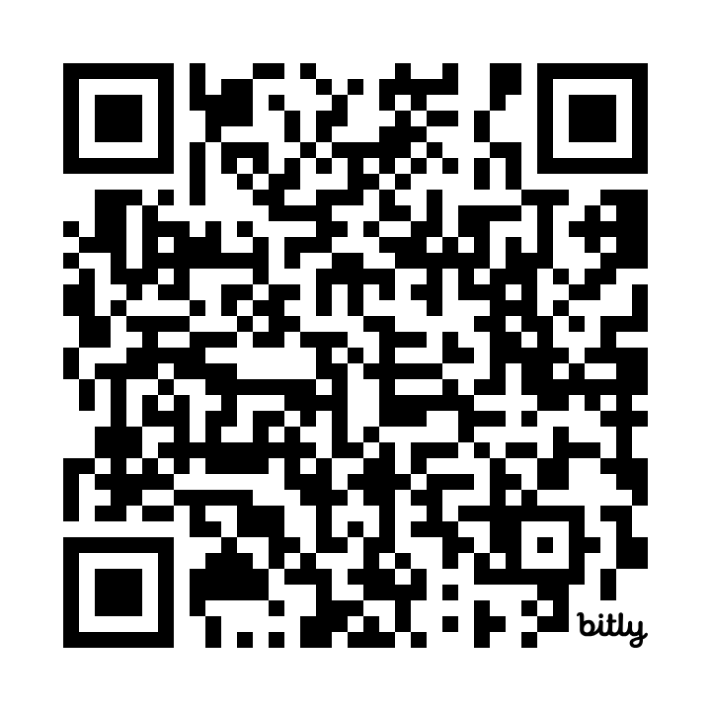
Please Take the Survey!
https://bit.ly/CAINCLUSIVEEDPREP
Notes:
Audri
27 of the 84 EPPs responded, representing a 32.14% rate of return as of 3/6/24. Grateful for CTC and CCTE for helping with the distribution of the survey.
52% CSU, 25% independents, and 22 of UC

Slide 34
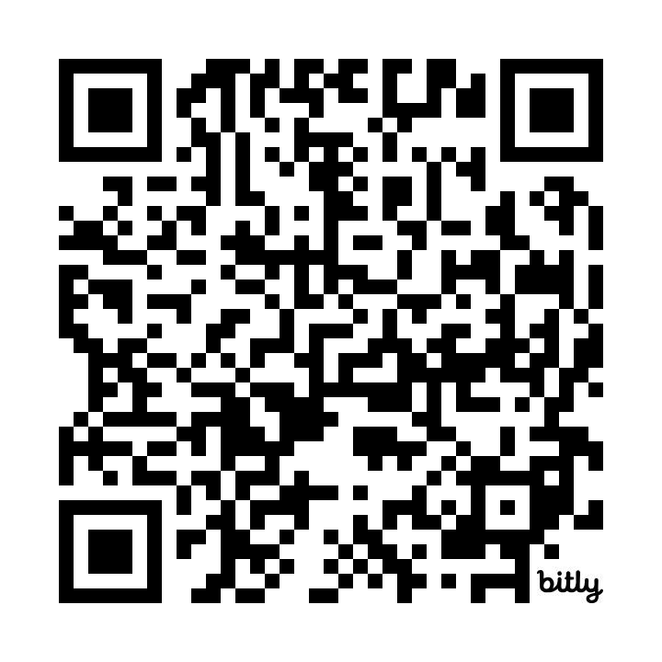
Interested in the Receiving the Preliminary Report?
https://bit.ly/EdPrepResults
Notes:
Audri

Slide 35
Stay Connected
with CAIS!
www.InclusionCalifornia.org
TPI@chapman.edu
Survey
Report
Notes:
Audri

