Slide 1
Saturday Panelists
CCTE October 19, 2024

Slide 2

Dr. Joshua Murguia
Dr. Joshua Murguia, a 12th grade English teacher at Orangewood Continuation High School and a lecturer in the teacher education program at CSU San Bernardino
Feedback situates itself in multiple educational contexts, and shows promise in skill-based formative assessments that become beneficial to educators with real-time data.
Notes:
5 minutes

Slide 3
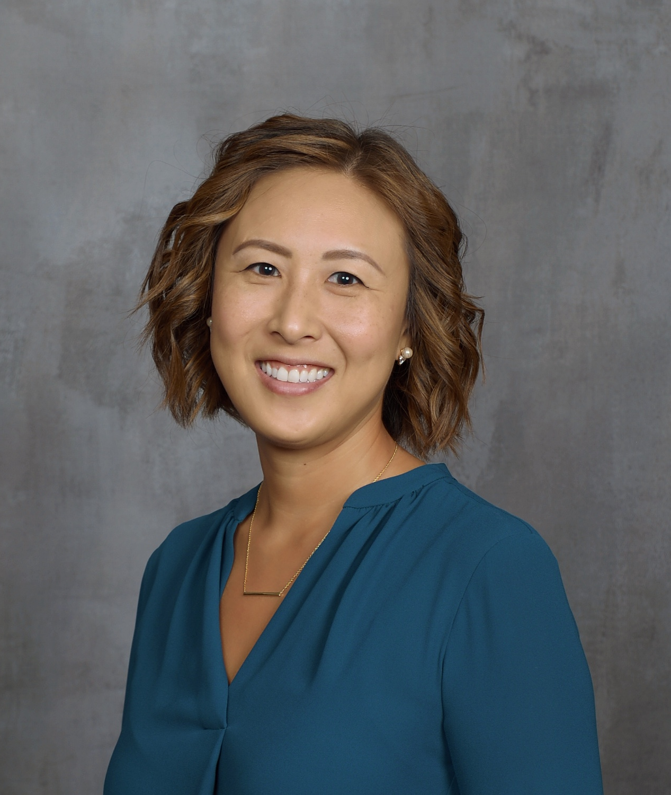
Dr. Rita Suh
Dr. Rita Suh, who served as co-director of the Culture and Equity Project at UCLA Center X, and is now in private consulting, a lecturer and coordinator of the teacher residency program at CSU Long Beach, brings particular feedback expertise to the panel on areas in teacher training, building professional relationships, increasing engagement, and helping teachers use culturally and linguistically responsive instructional approaches to maximize student achievement and opportunity for all students.
Notes:
5 minutes

Slide 4
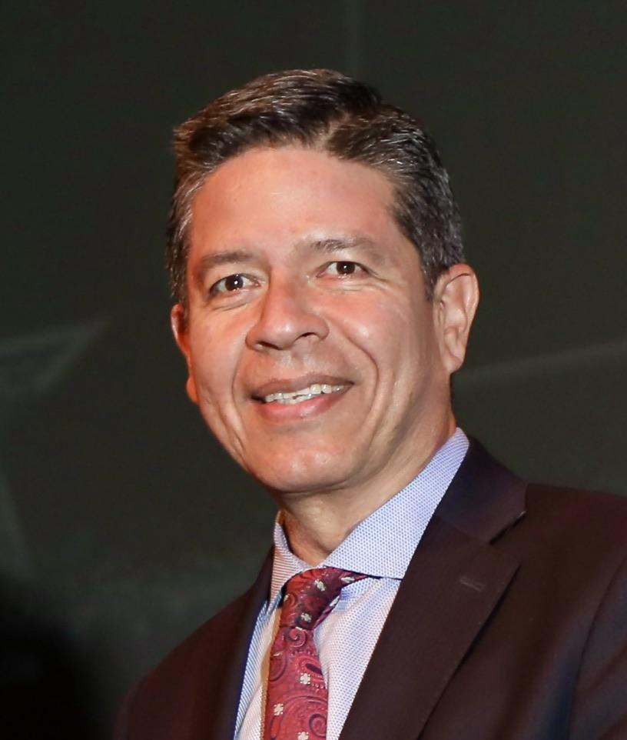
Patricio Vargas, Ph.D.
Dr. Patricio Vargas, Superintendent of Morongo Unified School District and Associate Professor at La Sierra University has established a collaborative culture within his organization establishing clear and open channels for feedback from all stakeholders creating a system where insights, concerns, and ideas can be shared freely, fostering trust and accountability. This approach has empowered all stakeholders, leading to a more cohesive, adaptable, and forward-moving organization.
Notes:
5 minutes

Slide 5
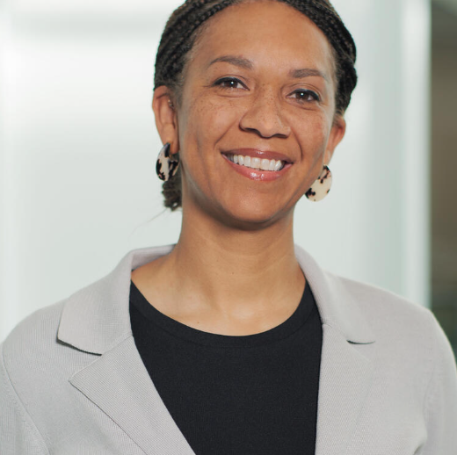
Hillary Walker
Hillary Walker is the Director of the Bay Area Writing Project at the Berkeley School of Education, and adjunct professor of African American Studies and Ethnic Studies at the College of Alameda.
A Writing Project approach centers collegial feedback on:
teacher demonstrations of writing practices.
teacher writing produced in writing groups.
relevant research and issues in education.
One current topic of interest for teachers is the use(s) of AI and feedback in the teaching and coaching of writing.
Notes:
5 minutes

Slide 6

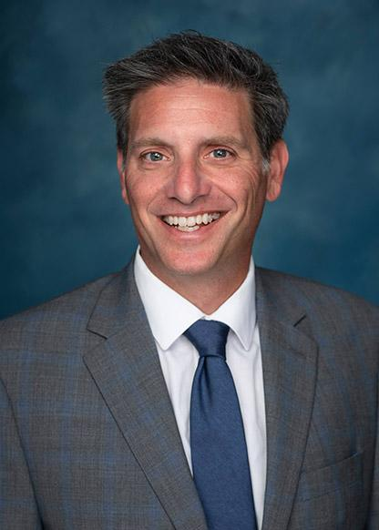
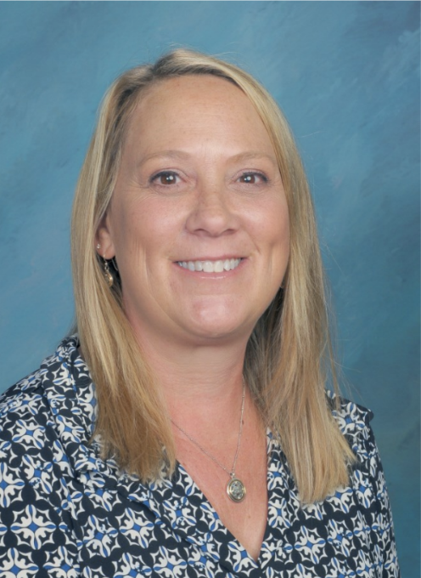
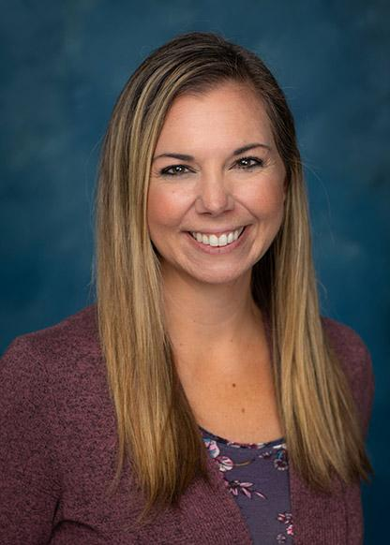
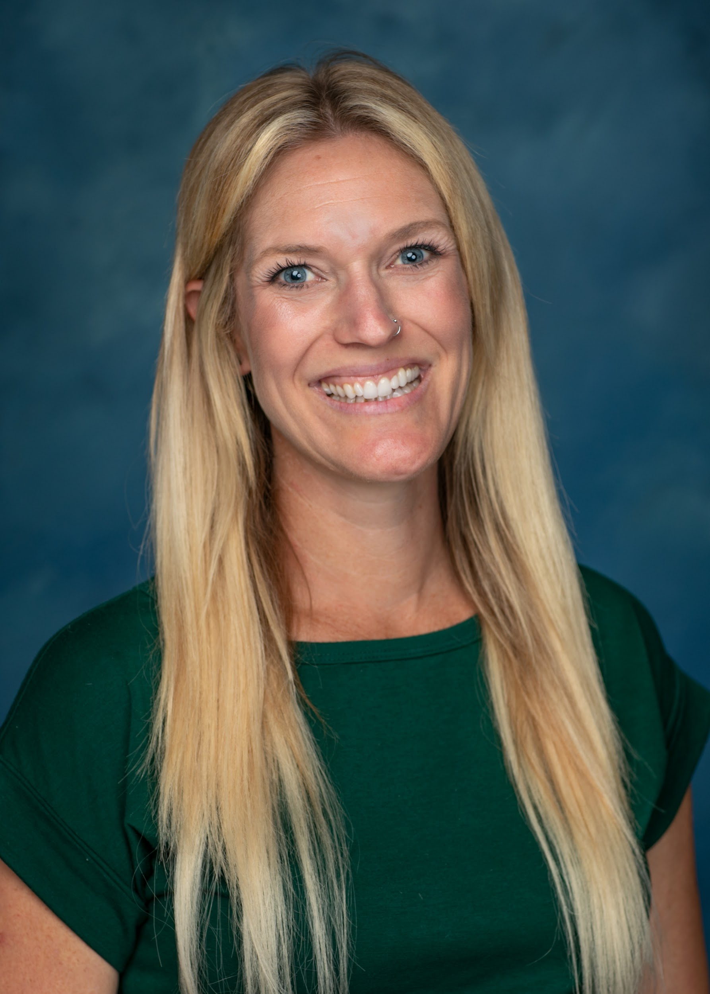
Community Roots Academy Leadership Team
Jeremy Cavallaro, Doctoral Candidate
Ingrid Beaty, M.A.
Danelle Tickel, M.A.Ed.
Kelsey Wan, M.A.Ed.
A premier project-based K-8 public charter school where feedback is key at all levels.
Notes:
1 minute

Slide 7
Jeremy Cavallaro, Doctoral Candidate
Ingrid Beaty, M.A.
Jeremy Cavallaro is the Co-Founder of Community Roots Academy.
Adaptive leadership supports hearing from all voices, paying specific attention to marginalized or unpopular voices.
Ingrid Beaty, is a highly qualified educator with over seventeen years of experience in elementary education.
Project Based Learning teaches all student to give warm and cool feedback to each other.
Notes:
2 minutes

Slide 8
Danelle Tickel, M.A.Ed.
Kelsey Wan, M.A. Ed.
Danelle Tickel earned her M.A.Ed. and Multiple Subjects credential from UC San Diego and her Administrative Services credential through UC Irvine.
Restorative circles in professional learning communities teach educators how to listen to feedback from each other.
Kelsey Wan serves as a Director of Special Education at Community Roots Academy (CRA).
Working as a team, special education integrates member voices into general education and special education professional learning communities.
Notes:
2 minutes

