Slide 1


University of La Verne & Branch Alliance
Feedback Centered Practices for Inclusive/Special Education Learning Communities
Amber Bechard, Ed. D
abechard@laverne.edu
Calvin Ramirez & Ana Andrade, Sierra Madre Middle School
Notes:
Which Zoom link do we use?

Slide 2
Feedback Centered Practices for Inclusive/Special Education Learning Communities
10:40-11:25
Outline
3 Establish the context by explaining who we are and how we prepared for the MRS
5 Offer Meet the Students sim
2 Transition/Debrief
5 Offer conference/IEP meeting sim
2 Transition/Debrief
7 Introduce Power Practices, research overview, and observation feedback tool
8 Calvin & Ana experience the Still I Rise Lesson (they can use Dara & Martha’s prep PPT or make their own)
5 Amber models providing feedback using tool
5 Ana & Calvin Conclusions-the impact of immediate and precise feedback
Survey
Panel Debrief
Notes:
How de we fit tech check in?
Which Zoom link do we use?

Slide 3
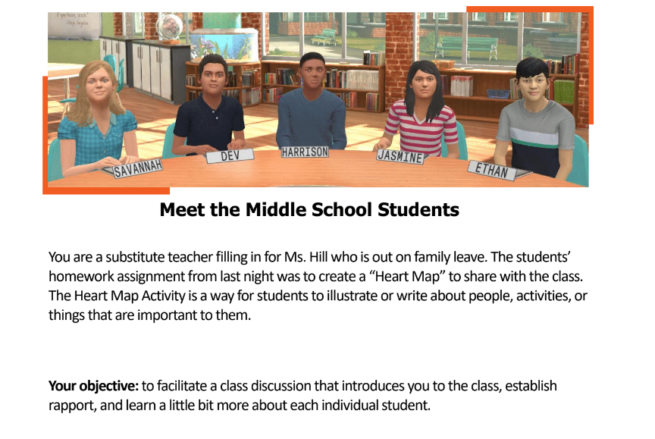
Session 1: Meet the Students
Working with partners, candidates rotated through the small group of 5 students, asking questions to get to know the students
Avatar students have consistent personalities and interests
Candidates took notes to inform their instructional design for lesson.
3
Notes:
Learning Outcome: Candidates were paired as a Gen ED and spec ed partners as our course emphasizes inclusive education and the co-teaching model. The experience offered immediate feedback from students, parent, and facilitators.
The facilitators: Ana and Calvin, alums and current teachers
Branch Ed and the sim specialist, pre-planning
Harrison and Mr. Reed, and increasingly challenging with advocate and additional professionals
Branch Ed and the sim specialist

Slide 4
Meet the Students
Objective: Get to know student strengths, interests, & challenges.
Start Simulation!
5
Notes:
Learning Outcome: integration of our gen ed & inc ed, emphasis on feedback for differentiated instruction and IEP implementation
The facilitators: Ana and Calvin, alums and current teachers
Branch Ed and the sim specialist, pre-planning
Harrison and Mr. Reed, and increasingly challenging with advocate and additional professionals
Branch Ed and the sim specialist

Slide 5
Meet the Students Debrief
Start Feedback!
2

Slide 6
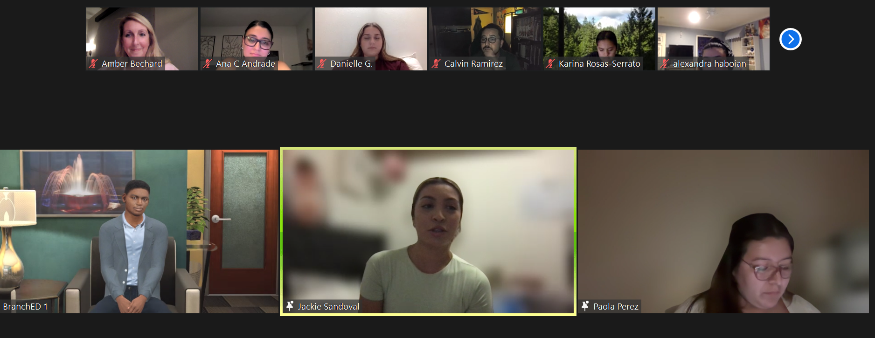
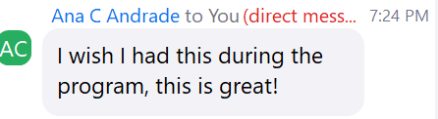
Session 2: Harrison's Parent Conference
Initial groups discussed Harrison's reading scores and emphasized reading at home.
Subsequent groups discussed ways to improve his reading.
<1

Slide 7
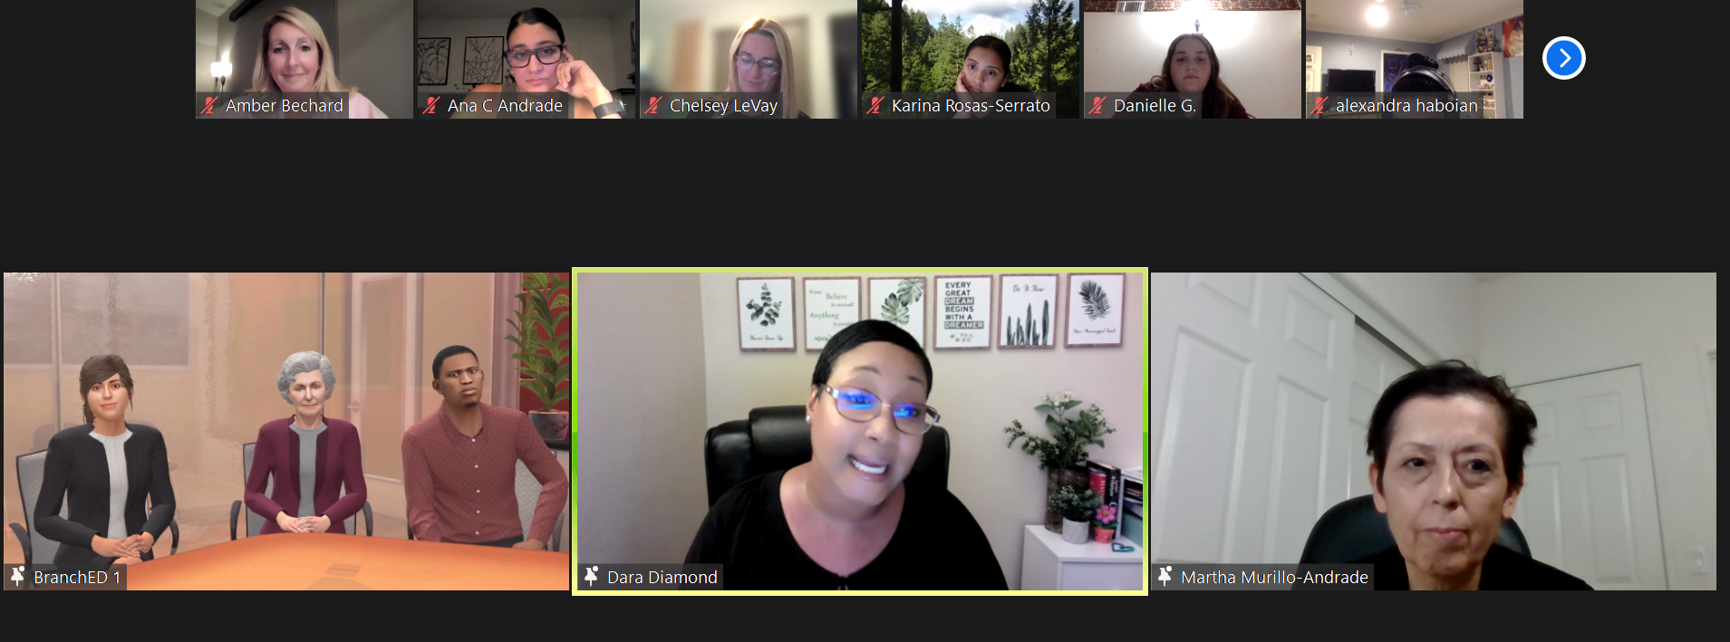
Session 2: An Advocate and Speech Pathologist join the Meeting
<1

Slide 8
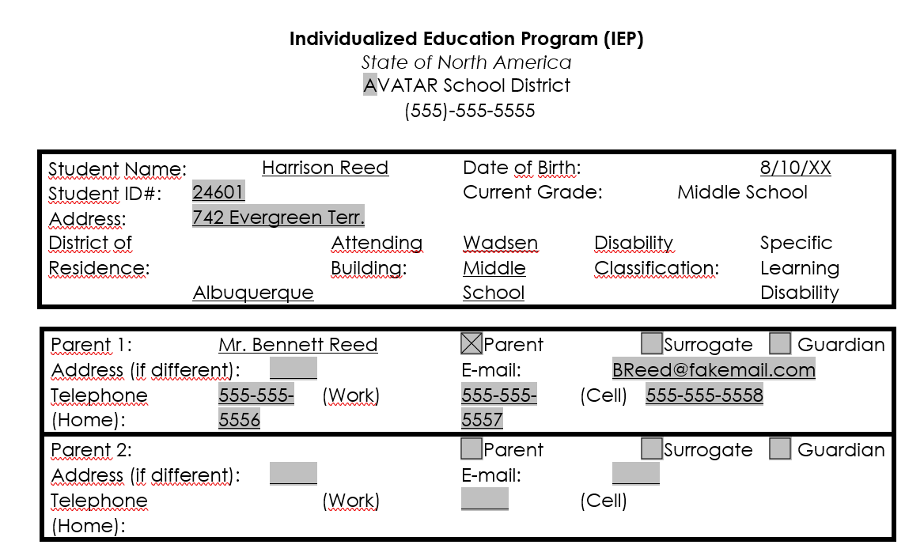
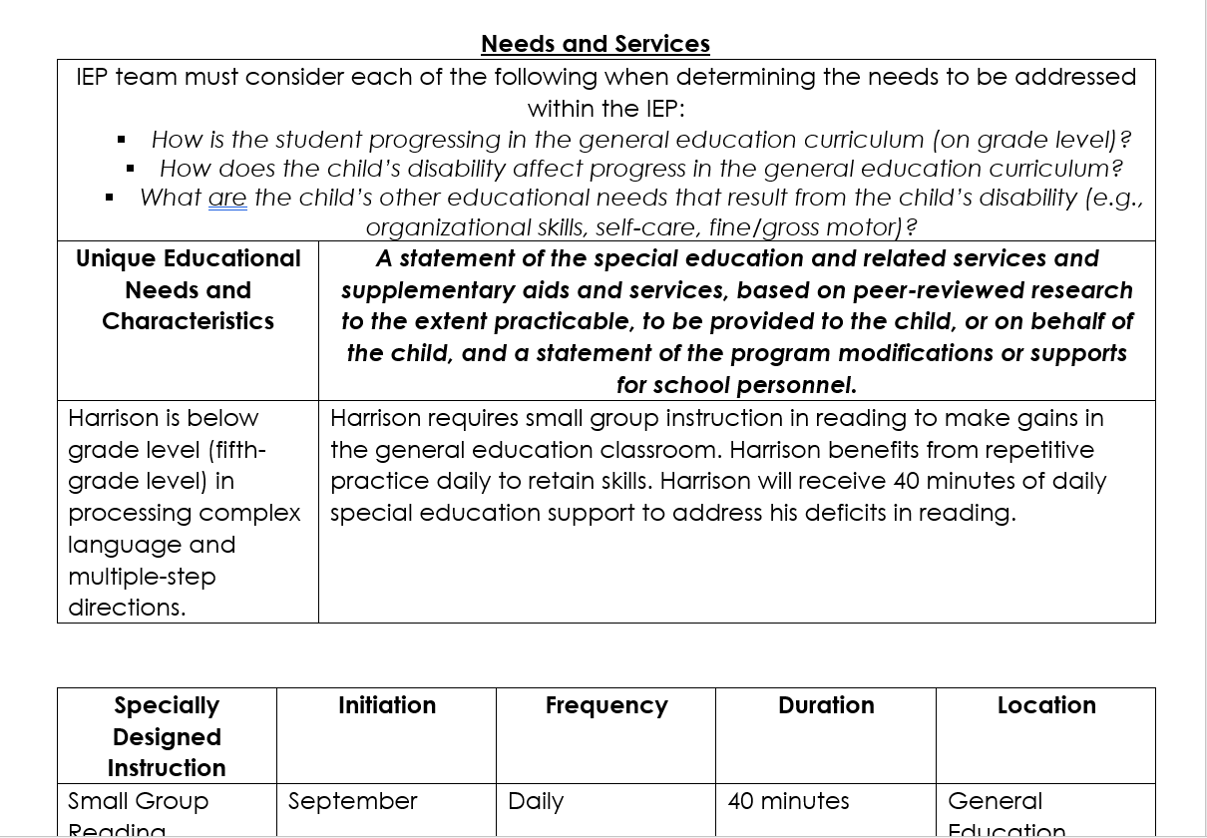
Harrison’s IEP
<1

Slide 9
IEP Meeting
Objective: Listen and respond to Mr. Reed’s concerns.
Start Simulation!
5

Slide 10
Meeting Debrief
Start Feedback!
2

Slide 11
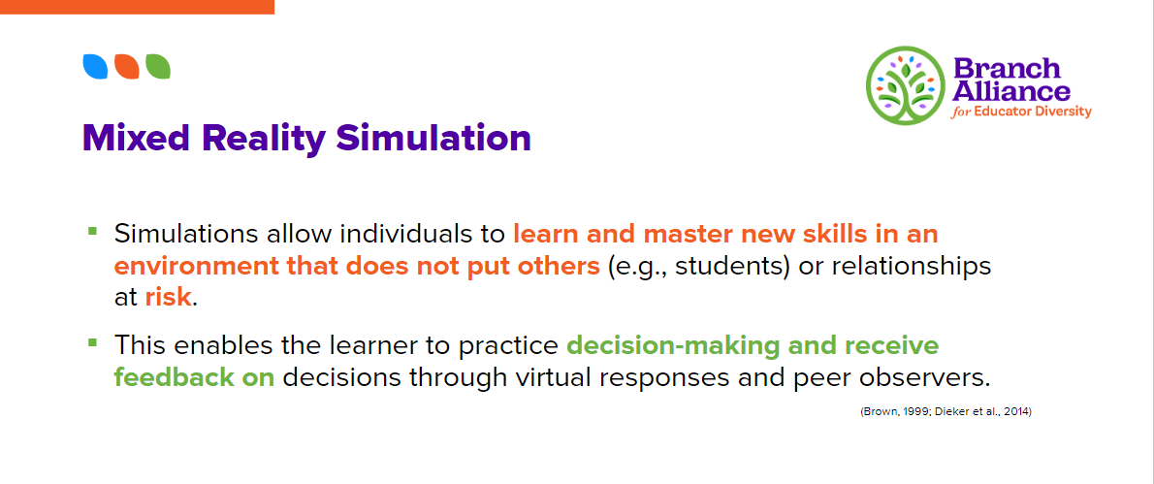

BranchEd
2

Slide 12
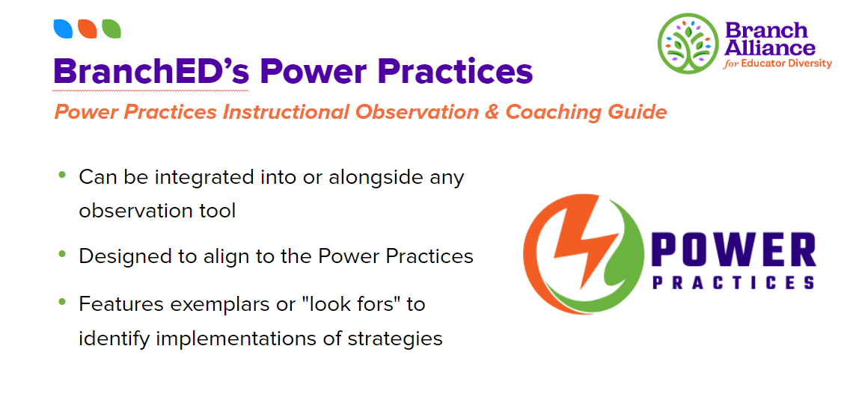

BranchEd
2

Slide 13
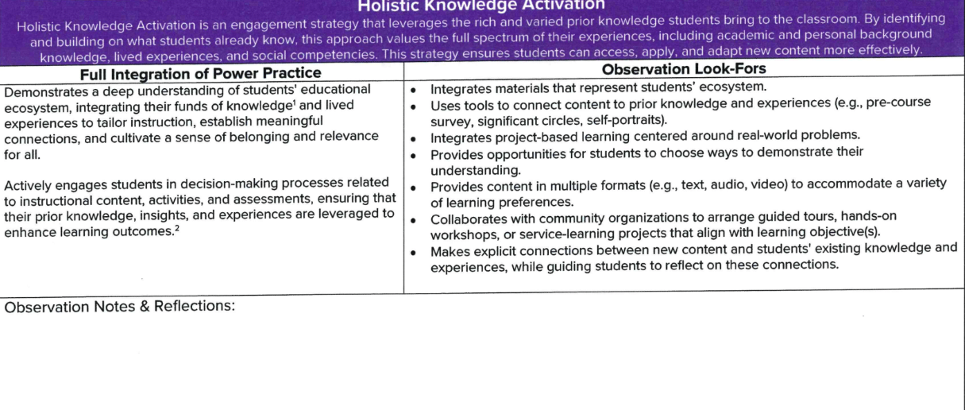
Power Practices Observation Tool
2

Slide 14
Still I Rise Lesson
Objective: Engage students in a meaningful differentiated lesson utilizing prior knowledge..
Start Simulation!
8

Slide 15
Power Practices: Feedback²
Start Feedback!
5

Slide 16


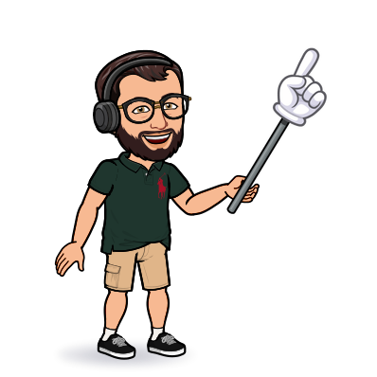
Reflection: Lessons Learned
The advantages of collaborators/service providers are…
Utilizing alumni for current knowledge is…
Limitations of technology include…
5

Slide 17
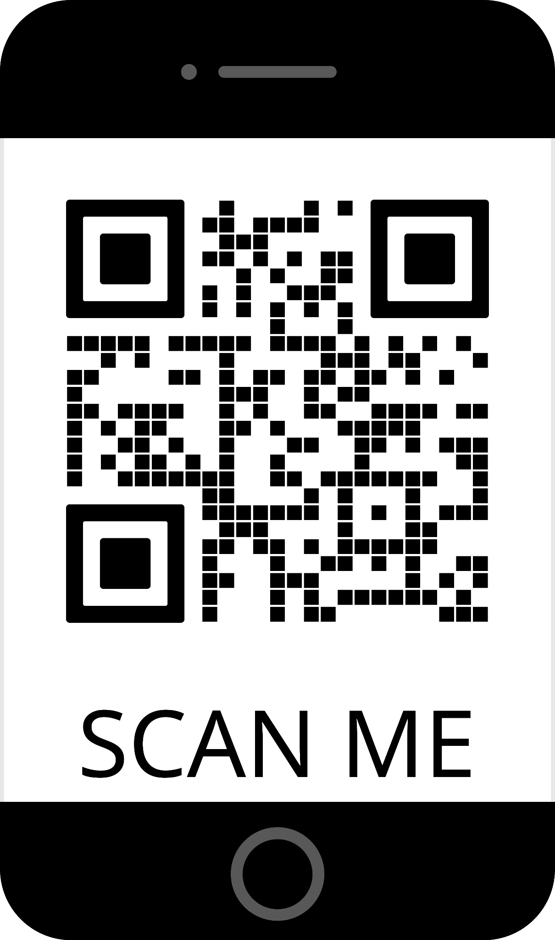
Student Feedback
“We got the chance to see how real students might respond to our actions and adjust our teaching accordingly.” Jackie
“The IEP meeting with Harrison’s father was challenging but a great example of how this particular meeting could go and gained much knowledge watching my classmate’s interactions.” Denise
“It allowed us to practice in real time what could happen in an IEP meeting, or a parent teacher meeting, and how a lesson could go.” Brittany
“I wasn't as stressed because there wasn't the added pressure of making a mistake with the real child and having real life consequences. With the simulation I was able to kind of experiment on things that I might be able to say with the real kid and then see how a simulated child would be able to react. Although it isn't 100% accurate, of course, to a real life classroom setting, it is a good experience for future teachers.” Priscila
5

Slide 18

BranchEd
<1
Notes:
Harrison and Mr. Reed, and increasingly challenging with advocate and additional professionals
Branch Ed and the sim specialist

