Slide 1

CCTE Conference
Updates from the
California Commission on Teacher Credentialing
FALL 2024
SAN DIEGO, CA

Slide 2
Agenda
CSTP
CWA Standard and Precondition
Literacy Standards & Certification and Performance Assessment
PK-3 ECE Specialist Credential and Child Development Permits
SLP Standards
RDI-TPA
Grants
Tools for Potential Candidates
Glimpse into Future PSD Work

Slide 3
California Standards for the Teaching Profession (CSTP) Refresh
  Jointly developed by the Commission on Teacher Credentialing (CTC) and the California Department if Education (CDE), the original California Standards for the Teaching Profession (CSTP) are adopted.
  Served as the foundation for the Beginning Teacher Support and Assessment (BTSA) program facilitating formative assessment for new teachers.
1990’s
  October: Commission updates the CSTP adhering to Education Code (EC) section 44279.2 which establishes that regular revisions occur for developing and administering a system for ensuring the quality and effectiveness of Teacher Induction programs. This includes periodically evaluating the validity of the CSTP.
2009
  The Commission seeks applicants to participate in an expert workgroup to refresh the CSTP.
2019
3
Notes:
Erin

Slide 4
California Standards for the Teaching Profession (CSTP) Refresh
  Facilitated by staff from the CDE, the Commission, and the Region 15 Comprehensive Center at WestEd, expert workgroup is formed and charged with making recommendations for updating and refreshing the CSTP.
  2021 - Work is paused due to COVID-19 pandemic and priority of developing PK-3 Early Childhood Specialist Instruction Credential, revised literacy standards, and literacy-related teaching performance expectations (TPEs).
2020-21
2023
  Workgroup and key focus area groups reconvene and revise draft of CSTPs.
  February 2024: Commission adopts revised CSTP with slight modifications.
  April 2024: Commission accepts modifications and fully adopts the revised CSTPs.
2024
4
Notes:
Erin

Slide 5
California Standards for the Teaching Profession (CSTP) Refresh
Domains unchanged but standard descriptors have been updated.
CSTP 1: Engaging and Supporting All Students in Learning
  Teachers apply knowledge about each student to activate an approach to learning that strengthens and reinforces each student’s participation, engagement, connection, and sense of belonging.
CSTP 2: Creating and Maintaining Effective Environments for Student Learning
  Teachers create and uphold a safe, caring, and intellectually stimulating learning environment that affirms student agency, voice, identity, and development and promotes equity and inclusivity.
5
Notes:
Erin

Slide 6
California Standards for the Teaching Profession (CSTP) Refresh
CSTP 3: Understanding and Organizing Subject Matter for Student Learning
  Teachers integrate content, processes, materials, and resources into a coherent, culturally relevant, and equitable curriculum that engages and challenges learners to develop the academic and social– emotional knowledge and skills required to become competent and resourceful learners.
CSTP 4: Planning Instruction and Designing Learning Experiences for All Students
  Teachers set a purposeful direction for instruction and learning activities, intentionally planning, and enacting challenging and relevant learning experiences that foster each student’s academic and social–emotional development.
6
Notes:
Erin

Slide 7
California Standards for the Teaching Profession (CSTP) Refresh
CSTP 5: Assessing Students for Learning
  Teachers employ equitable assessment practices to help identify students’ interests and abilities, to reveal what students know and can do, and to determine what they need to learn. Teachers use that information to advance and monitor student progress as well as to guide teachers’ and students’ actions to improve learning experiences and outcomes.
CSTP 6: Developing as a Professional Educator
  Teachers develop as effective and caring professional educators by engaging in relevant and high-quality professional learning experiences that increase their teaching capacity, leadership development, and personal well-being. Doing so enables teachers to support each student to learn and thrive.
7
Notes:
Erin

Slide 8

California Standards for the Teaching Profession (CSTP) Refresh
Revised Standards, Elements, and Indicators of Practice.
Focal areas include:
Literacy
English learners
Special education/students with disabilities
Cultural responsiveness
Social emotional wellness and learning
Parent engagement
Diversity, equity, and inclusion
8
Notes:
Erin – The focal areas were the lenses through which the work was focused and were kept these areas front and center as the CSTP were being refreshed.

Slide 9
California Standards for the Teaching Profession (CSTP) Refresh
Timeline | Action
April 2024 | Commission adopts proposed revisions to the 2024 CSTP.
Spring/Summer 2024 | Expert workgroup convened to develop the Continuum of Teaching Practice.
April 2024 through July 2026 | PSD staff provide targeted Technical Assistance for the Teacher Induction programs as they align to the 2024 CSTPs.
Fall 2026 | All Teacher Induction programs are aligned with the 2024 CSTP. Approved programs have submitted an assurance statement to the Commission verifying full CSTP 2024 implementation within their Teacher Induction programs.
January 2026 | Approved Teacher Induction Programs notify the Commission of their intended date for full implementation of the revised CSTP*
9
Notes:
Erin – Continuum of Teaching Practice, aka Descriptions of Practice, also being updated. A draft is under review at the Commission. (Posting is TBD, if asked.)

Slide 10
California Standards for the Teaching Profession (CSTP) Refresh
Resource | Location
Commission Dedicated Email for Teacher Induction Program Questions | Induction@ctc.ca.gov
Sign up for the Commission Professional Services Division Weekly Newsletter | PSD News Email List (ca.gov)
Join our bi-monthly Teacher Induction Office Hours for Technical Assistance | Technical Assistance Webpage (Zoom Links for the 1st and 3rd Thursday)
10
Notes:
Erin

Slide 11
Child Welfare and Attendance (CWA) Standard and Precondition
Timeline | Action
2019 | Commission adopts new PPS standards and PEs; CWA content embedded in all programs. Candidate option. Must focus 150/600 hours of clinical practice on CWA activities.
2022 | Implementation of new standards. (Delayed due to COVID.)
2023 | Senate Bill 223 (Chap. 175, Stats. 2024) authorizes LEAs to offer CWA.
2024 | Staff and subgroup of PPS workgroup develops stand alone set of CWA standards and performance expectations. For use in certain situations. Adopted by Commission in August 2024. PSA 24-09 Precondition for Commission adoption in October 2024.
11
Notes:
Erin

Slide 12

Update On Implementation of SB 488: Reading and Literacy Instruction
Literacy Standards and TPEs Adopted for:
Preliminary Multiple and Single Subject
Preliminary Education Specialist Mild Moderate Support Needs and Extensive Support Needs
Preliminary Education Specialist Visual Impairments, Deaf and Hard of Hearing, and Early Childhood Special Education
PK-3 ECE Specialist Instruction
12
Notes:
Erin

Slide 13
Update On Implementation of SB 488: Reading and Literacy Instruction
Key Features of New Standards/TPEs
Aligned to the ELA/ELD Frameworks and other Foundational Documents
Require the Incorporation of the California Dyslexia Guidelines
Universal Design for Learning
Equity/Asset-Based Approaches
Multi-Tiered Systems of Support – best first instruction, targeted/supplemental instruction, intensive intervention
Multi/Biliteracy and ELD
Development of a Literacy Performance Assessment (operational Fall 2025) to replace RICA
13
Notes:
Erin

Slide 14

Update On Implementation of SB 488: Reading and Literacy Instruction
All currently approved programs must be aligned with these new TPEs and standards as of July 1, 2024.
All new program proposals aligned beginning October 2023.
Required Certification process in 2024-2025.
Notes:
Erin

Slide 15

Update On Implementation of SB 488:
Reading and Literacy Instruction
Certification Process
PSA 24-01 and 24-08
Certification focused on 44259(b)(4)(A) and (B) – particularly Foundational Skills
Bi-weekly Technical Assistance March-September
Submissions were due October 4
Over 300 programs need to be certified by Commission by July 1, 2025 – Iterative process
Notes:
Erin

Slide 16
Update On Implementation of SB 488:
Reading and Literacy Instruction
What does 44259(b)(4)(A) and (B) say?
  (i) The study of organized, systematic, explicit skills including phonemic awareness, direct, systematic, explicit phonics*, and decoding skills.
(ii) A strong literature, language, and comprehension component with a balance of oral and written language.
(iii) Ongoing diagnostic techniques that inform teaching and assessment.
(iv) Early intervention techniques.
(v) Guided practice in a clinical setting.
*defined in code
Notes:
Erin

Slide 17
Update On Implementation of SB 488:
Reading and Literacy Instruction
Commission approved Foundations of Reading Exams (Agenda Item 5F) in August 2024 for specified individuals only.​
1)Prelim holders with RICA renewal codes (pandemic) ​
2) MS and Ed Specialist candidates who complete all other credential requirements except RICA by June 30, 2025.​
3) Single Subject credential holders who want to add MS credential​
4) Private School teachers seeking MS, PK 3 ECE, or Ed Specialist​
5) Teachers prepared in another country​
Other potential options to be considered by Commission at October 2024 meeting.​
Notes:
Erin

Slide 18
Literacy Performance Assessment
CalTPA model pilot study and field test
Pilot study Spring 2024 (see August 2024 Agenda Item 5B)
19 programs (MS, MMSN, ESN, ECSE, DHH, and VI), 219 candidates including candidates earning a Bilingual authorization.
  No PK-3 ECE programs approved in time, so sample was MS candidates in TK settings.
Credential specific assessors trained and calibrated to score
Initial standard setting study to be conducted spring 2025
Recommended passing standard for Commission adoption summer 2025
Notes:
Amy

Slide 19
Literacy Performance Assessment
FAST and edTPA
FAST literacy assessment approved for field test by Commission August 2024
edTPA literacy assessment expected approval for field test at December 2024 Commission meeting
Notes:
Amy

Slide 20
Also, Performance Assessment – Reminder
December 2023 Commission approved programs to use multiple measures to determine if candidates who scored within -1.0 SEM might be recommended for Preliminary credential. PSA-24-02 was updated in August to include info for submitting online recommendations.
This option is not available for field test participants.
Notes:
Amy

Slide 21
PK-3 ECE Credential
Standards and TPEs adopted October 2022
New program submissions began coming in Spring 2023
  Must address Literacy standard and TPEs
Regulations approved by OAL – April 1, 2024
7 programs approved since May 2024
  3 CSUs
  2 Private/Independent IHEs
  2 LEAs (specifically, county offices)
19 more in the pipeline
Notes:
Erin

Slide 22
PK-3 ECE Credential
ECO option for PK-3 included in 2023 Budget Trailer Bill
  Commission staff reviewing potential options for Commission approval (likely in 2025)
PK-3 TPA
  Currently allowable to take MS version in a TK classroom, but regulations are being proposed to remove that allowance as PK-3 TPAs are moving toward adoption.
  Pilot study under way with CalTPA model
  Approval of FAST and edTPA models anticipated but currently no candidates in PK-3 programs at institutions that use these models
Notes:
Erin

Slide 23
Child Development Permit Work
Panel of 28 Child Development Permit (CDP) workgroup members met from August 2023 to July 2024 to work on recommendations to the Commission for potential revisions to the CDP matrix.​
All meetings were open to the public with an opportunity for public comment. ​
Recommendations to be presented at the October Commission meeting.
An extensive field survey being conducted with results presented for Commission consideration in February.
Updates included: educational requirements, authorization, supervised clinical (field) experience, provisional certification, renewal requirements, validity term, and alternative pathways.​
Notes:
Erin

Slide 24
Speech-Language Pathology (SLP) Standards
Updated Standards and Performance Expectations coming at the December 2024 Commission meeting​. ASHA updated their standards in 2020.
New and streamlined approach being presented:​
If an institution is accredited in good standing by Association of Speech and Hearing (ASHA), fewer standards they need to meet for California.​
Out for field review currently.​
Notes:
Erin

Slide 25
Workgroup to Review the Design and Implementation of the Teaching Performance Assessments (RDI-TPA)
“To ensure the teaching performance assessments described in Sections 44320.2 and 44320.3 are valid and authentic, formative in nature, embedded in preparation, and inform program improvement through the accreditation system, the commission shall convene a workgroup to assess current design and implementation of the state’s current teaching performance assessments.”
44320.4(a)
Notes:
Adam

Slide 26
RDI-TPA Workgroup
At a minimum, the recommendations from the workgroup shall include:
(1) An analysis of any modifications needed to current assessments to ensure they are valid and authentic to the work of teaching, reasonable to implement in the wide range of classroom settings across the state, and appropriate for beginning teachers.
44320.4(c)(1)
Notes:
Adam

Slide 27
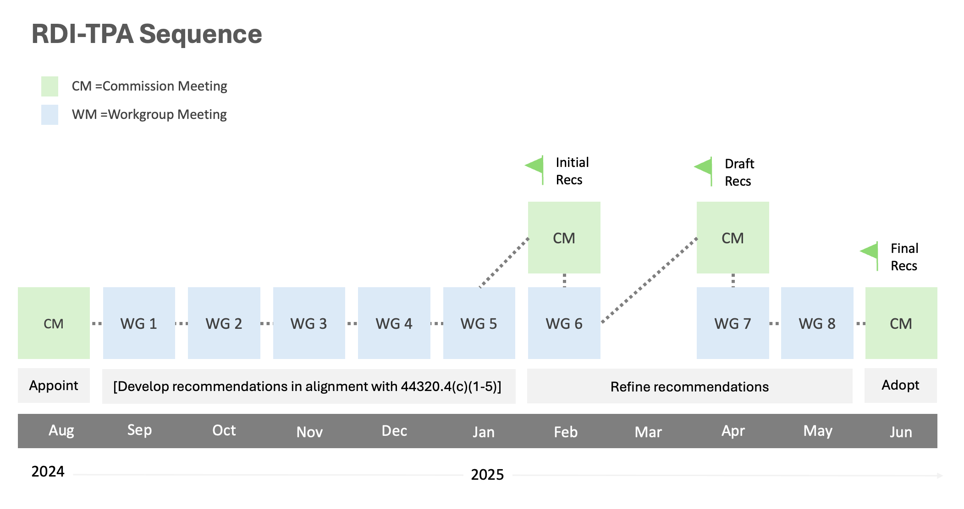
Notes:
Adam

Slide 28
RDI-TPA Workgroup Meeting Dates
RDI-TPA Workgroup Meeting 1 (September 19-20, 2024)
RDI-TPA Workgroup Meeting 2 (October 14-15, 2024)
RDI-TPA Workgroup Meeting 3 (November 5-6, 2024)
RDI-TPA Workgroup Meeting 4 (December 4-5, 2024)
RDI-TPA Workgroup Meeting 5 (January 8-9, 2024)
RDI-TPA Workgroup Meeting 6 (February 26-27, 2024)
RDI-TPA Workgroup Meeting 7 (April 23-24, 2024)
https://www.ctc.ca.gov/
Notes:
Adam

Slide 29
Updates on Grants
All current Commission-administered grant programs:
Teacher Residency Grant (Capacity and Implementation) (TR)​
School Counselor Residency Grant (Capacity and Implementation) (SCR)​
Statewide Residency Technical Assistance Center Grant (SRTAC)​
Classified School Employee Teacher Credentialing Grant (Classified)​
Diverse Education Leaders Pipeline Initiative Grant (DELPI) ​
Computer Science Supplementary Authorization Incentive Grant (CS)​
Local Solutions to the Shortage of Special Education Teachers
Reading and Literacy Supplementary Incentive Grant (Read/Lit)​
Integrated Undergraduate Teacher Preparation
Dyslexia Grants
Notes:
Erin

Slide 30
Updates on Grants
Teacher Residency Capacity due 11/01/2024​
Teacher Residency Implementation and Expansion due 02/07/2025​
School Counselor Residency Capacity, was due 10/04/2024 and again on 03/07/2025​
School Counselor Implementation, was due 10/11/24 and again on 01/31/2025
Classified School Employees Teacher Credentialing due 11/08/24 and 02/21/25​
Computer Science Supplementary Authorization Incentive due 11/15/24 and 02/28/25​
Reading and Literacy Supplementary Authorization Incentive due 11/15/24 and 02/28/25
Notes:
Erin

Slide 31
Roadmap to Teaching
Find your Career Path
Basic Skills Requirement Calculator
Pathways at a Glance
Program Pathways Dashboard
Contact our Education Career Counselors
Email our experts: careerguidance@ctc.ca.gov
Notes:
Erin

Slide 32


Thank you!!
Notes:
Erin

Slide 33

Questions?

Slide 34
Resources
How find information:
Subscribe to the PSD News
Subscribe to the ECE News
How to contact us:
PSDInfo@ctc.ca.gov
ECE@ctc.ca.gov

