Slide 1
Collaborative Case Inquiry (CCI): A Promising Model for Preservice Teacher and Teacher Supervisor Learning and Development
Johnnie Wilson, UCSC
Jennifer Hinz, UCSC
Soleste Hilberg, UCSC
Notes:
Introductions

Slide 2
Overview
Literature on Preservice Teacher (PST) Supervision
Collaborative Case Inquiry (CCI) with Preservice Teachers
CCI Protocol
CCI with Teacher Supervisors
Resources and Contact Information
Notes:
Soleste

Slide 3
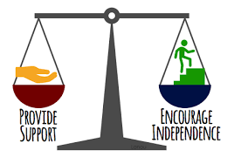
Literature on PST Supervision: Key Findings
What is the purpose of teacher supervision?
Support preservice teacher learning in field placements (Burns, Jacobs, & Yendol-Hoppey (2016)
Why?
Student teaching is arguably the most important aspect of learning to teach (Cuenca, 2010)
Supervisors are vital in supporting the translation of theory into practice in field placements (Cohen, Hoz, & Kaplan (2013)
“Boundary spanners” bridging university learning (theory, research) with field placement (practice) (Cuenca, 2010)
Who do we know about who teacher supervisors are?
We know that in California, it is uncommon for preservice teacher supervisors afforded guaranteed full-time positions
What do we know about what teacher supervisors do?
Responsibilities extend far beyond simply ensuring program expectations are met: evaluate, liaisons with schools, teachers cultivating relationships than enable access to classrooms and schools, maintaining communication between ST and CT, structuring preservice teacher reflection (Burns, Jacobs & Yendol-Hoppey, 2016)
Though expectations and demands are high, requiring extensive knowledge and expertise, teacher supervisors are often peripheral members in both University and K-12 contexts (Barahona, 2019)
What is needed?
Better understanding the effective supervision methods and moves
Greater recognition for the value of PST supervision
Notes:
Student teaching is central to teacher preparation. Student teaching, providing the opportunity to practice the art of teacher, with feedback and support, and to apply the key constructs that are central to courses on the foundation, research, theory, and methods of teaching, is inarguably a central component of the teacher education program experience

Slide 4
Literature on PST Supervision - Why CCI?
Burns & Badiali, 2016
“… the role of the university supervisor is critical to developing reflective habits and promoting preservice teacher growth and development (Bates, Drits, & Ramirez, 2011; Burns, Jacobs, & Yendol-Hoppey, 2015; Nguyen, 2009). Yet university supervisors may be the most undervalued actors in the entire teacher preparation equation when one considers the knowledge, skills, and dispositions they must have to teach about teaching in the field.”
Burns, Jacobs & Yendol-Hoppey, 2016
“Teacher preparation programs need to consider how they are preparing supervisors to engage in these expanded tasks [such as] examining one’s practices through self-study and innovating to enhance PST supervision”.
McCormack, Baecher &Cuenca, 2019
“...we can find models in which university-based supervisors meet more intensively within communities of practice to reflect on their work with other supervisors (e.g. Baecher, Graves & Ghailan, 2018; Dangel & Tanguay, 2014)”
“institutions must provide regular opportunities for supervisors to examine and discuss the dilemmas of practice they encounter, much as we ask our teacher candidates to actively reflect on their own teaching practice...
Supervisors in our study relished the opportunity to be asked about their experiences and come together for a group discussion about the dilemmas of supervision they were facing.”

Slide 5
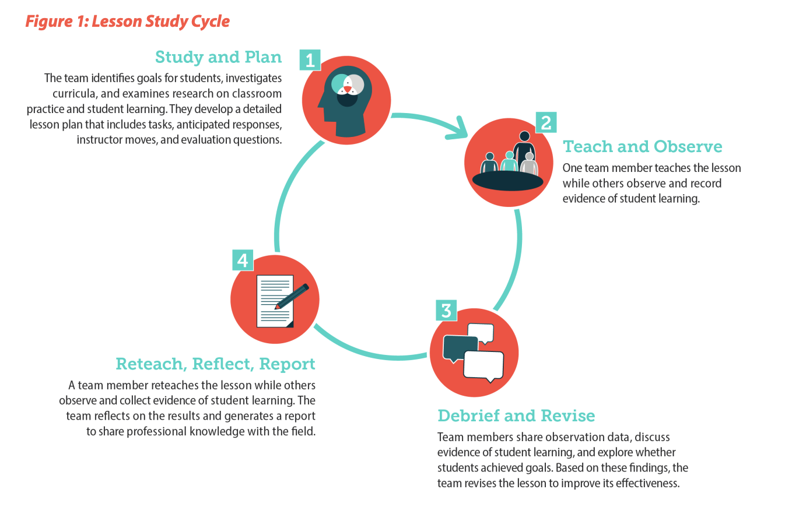
Collaborative Case Inquiry with Preservice Teachers
Lesson Study Overview
Framed from Japanese Lesson Study -
Key elements drawn for this work-
Continuous Improvement
Cycle of Inquiry and Reflection
Collegiality
Focus on Case of Teaching
Value for Student Teaching:
Works from premise that developing in teaching is a continuous and shared activity.
Instills a disposition towards reflective inquiry into one’s teaching practice
Holds sustaining productive collegial relationships as an expectation for professional conduct
Notes:
Johnnie

Slide 6
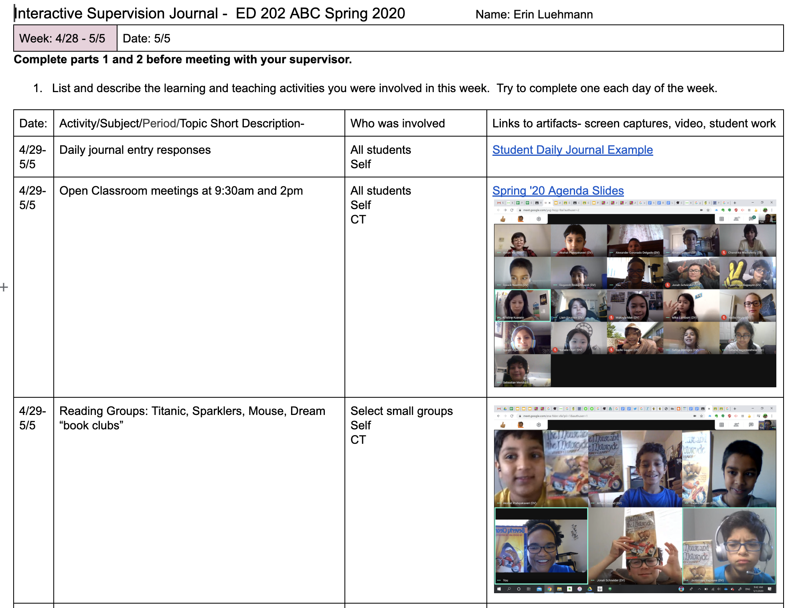
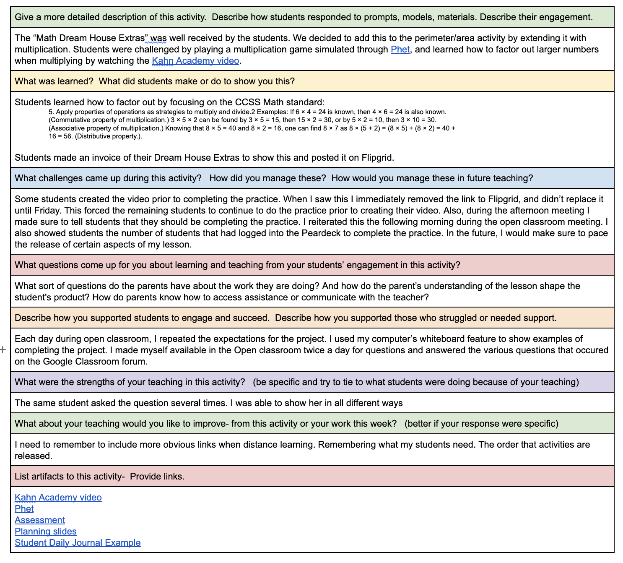
Collaborative Case Inquiry Protocol
Interactive Supervision Journal:
Students represent their own teaching through the use of this tool.
Essential medium for discussions of their teaching and development.
First part is a general representation of a week of teaching
Second part a description of a case of teaching for a focused consideration.
Third part a shared accounting of areas of strength, struggles/ things to work on, and next steps.
Notes:
JOhnnie

Slide 7
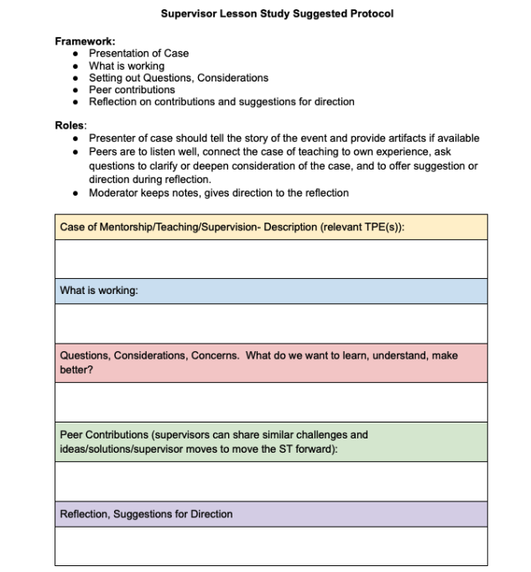
Collaborative Case Inquiry with Teacher Supervisors
Notes:
Jennifer

Slide 8
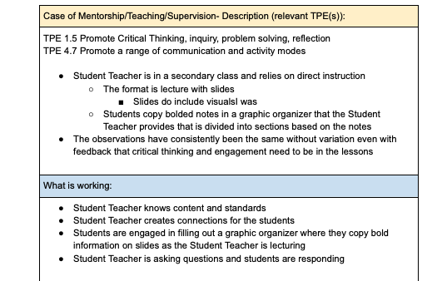
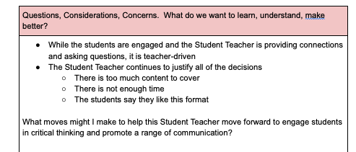
Collaborative Case Inquiry Before
Notes:
Jennifer

Slide 9
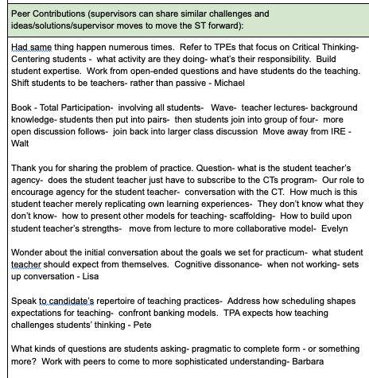
Collaborative Case Inquiry

Slide 10
Collaborative Case Inquiry Follow Up

Slide 11
Thank you!
Resources
CTERIN Presentation
https://tinyurl.com/CTERIN-CCI-2022
CCI Protocol
https://tinyurl.com/CCIProtocol2023
Jennifer’s Case
https://tinyurl.com/CCIJennifersCase
Contact Information
Johnnie Wilson
jobwilso@ucsc.edu
Jennifer Jones Hinz
jhinz@ucsc.edu
Soleste Hilberg
soleste@ucsc.edu
Notes:
Jennifer
Nice slide, Jennifer! (Soleste)

