Slide 1
California Council on Teacher Education (CCTE)
Spring Policy Action Network (SPAN)
2023

Slide 2
Removing RICA Roadblocks: Supporting Success for Pre-Service Teachers
Presenters:
Mary K. Requa, PhD
Jill Yochim, MA, CALT, C-SLDS

Slide 3
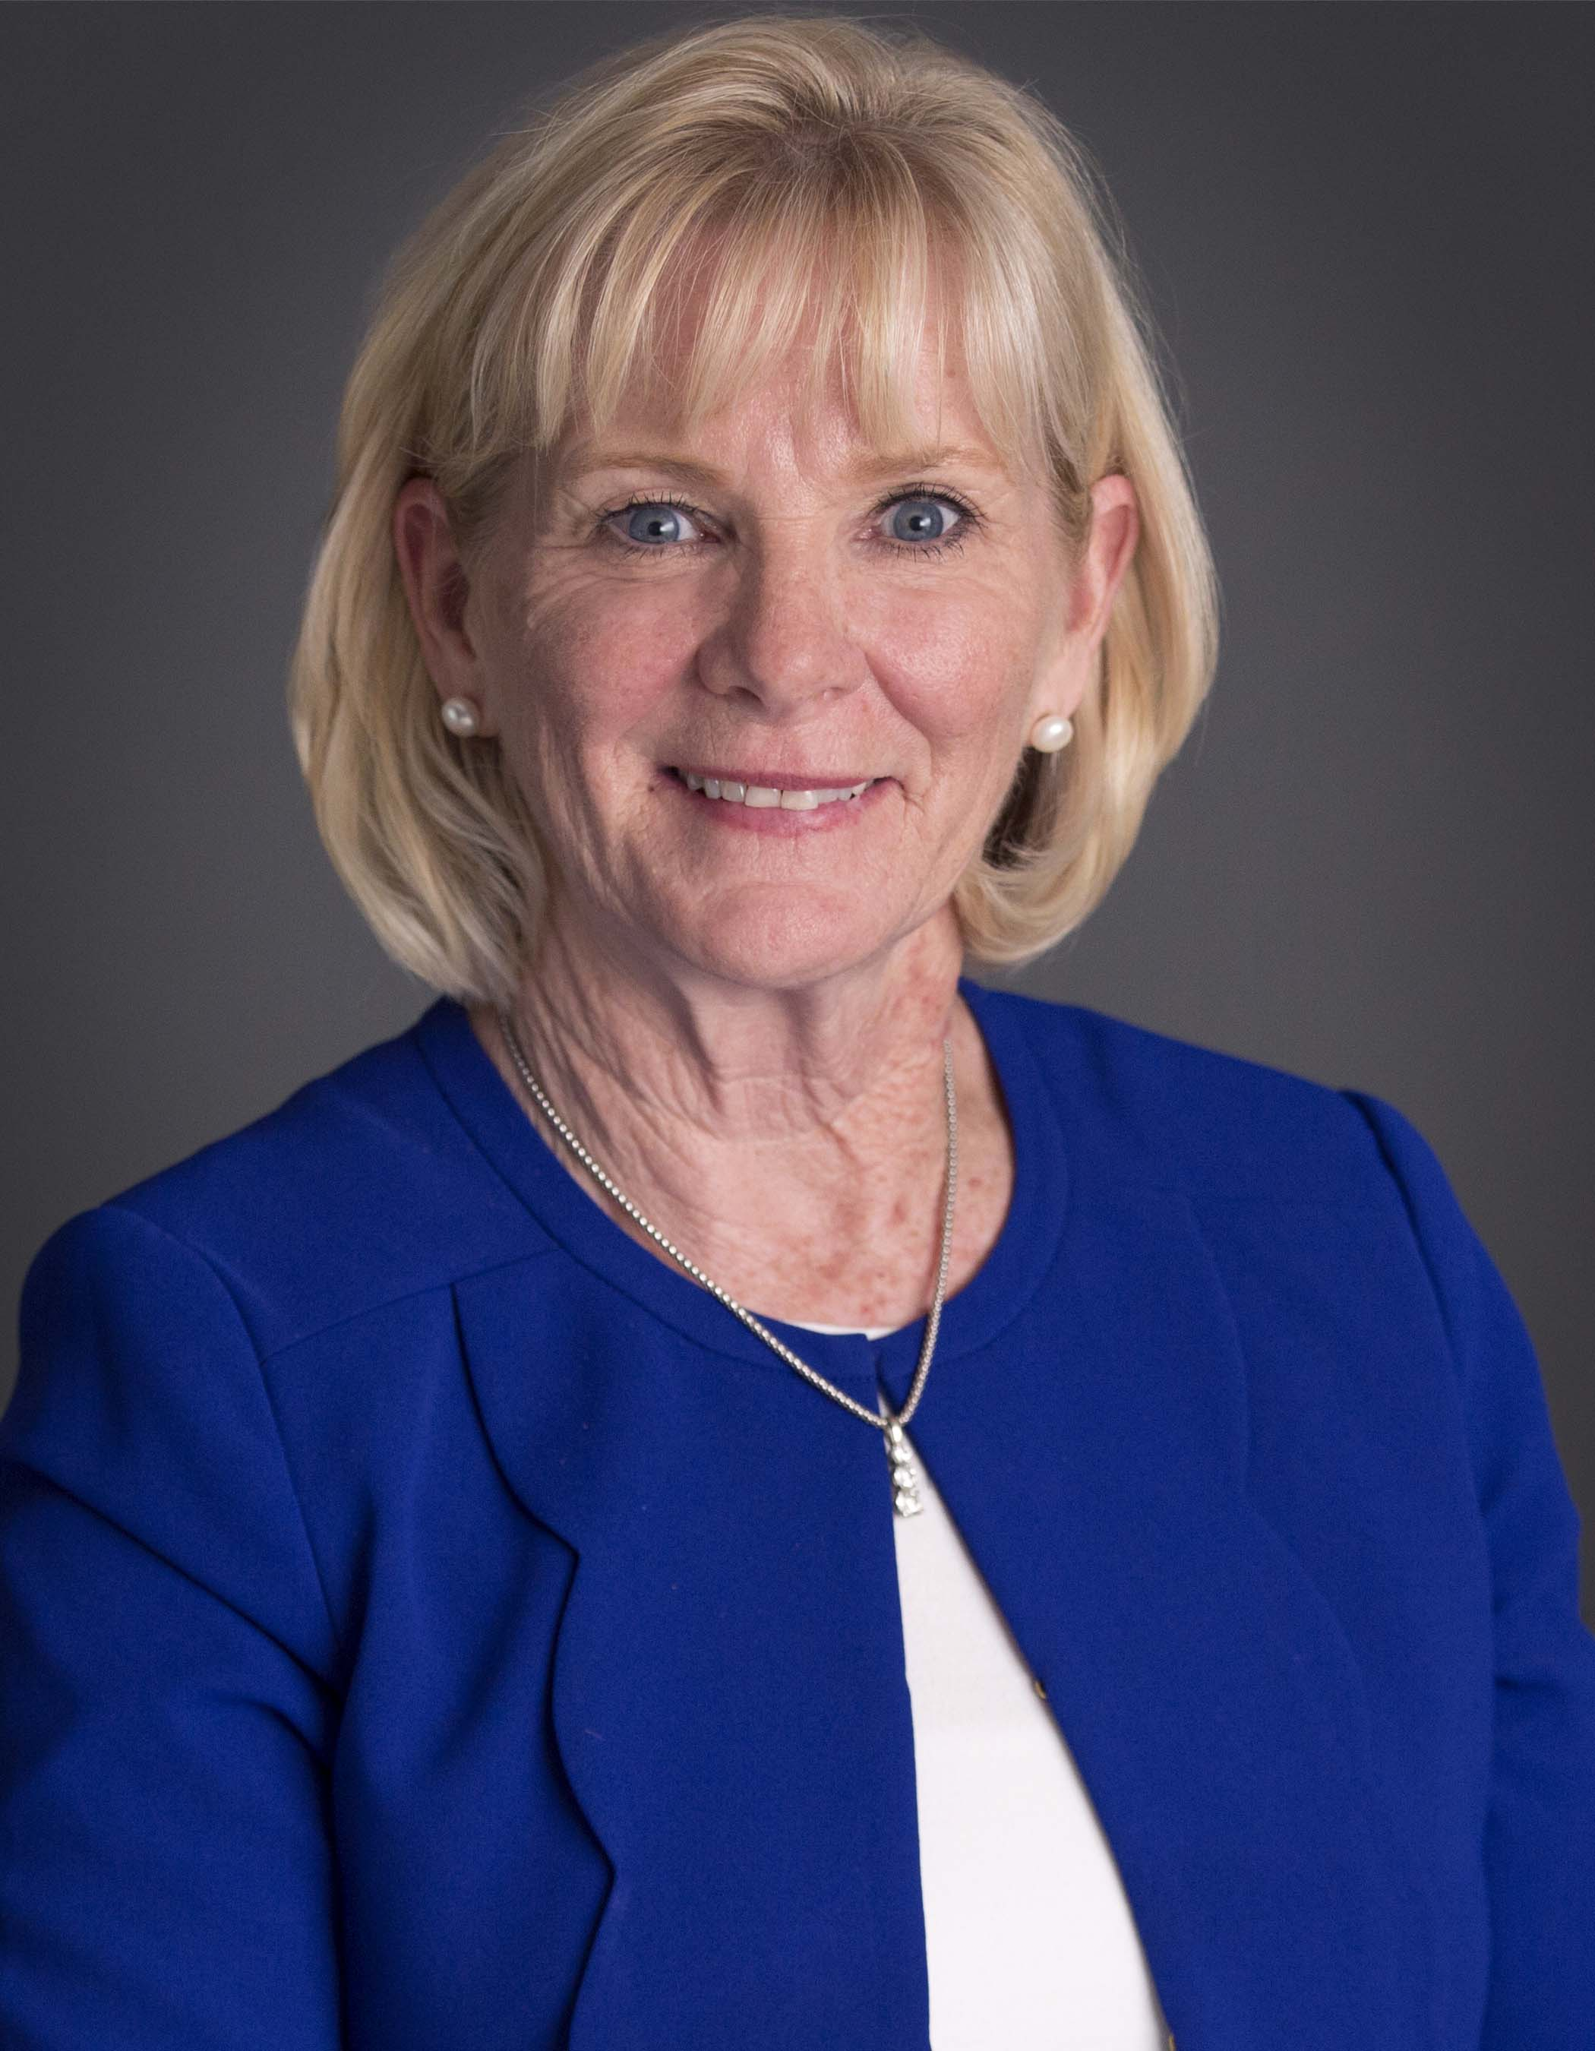
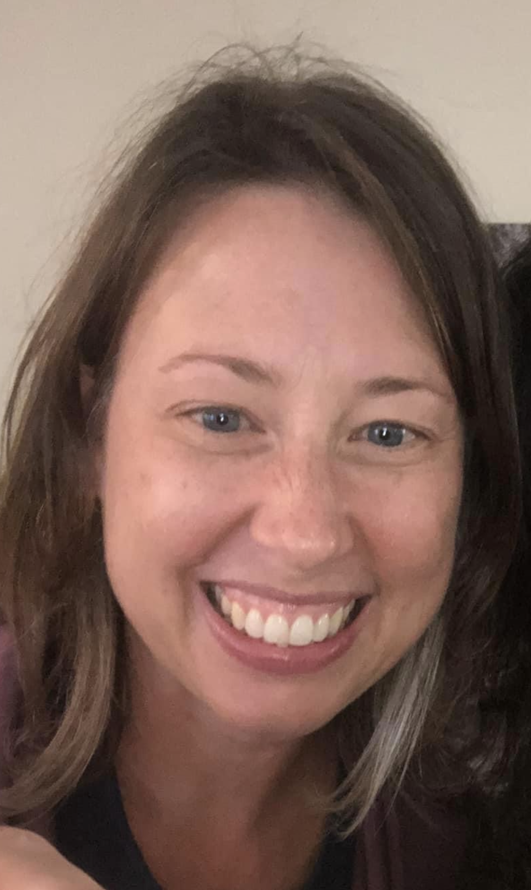
About Us
Mary K. Requa, PhD
Assistant Professor
Department of Special Education, MMSN Program
San Francisco State University
mrequa@sfsu.edu
Jill Yochim, MA
Doctoral Student
Joint Doctoral Program at University of California, Berkeley and
San Francisco State University
jyochim@sfsu.edu

Slide 4
Our Purpose:
To demonstrate the effectiveness of our test preparation workshop in supporting PSTs to successfully take and pass the Reading Instructors Competency Assessment (RICA)
To encourage institutions who prepare teacher candidates to consider offering a no-cost RICA test preparation to their PSTs.
Notes:
Low cost to the institution, with only honorarium or stipend provided to instructors.
Since we implemented these sessions, our pass rates have improved when compared to overall success rates in the state of California.

Slide 5
Examine the effects of a four-hour online RICA test preparation workshop on pre-service teachers (PSTs) examination pass rates.
Identify ways in which teacher preparation programs can aid in preparing PSTs for the Reading Instructors Competency Assessment (RICA) by providing a test preparation workshop.
Learning Outcomes
Acknowledge that testing requirements can be a barrier or “roadblock” that challenges both PSTs and the schools who need them.
Learn about the factors that inhibit or enable teacher candidates to pass required tests.

Slide 6
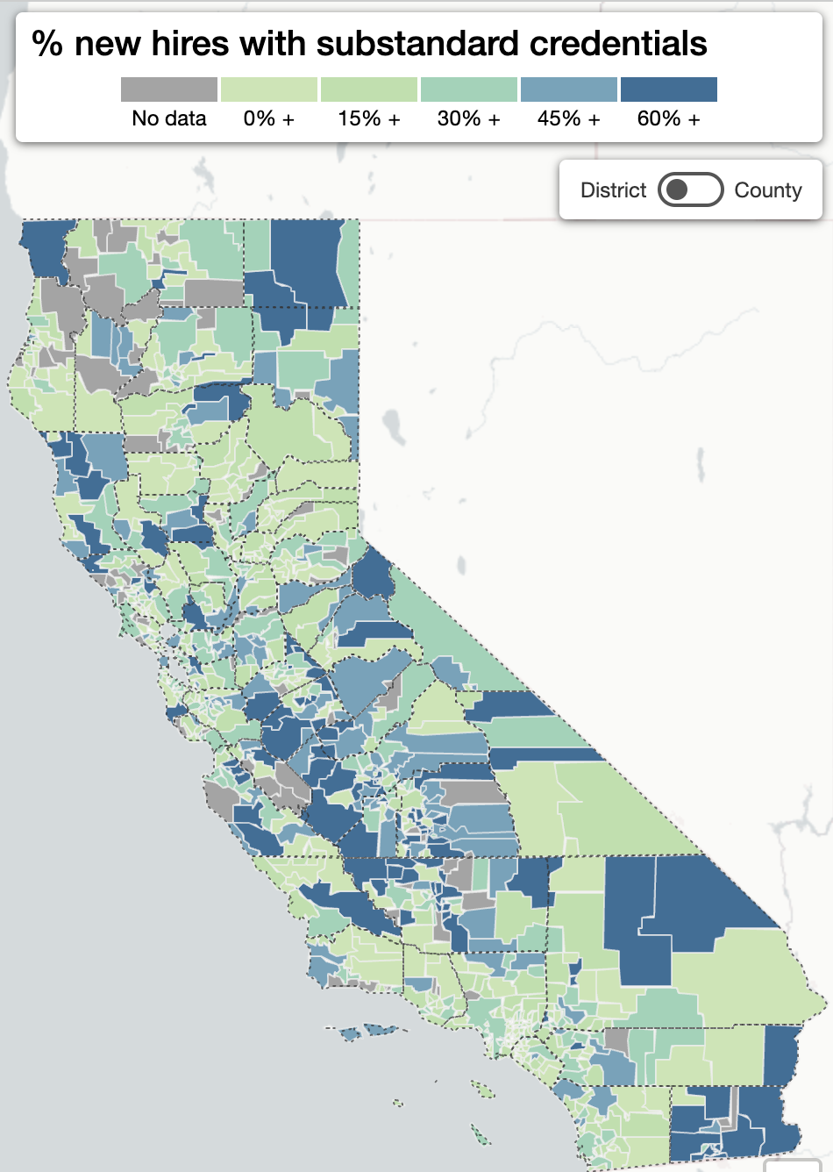
30,000
34%
4,126
Number of Newly Hired Teachers
in CA (2020)
Percent of New Hires with
Substandard Credentials
Teachers needed to reduce student-teacher ratio to pre-recession levels (2008-2012).
Learning Policy Institute. (2019). Understanding teacher shortages in California: A district- and county-level analysis of the factors influencing teacher supply and demand (interactive map). Palo Alto, CA: Learning Policy Institute.
Notes:
The U.S., and California in particular, has experienced recurring teacher shortages for decades and there are real barriers to entry in terms of standardized, requisite testing for licensure.

Slide 7
A study of California districts in which students outperformed their peers statewide found that, overall, these districts employed fewer teachers on substandard credentials and permits than the state average. After controlling for several school and community characteristics, these lower rates of hiring teachers on substandard credentials were associated with significant increases in student academic performance, especially for African American and Latino/a students.
Notes:
Based on research on attracting and retaining teachers, Carver-Thomas and colleagues (2020), in collaboration with the Learning Policy Institute, have identified strategies that state and local agencies in California can implement in order to address ongoing teacher shortages, particularly in high-need fields and schools. One identified strategy that most closely aligns to this presentation is to “streamline requirements for entry into the profession by considering multiple pathways for demonstrating competence for both in-state and out-of-state entrants to the profession”.
The growing number of substandard credentials issued by the state is an indicator that teacher supply continues to be insufficient to meet the demand.

Slide 8
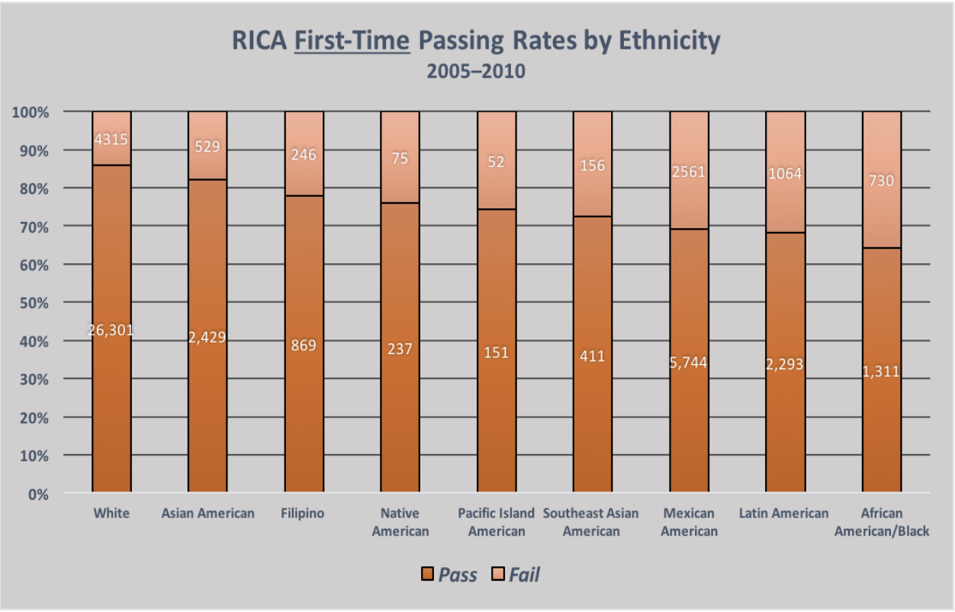
Teachers of color make up only 18 % of the public school teaching force (Goldring, Gray, & Bitterman, 2013).
Almost every state has a large teacher-student diversity gap.
Students of color represent 73% of California’s student enrollment but only 29% of the state’s teachers (Boser, 2014).
Ethnic disparities in passing the RICA are well documented (California Commission on Teacher Credentialing, 2010; Barlin, A., 2017).
The testing barrier significantly affects PSTs of color and may delay or even prevent them from entering the profession.
.
Notes:
Students benefit from teachers with cultural backgrounds similar to their own because such teachers provide real-life models of academic engagement (Ingersoll & May, 2011) which stimulates effort, interest, and confidence which enhances student performance (Dilworth, 1990).

Slide 9
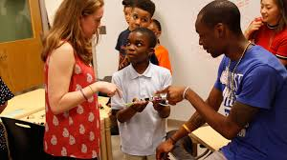
In 2013–14, on average, high-minority schools had four times as many uncertified teachers as low-minority schools.
The teacher shortage negatively impacts the neediest communities.
Highly qualified teachers may choose to teach in more highly resourced districts leaving high poverty communities with the highest number of underprepared teachers .
This is a very real threat to educational equity.
Carver-Thomas, D., Kini, T., & Burns, D., 2020
Sutcher, L., Darling-Hammond, L., & Carver-Thomas, D., 2016
Notes:
Low-achieving schools were nearly five times as likely as high-achieving schools to employ these teachers; high-minority schools were nearly seven times as likely as low-minority schools to employ them.
The current teacher shortage is a crisis in many ways and for many people, but children in high-poverty communities of color are suffer most (Johnson, Berg, & Donaldson, 2005; Redding & Smith, 2016).
data from the California Commission on Teacher Credentialing (CTC) and public- and restricted-use student and staffing data from the California Department of Education (CDE)

Slide 10
In a survey recently conducted by Hardacre and colleagues (2021), respondents reported that their teacher education programs did not prepare them well for the exams and suggested more test prep workshops.
Hardacre, B., Hafner, A., & Nakama, P. (2021). The Impact of Test Anxiety on Teacher Credential Candidates. Teacher Education Quarterly, 48(3), 7-28.

Slide 11
Factors Affecting Success
Test Anxiety
Lack of access to test practice materials
Poor Test Taking Skills
Notes:
As with any high-stakes test, the actual performance of a test taker can be affected by many different factors aside from lack of content mastery including test anxiety, poor test taking skills, or lack of access to test practice materials. Preparation programs such as ours, at no cost to students, can aid in preparing teacher candidates for tests and relieve some of their test anxiety through content review and practice as well as an overview of testing strategies. High rates of anxiety can contribute to poor academic performance in students, and this kind of anxiety may lead to low confidence or to poor performance on exams (Putwain & Symons, 2018).
The purpose of the RICA is to ensure that California-trained candidates for Multiple Subject Teaching Credentials and Education Specialist Instruction Credentials possess the knowledge and skills to provide effective reading instruction to students. In order to ameliorate the challenges PSTs encounter in attempting to successfully pass the RICA, we offer our teacher candidates a no cost, four-hour, fully online, synchronous test preparation workshop each semester. Online learning increases information retention and requires up to 60% less time to learn new information, according to the World Economic Forum (Li & Farah, 2020). Therefore, Institutions of Higher Education who prepare new teachers are well situated to provide programs, materials, methods, and content in cost effective, efficient ways.

Slide 12
Components
of the workshop
Intensive review of the fundamental underpinnings of literacy acquisition
Testing practice items and resources
Practice in writing constructed responses to case study literacy scenarios
Test taking strategies
Notes:
Materials used in our workshop can be found here:

Slide 13
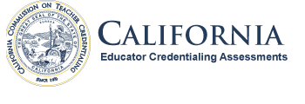
Data Sources
edReports
Commission Educator Credentialing Examination edReports
CA Test Takers
RICA pass rates: all test takers in the State of California from 2018- early 2023.
SFSU GCOE Test Takers
RICA pass rates: test takers in the SFSU Graduate College of Education from 2018- early 2023.
SFSU GCOE Test Prep
RICA Pass rates: PSTs who participated in Test Prep 2018-early 2023.
Event Brite Student Registration records
Notes:
Since we implemented these sessions, our pass rates have improved when compared to overall success rates in the state of California.

Slide 14
Table 1. RICA Pass Rates 2018- early 2023
Notes:
We examined RICA pass rate data for our students from 2018 through 2022 collected from the Commission Educator Credentialing Examination edReports. Initially, we compared our PSTs’ RICA pass rates to all test takers in the state of California from 2018 – 2022. While fewer students attempted the RICA during the height of the pandemic (2020-2021), the data suggests that, when comparing our teacher candidates to PSTs across the state, our students had higher pass rates overall (Table 1).

Slide 15
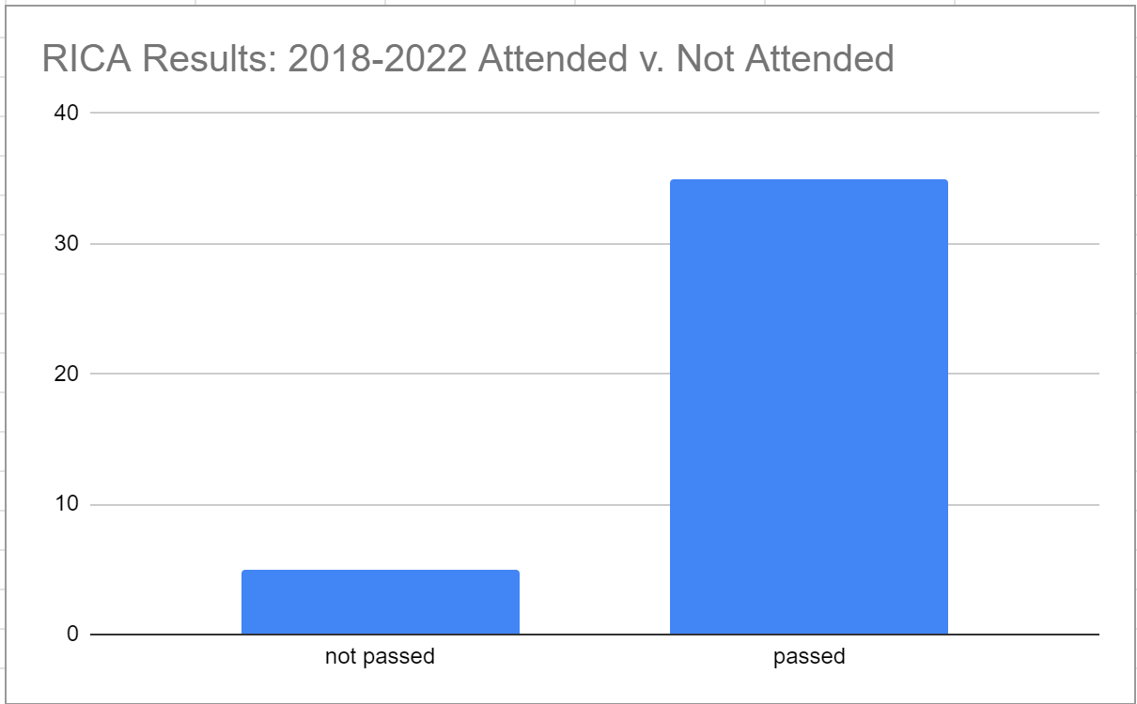
Table 2. RICA Results of Test Preparation Participants 2018-early 2023
Notes:
We then examined testing outcomes for students within our university. Results suggest that students who participated in the test preparation session experienced greater pass rates when compared to those who did not participate (Table 2). This project informs teacher preparation programs about one way they can support teacher candidates in passing required tests.
Our data indicate that PSTs will benefit from relatively a low-cost test preparation workshop. We focused on content as well as test-taking skills which can help alleviate anxiety. With just one online session, our students demonstrated positive results in passing the RICA.

Slide 16
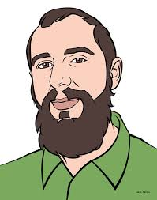
Testimonials
Ethan
Natalie
I wanted to let you know that I passed my RICA earlier this month. Thank you again for your workshop, I think it made the difference.
This morning was amazing. Thank you so much for the workshop and for all these incredible materials!
Lili
Brian
Just got my results for the RICA. I passed!!!!Thanks for all of your help and support. It is truly invaluable..
Thank you for teaching the RICA this past weekend. It was very helpful and informative.

