Slide 1
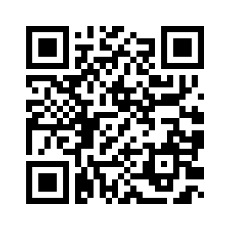
Addressing Implicit Bias in Teacher Education
https://tinyurl.com/addressingimplicitbias
CCTE Conference
March 13, 2023
Cindy Collado, Assoc. Prof. Sacramento State
Jaci Urbani, Assoc. Prof. Mills College at Northeastern
Belle Manalo, ECE, ECSE, MEd.
Naomi Gonzales, ECSE, MEd.
Notes:
Cindy kicks it off with title and introducing self then Jaci

Slide 2
Are you ready?
To learn about…
A great resource with ideas for addressing implicit bias in your teacher preparation programs
How to create an action plan for integrating cultural consciousness activities to address teachers’ bias within your programs to build a more equitable on-ramp to inclusion.
Then you’re in the right place!
Notes:
Jaci We got into education because we’re good people. Our implicit biases are getting in the way of being good teachers… so we need to do the work of retraining our brains because they’ve been influenced by society, by our non-inclusive experiences, and the ableist systems in place…

Slide 3
What are IMPLICIT BIASES?
What is CRITICAL CONSCIOUSNESS?
Notes:
Jaci
Use critical thinking to examine internal prejudices (Freire, 1998)
Identify inner beliefs by assessing words & actions and circumstances where they occur (Bem, 1972)
Identify how oppressive actions and systems sustain or
perpetuate inequities
Determine how individual prejudices and practices may support or disrupt them (Jemal, 2017; McNeal, 2016)

Slide 4
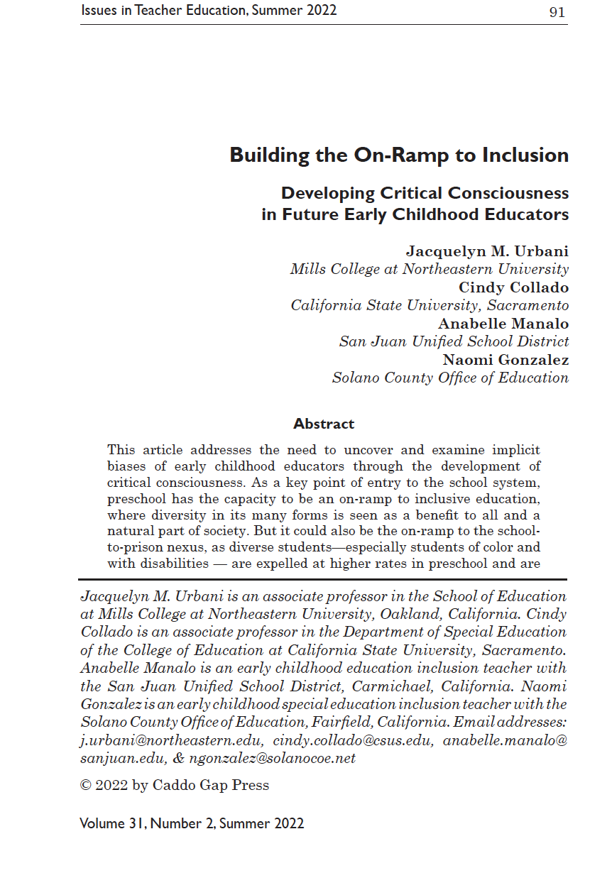
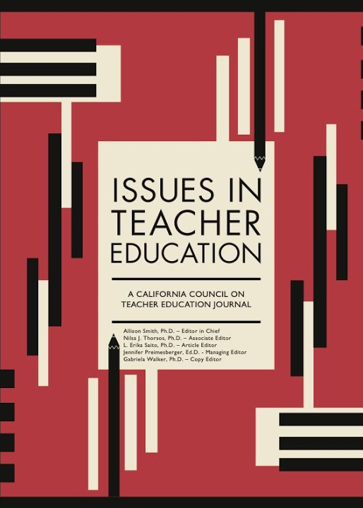
Our Practitioner Report
Reviewed course syllabi, evaluations, and student work across multiple courses
  Across 2 universities
  In credential, undergraduate, & graduate programs
  With diverse students
Analyzed through DisCrit lens
  Identified 3 responsibilities
  Strategies aligned with the 4 Anti-Bias Goals of early childhood

Slide 5
Our Education System is Racist and Ableist? What???
3x
2.5x
“Students of color also receive more stigmatizing disability labels requiring more extensive support needs, and these tend to be equated with a need for segregated placements (Kurth et al., 2019)” (Urbani et al., 2022)
Yes! It’s true…
Black Preschool Boys 3x more likely to be expelled than K-12 students
Students with disabilities 2.5x more likely to be expelled than students without disabilities
Notes:
As a grad student who recently graduated from sac state’s teacher preparation program, it was powerful for the program and professors to address Critical Consciousness as it made me more aware of my (inclusive) teaching practices. The reason why we need to have Critical Consciousness as educators is because the education system is Racist and Ableist. To be able to move past this oppressive system, we first have to come to terms and understand that this is TRUE. Data shows that Black preschool boys are 3x more likely to be expelled than k-12 students. Students with disabilities are 2 and a half times more likely to be expelled than students without disabilities. Students of color also receive more stigmatizing disability labels requiring more extensive support needs, and these tend to be equated with a need for segregated placements
In the research, it is argued that segregated placement settings for our students with disabilities is the modern way to segregate our marginalized students (BIPOC = Black, Indigenous, People of Color )

Slide 6

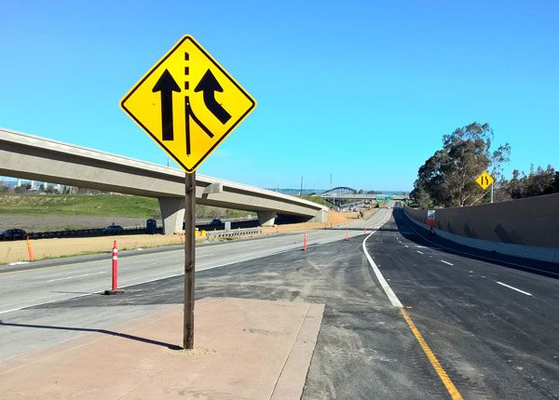
School to Prison Nexus
Focus only on evidence-based practices while ignoring equity principles and diversity.
Accept education system as working and unbiased.
Educators
Notes:
As candidates are being prepared in teacher preparation programs, traditionally, the focus is only on evidence-based practices, thus ignoring equity principles and diversity. This is deficit thinking where we believe that there’s only one way to behave and act in our education system; we’re accepting that the education system as working and unbiased. And because educator preparation program is focusing more on compliance approach and deficit thinking, were looking towards “fixing” our students and ultimately moving them to segregated settings to work on that compliance. This leads to the School-to-Prison Nexus because what’s happening for our candidates is that our BIPOC students are more observed and watched in our school system, leading to having different expectations for them and consequently students getting moved to segregated settings to address those different expectations and that segregation continues all the way through the school-to-prison pipeline.

Slide 7

Inclusive Education For ALL Children
Create opportunities for students to develop equitable instructional practices
Analyze oppressive policies and practices
Educators
Notes:
Belle
To counter this in our education system, we need to train our candidates on asset-based approach - and for educators to have the end goal of inclusive education for all children in mind. Candidates are taught about backward mapping. If our goal is not the school to prison nexus, but inclusive education for all children, we need to teach them how to create opportunities for students to develop equitable instructional practices while simultaneously analyzing oppressive policies and practices. Asset-based thinking is when we realize there’s many ways to behave and act and so we create multiple opportunities for children to engage and learn in our spaces, leading to inclusive education for all children.

Slide 8
So…
If… our Implicit Biases influence the way we treat and teach diverse children…
Then… we need to proactively address these biases so all children can benefit from our education system.
Notes:
Belle - read the slide
If… our Implicit Biases influence the way we treat and teach diverse children…Then we need to proactively address these biases so all children can benefit from our education system.
Implicit bias is defined as an individual’s “attitudes or stereotypes that affect their understanding, actions, and decisions in an unconscious manner” (Staats, 2016, p. 29).

Slide 9
3 Responsibilities of Teacher Educators
1. Serve as a Model
2. Facilitate Difficult Conversations
3. Be Lifelong Reflective Learners
Notes:
Jaci

Slide 10

Connecting the 4 Anti-Bias Goals of Education
to Critical Consciousness
Identity
Diversity
Justice
Activism
Assumptions & Privileges
“Comfort & Joy”
Anti-Bias
Identify Inequities
Address Inequities
Notes:
Cindy - by 3:25p

Slide 11

Equity Pause
Creating the Onramp to Inclusion through intentional reflection & a shift to an asset-based approach
Making it Real
Developing Critical Consciousness in Teachers
Notes:
Ensure integrate equity pause into your program across the 4

Slide 12
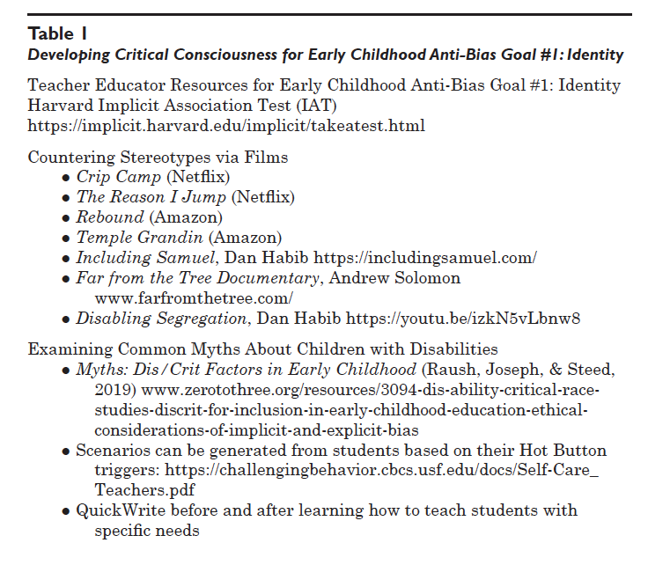
More Ideas for Identity activities…
See Urbani et al. 2022
Little Man by Nicole Kahn
Write assumptions about behavior and reframe it
Watch a video about family watching TV and their assumptions
Reflect on qualifiers for prek inclusion - shift it to just every child belongs in prek
Notes:
Cindy

Slide 13
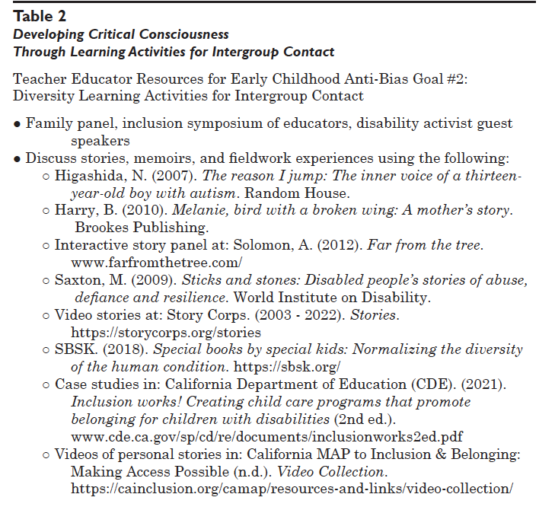
Ideas for Diversity activities…
See Urbani et al. 2022
Book Clubs/Literature Circles
Jigsaws
Intergroup Contact

Slide 14
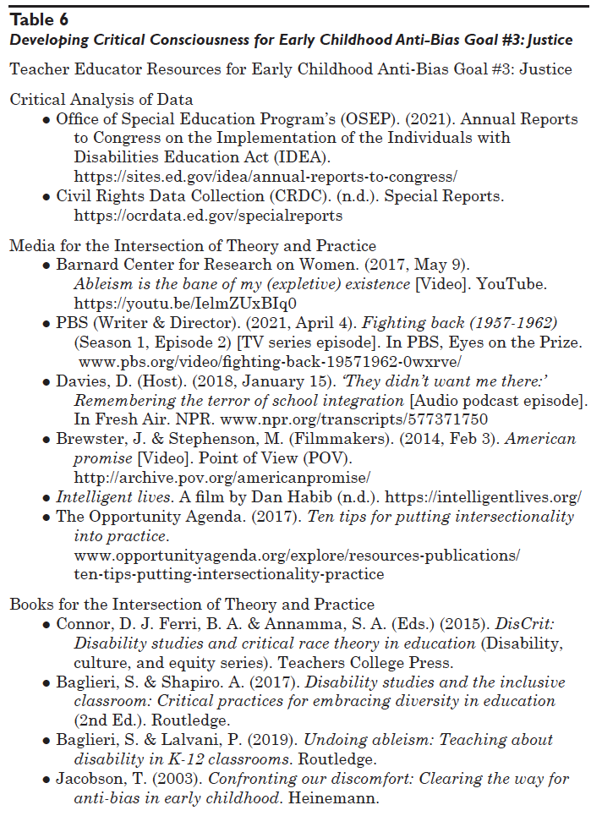
More Ideas for Justice activities…
See Urbani et al. 2022
Notes:
Jaci

Slide 15
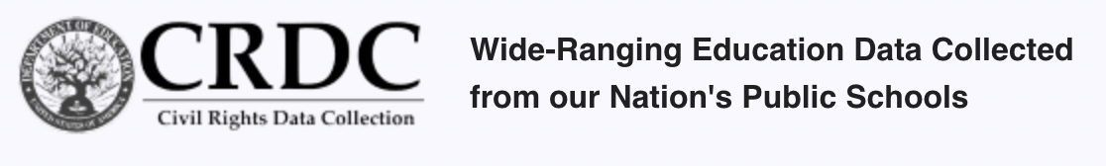
Activism Ideas
Asset-based approach to projects & skills (e.g., IEP writing, etc.)
Integrate Critical Consciousness throughout program
TEACHING
Vestibulum congue
Making action plans for change
Analyzing LRE data
Notes:
Jaci

Slide 16
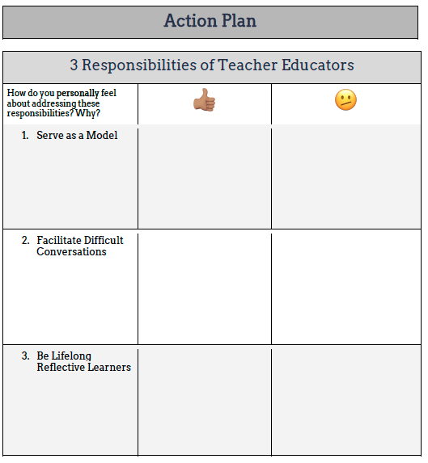
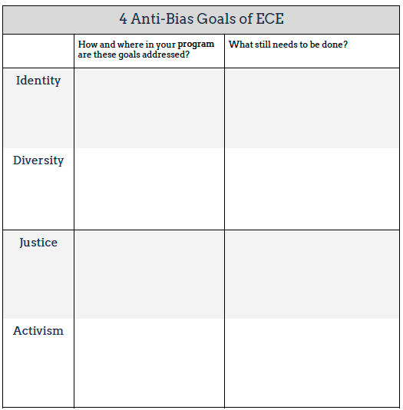
Your Action Plan

Slide 17
References
Bem, D. J. (1972). Self-perception theory. In Advances in Experimental Social
Psychology, 6, 1-62. Academic Press.
Freire, P. (1998). Pedagogy of freedom: Ethics, democracy, and civic courage. Rowman
& Littlefield Publishers.
Jemal, A. (2017). Critical consciousness: A critique and critical analysis of the
literature. The Urban Review, 49(4), 602-626.
McNeal, L. R. (2016). Managing our blind spot: The role of bias in the school-to-prison
pipeline. Arizona State Law Journal, 48, 285.

Slide 18
Urbani, J. M., Collado, C., Manalo, A., & Gonzalez, N.
(2022, Summer). Building the on-ramp to inclusion:
Developing critical consciousness in early childhood
educators. Issues in Teacher Education, 31(2), 91-121.

Slide 19
Cindy Collado, Assoc. Prof.
Sacramento State cindy.collado@csus.edu
Jaci Urbani, Assoc. Prof.
Mills College at Northeastern (j.urbani@northeastern.edu)
https://tinyurl.com/addressingimplicitbias

Slide 20
Thanks!
Please keep this slide for attribution.

