Slide 1
Making Teaching Possible for BIPOC Candidates
The California Coalition for Educator Diversity
Notes:
Kai

Slide 2
The Coalition
A group of researchers, practitioners, and advocates committed to advancing teacher diversity and equity in schools through uplifting humanzing, evidence-based, policy, practice, and research.
Notes:
KAI
A group of researchers, practitioners, and advocates committed to advancing teacher diversity and equity in schools through elevating humanizing, evidence-based, policy, practice, and research.
In many ways the space that this collective group of individuals has created, mimics our vision for education. It’s been a space where we have shared a professional and personal wins and losses. A space where information, guidance, and support is shared and given freely. It’s been nurturing and empowering, and in so many ways, humanizing the work that each of us do.

Slide 3
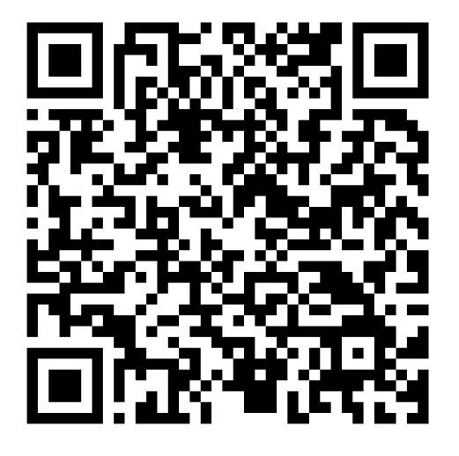
Why the Funding Guide?
Increase Access to Resources
01
02
Humanizing the Cost
Notes:
KAI
Increase Access to Resources
The funding is disjointed
Knowing where to go, how to find information about RFP’s, deadlines, how the funds need to be used
For schools and districts that have lower staff capacity, less resourced schools it is more difficult
Piecing together & finding these resources is time consuming, time that schools with lower staff capacity might not have available.
Humanize the Cost
Money is just a resource, how we spend it matters
And how we spend it should reflect the values and aims we have as a community of learners.
If we say we want schools to be more diverse and inclusive spaces, then how we spend our funds should reflect that
In the guide we highlight, how funds can be used to promote diversity efforts and/or support in humanizing the profession
How we spend it is even more important in generating schools that are inclusive and diversity

Slide 4
Humanizing the Teacher Profession
Ensuring the pipeline process is equitable and inclusive
Acknowledge and name the policies and practices that dehumanize (dismiss, devalue, diminish, and discredit) teachers
Policies and Practices that holistically support the wellbeing of Teachers
A livable wage or viable salary
Climate & Culture where BIPOC candidates and teachers feel safe, welcomed, supported, and valued
Adequate support and resources that reflect the value we as a society place on the importance of K-12 education
Having the agency to continuously learn, grow and evolve in the ways we recruit, prepare, and support teachers
Notes:
KAI
Life long learning is not just a catchy euphemism we pedal to kids, As learning organizations the onus is on us to continuously reflect and interrogate our own systems and unapologetically evolve and change to meet not just the needs of our students, but of our teachers and for the benefit of Education as a whole.

Slide 5
Conditions for Systems Change
Practices
Structural Changes
Resources Flows
Policies
(Explicit & Tangible)
Relationships &
Connections
Power Dynamics
(Semi-Explicit
&
Semi-Tangible)
Mental Models
Transformative Changes
(Implicit & Intangible)
Graphic by: The Liberatory Classroom
Notes:
KAI
When we look at it from a systems change perspective money and funding alone will not humanize the teaching profession. This image is adapted from Peter Senge’s inverted triangle model.
Policy - Rules & priorities that guides action
Practice - Agreed upon activities & habits
Resource Flow - Allocation of money, people & knowledge
Connections & Relationships - Quality of connections between the stakeholders in the system
Power Dynamics - Who holds decision-making power? Who gets to contribute to these decisions?
Mental Models - Habits of thought—deeply held beliefs and assumptions; ways of operating that influence how we think, what we do, and how we talk.
1865 Example

Slide 6
The Educator Pipeline
Interest & Recruitment
Preparation & Initial Experience
Licensing & Certification
Hiring
Continuous Support & Development
Notes:
KAI

Slide 7
Structural Barriers to Entry
01
Financial Cost
Golden State Teacher Grant
National Board Incentive Program
Classified School Employee Program
02
TEP Structure
Integrated Teacher Prep Program
Golden State Pathways Program
CA Teacher Residency Program
03
Testing
Teacher Exam Fee Waivers
Notes:
Kevin
As noted into the analogy of the iceberg, structural barriers are some of the issues that first become apparent when we are working towards system change. These include categories of practices, policies and resource flows. When seeking to attend to teacher education pathways and removing barrier for BIPOC candidates, members of the Coalition named three structural barriers that commonly hinder candidates in this community: Financial Costs, Teacher Education Program structures, and Testing requirements.
As we know, financial costs to attend a teacher education program can be prohibitive for students. Paying for tuition while engaged in student teaching and coursework often means that students must either have reserved savings or take out substantial loans. For those students whose work income may also support other family members or children, this pathway seem unrealistic or leaves them with an undue burden of debt.
The Coalition has identified some funding sources aimed at helping to lower the financial burden of entering a teacher education program. These include the Golden State Teacher Grant, The National Board Incentive Program (subsidy grant for teachers interested in getting certified and incentive or NBC teachers to teach in priority schools), and the Classified School Employee Program.
For some candidates, the structure of the teacher education program may be a barrier. For example, a student who is financially dependent on present employment while also seeking a teaching credential through a teacher preparation program may find it difficult to be engaged in full-time teaching while also completing coursework. Calendars and internal timelines for completion of certain aspects of the program may be equally prohibitive.
Some financial resources have been allocated to assist with over coming some of these barriers such as the integrated teacher Prep program(building pathways where people can get their credential while getting their bachelor's), Golden state pathways program (Qualifying LEAs and community colleges), and the California Teacher Residency program.
Testing can be prohibitive for students for a number of reasons. Testing requires additional preparation - often above and beyond the coursework and fieldwork that students are engaged in. Testing expectations which overly burden students with additional responsibilities by overlapping with programmatic or field expectations can be barriers. The additional cost of tests and retests can be great barriers.
Teacher Exam Fee Waivers try to lessen the financial burden.
There are structural barriers, where money is being allocated.

Slide 8
Notes:
Kevin
WestEd looked at how frequently candidates in teacher residency programs experienced specific hardships around: food insecurity, housing insecurity, inability to pay bills, and inability to pay school expenses.
Over half of all residents indicated that they had experienced a inability to pay bills or housing expenses.
Almost a quarter did not have or were unsure about having access to health insurance.
Almost thirty percent
While there are some outstanding benefits to residency programs as we are developing pathways for teacher candidates, we are reminded that we must be aware of the financial and living needs of candidates that extend beyond the context of program tuition. this especially true if the structure of the pathways does not permit for maintaining additional employment.

Slide 9
Neutral/ Don’t Know
Notes:
Kevin
We asked newer teachers to “indicate whether each of the following components of their teacher preparation program have had a positive or negative impact on their preparation.”
All components of teacher preparation we tested for had more of a positive impact than a negative impact.
[Go through each component].
Clinical practice, 81% of teachers stated that these components had a positive impact on their teacher preparation.
We consider testing part of the process for clearing credential, even though testing wasn’t an explicit response option for the this question. We did ask a separate question around the various tests & assessments that teachers have to take.
So this is an overview of teachers perceptions of their teacher prep.

Slide 10
Large proportions of teachers say that each of the assessments we tested had no impact on their teacher preparation.
Notes:
Kevin
We asked teachers to “indicate whether each of the following assessments had a positive or negative impact on their teacher preparation”
We find that large proportions of teachers say that each of the assessments we tested for had no impact on their prep. However, we think it’s important to highlight how large proportions of the teachers we surveyed viewed these tests as having had a negative impact.
The edTPA, given the time and nature of the assessment, is a particular pain point for teachers, with only 9% stating it had a positive impact and 26% saying it had a very negative impact. That is larger than any of these positive percentages.
CSET: 28% of teachers say it had a negative impact
CBEST: 11% of teachers say it had a negative impact
RICA: 20% say it had a negative impact
EdTPA: 39% say it had a negative impact

Slide 11
Issues Money Does Not Solve
“For CSETs, you're on your own…What happens if I want to be able to study for it? Well, I have to pay for those workshops, which are not cheap [..] You can be a fabulous teacher and not be able to pass those tests because you don’t have the support.”
Mentorship
How we measure/evaluate candidates
TEP Structure
What tests are required and when
Recruitment interest & knowledge
Continuity within the Pipeline
Notes:
Charlotte
General feeling of aloneness and lack of support

Slide 12
Systemic Barriers to Retention
01
Culture & Climate
Educator Workforce Grant
Educator Effectiveness Block Grant
Anti-bias Education Grant
02
In-Class Supports
03
Viable Career Option
Notes:
KAI/Shilpa
Culture & Climate: of the teaching classroom
In- Class Support: resources within classroom, within their sites
Viable Career Options: the cost education. Living wages, Student Loans, Financial and holistic supports to thrive within the field
Robust, relevant and ongoing professional development
Prep periods
Paraprofessional and administrator support
Sustainable salaries
Other sources of financial assistance (e.g., housing, transportation and/or child care stipends or loan forgiveness programs)
Ongoing mentorship
What can we do that doesn’t require money?

Slide 13
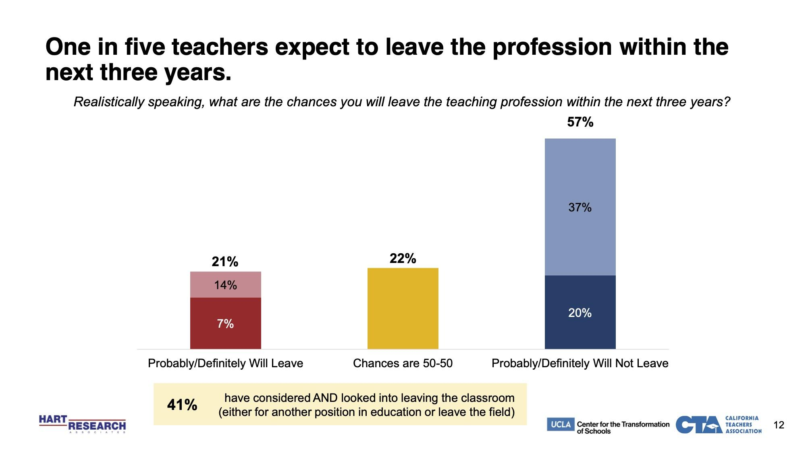
n = 4,632
Notes:
Shilpa
Top reason teachers are leaving are due to Burnout, low salary is actually 4th
What are our options to stem the tide?
More in-class support
Sustainable starting salaries and regular salary increases
Meaningful opportunities to develop and exercise leadership skills
Other sources of financial assistance (e.g., housing, transportation, and/or child care stipends)
Supportive administrators who value each and every educator and create affirming and inclusive spaces of belonging for students and staff alike
Strong harassment and bullying prevention policies and clarity for staff regarding how to respond if they witness or observe perceived student-on-student bullying and harassment
A commitment by administrators to respond appropriately and effectively to notice of such conduct.
Devolution of teacher professionalism and a perception that this is a school where things are swept under the rug
What does it mean when we replicate harmful cycles?

Slide 14
Notes:
Shilpa
These racially discriminatory experiences start being felt while teachers are in their prep program, our survey data indicates that this continues throughout their teaching career.
Weighted n
Latinx: 1,251
AAPI: 392
Black: 185
Native American: 32
Less than half of teachers strongly agree that:
The environment at their school is supportive of different cultures (41% strongly agree) and different identities (36%).
Their fellow teachers demonstrate a genuine commitment to cultivating diversity (31%).
The leadership at their school demonstrates a genuine commitment to cultivating diversity (32%).
Their school makes a genuine effort to involve a diverse group of employees in decisions and policies (24%).
Though diversity, equity, and inclusion have become topics of national conversation, the impact of these efforts on practice, policy and implementation for many teachers is inadequate.

Slide 15
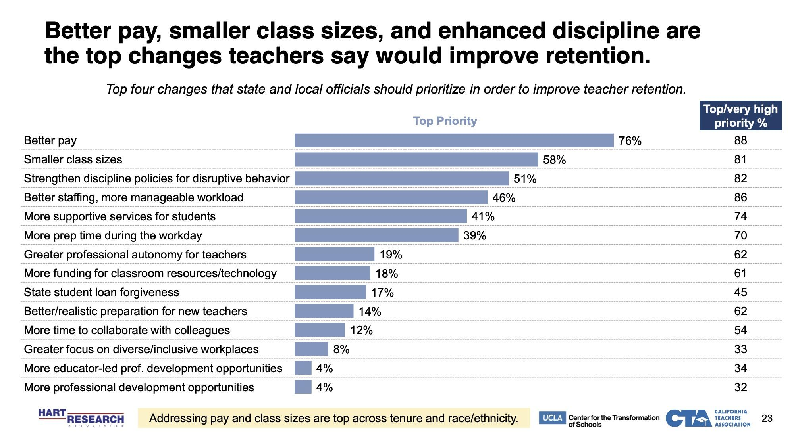
Notes:
Shilpa -
This is what teachers believe would induce more people to stay and promote retention.
Walk people through what they see and Kai can hop in.
Primary reasons why educators are thinking about leaving the profession:
Workload, long hours
Low pay and salary that can’t keep up with inflation

Slide 16
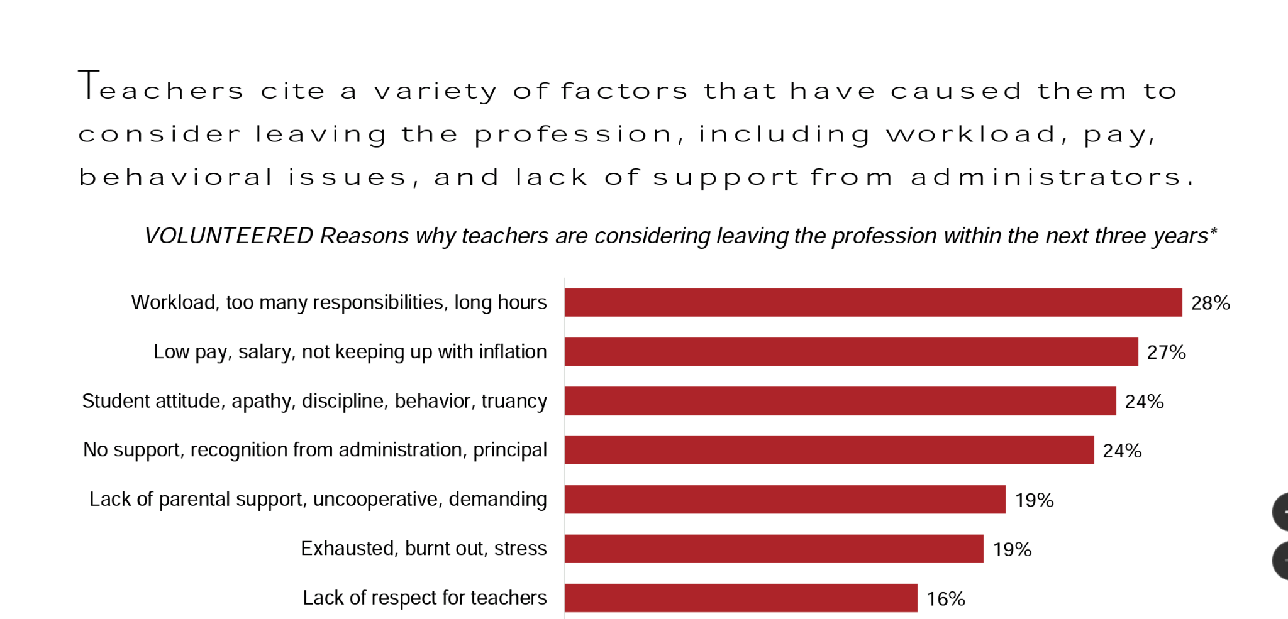
Notes:
Shilpa
Qualitative Data-
Greater focus on workload and responsibility. It’s not realistic - the breadth of what we ask teachers to do. These are things that teachers may not have been prepared for in their preparation.

Slide 17
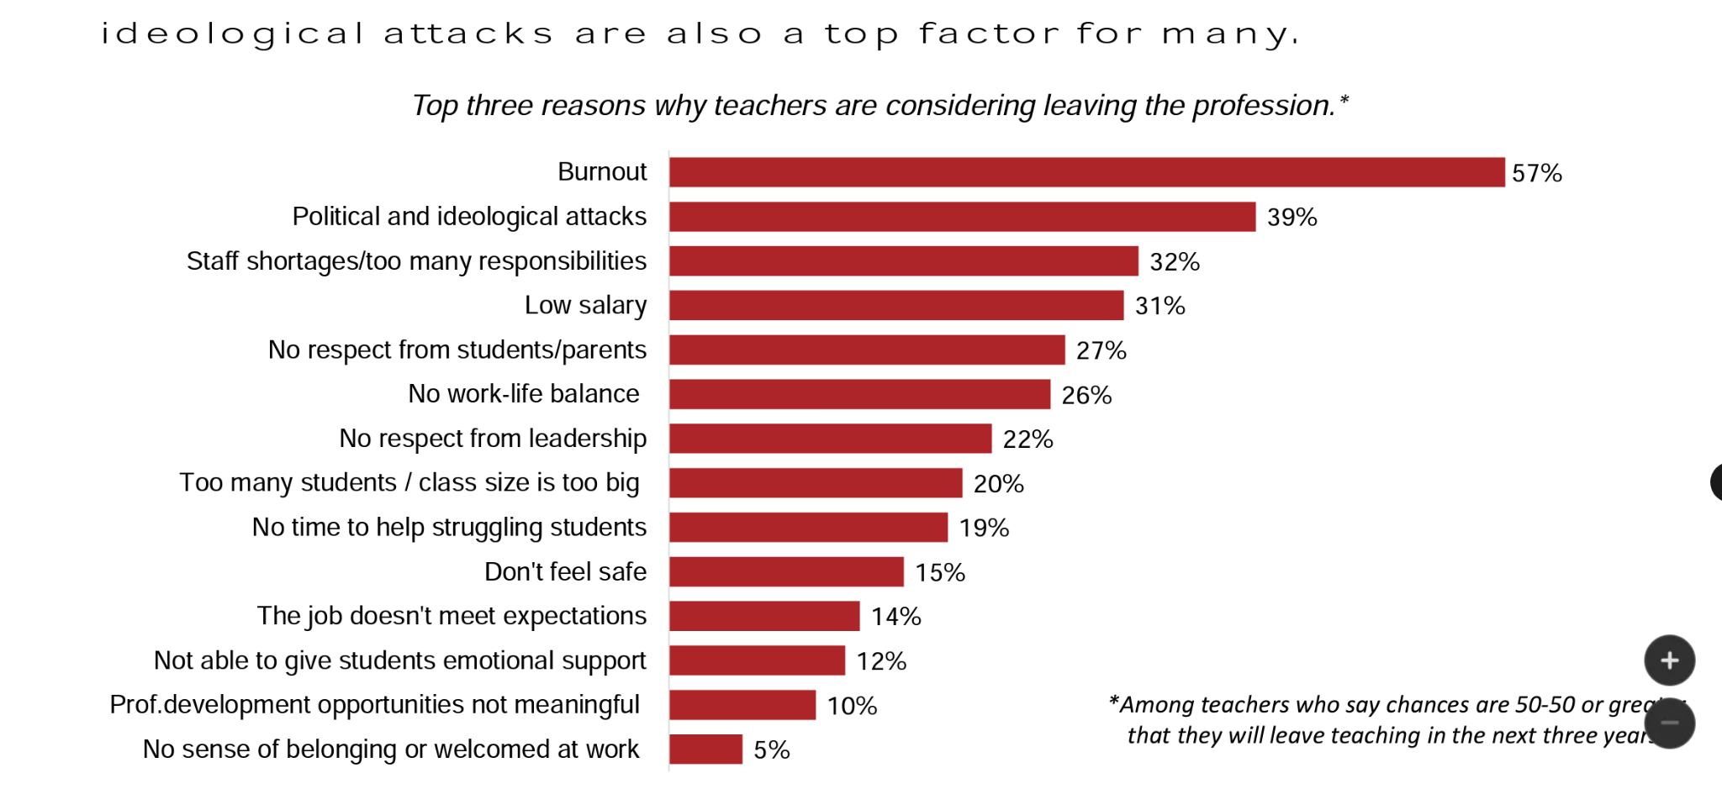
Notes:
Shilpa
Political and ideological attacks rank so highly now. What are teachers responsible for? The ideological attacks on teachers and prohibitions on what teachers can teach are such that teachers are struggling to adequately prepare students for the diverse and beautiful world that they will fully enter. This is an issue even here in California, particularly in so-called purple areas - even if the issue may not be as much at the forefront as in other states.

Slide 18
Issues Money Does Not Solve
“When the others don’t see my racial group as a
minority since most of the students are predominantly
Asian. We get blanketed as all one group, doesn’t
matter what country our ancestors came from. They
automatically assume we are all Chinese.”
Adequate preparation for the realities of teaching
How are we operationalizing equity at our schools
Culturally responsive policies & practices
Notes:
Charlotte
General feeling of aloneness and lack of support
How do we create inclusive communities of belonging for students and staff?
How do we support educators of diverse backgrounds at school sites where they may feel isolated?
What creative solutions are possible of little cost?
What responsibility do TPP programs have to teach educators how to create/foster inclusive communities in their school sites? Can they foster a certain mindset and provide education about how power dynamics manifest and can be perpetuated?

Slide 19
How to sustain a thriving educator pipeline community?
Partnerships
Mutually Beneficial- reciprocal
Expansive and Inclusive
Community Members
Local Educational Agencies
Community Colleges
4-Year Institutes of Higher Education
Credentialing Bodies
Policy Makers
Collective Advocacy
Seek to address systemic and structural barriers beyond local control through informing state level agencies
Identifying barriers in policy and practice
Offering possible and equitable solutions
Petition for humanization of grant processes
Timeframes for application
Finances/personnel needed to apply/engage
Grant expectations timeline
Equity is operationalized in selection and distribution
Collective Action
Who is Responsible for What?
Data to support success of teachers “system wide,” including pre-preparation and career
Examine barriers which are in our control as the teacher preparation program level and address them
Creation of an easily usable directory of agencies and programs that are seeking to address specific issues as a resource
Recruitment
Preparation
Certification
Retention
Development
Notes:
Who is responsible for what (Kai), Kevin (partnerships) and Charlotte (collective advocacy) and Shilpa (collective action)
Naming responsibility
Noting that there are many people responsible from different aspect of each of the aspects of each of the “buckets of the pathway”
Acting collectively is a key aspect of this work
This addresses the silos that perpetuate the disjointed reality
This helps us to be very focused on what we are working on
Having access to the collective conversation to this end to help us to move forward in a united way

Slide 20
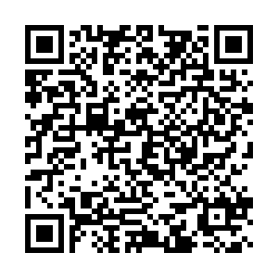
Q&A
What are some ideas you have for humanizing the teacher profession?
Where do you feel funding is lacking and/or does not adequately address the needs of BIPOC candidates?
What other system conditions need to be addressed?
How might we model the capacity, intentionality, & agency to learn, grow and evolve the way we do business in education?
Are our systems authentic to the unfinishedness of our humanity?
Notes:
Activity:
Take 10 minutes to discuss the following questions at your table. We will then open the floor for a short group conversation about ideas/topics that arose. Finally, time will be provided for individuals to answer these questions on a Google Forms survey. Responses will be anonymous. You may use the QR code in the lower left corner of this slide to access the form. Information gathered from this activity will provide insight in how we humanize the teaching profession and sustain a thriving educator community.

