Slide 1
Ethnic Studies Oral History Editorial Collective
Jesse Mills, Ph.D.
USD Ethnic Studies

Slide 2
What is the editorial collective?
Formed in October 2021
High school teachers and higher education scholars collaborate
Ethnic Studies teachers from three school districts
University faculty from USD, UCSD, and SDSU
Funding partner CSMP
Local oral histories ground curriculum and instruction
UCSD Race and Oral History Project
Notes:
Brief background of ESOHEC

Slide 3
What is the editorial collective?
Generate an open source repository
Monthly meetings, smaller working groups, convenings
Generate, refine ethnic studies lesson segments and support materials

Slide 4
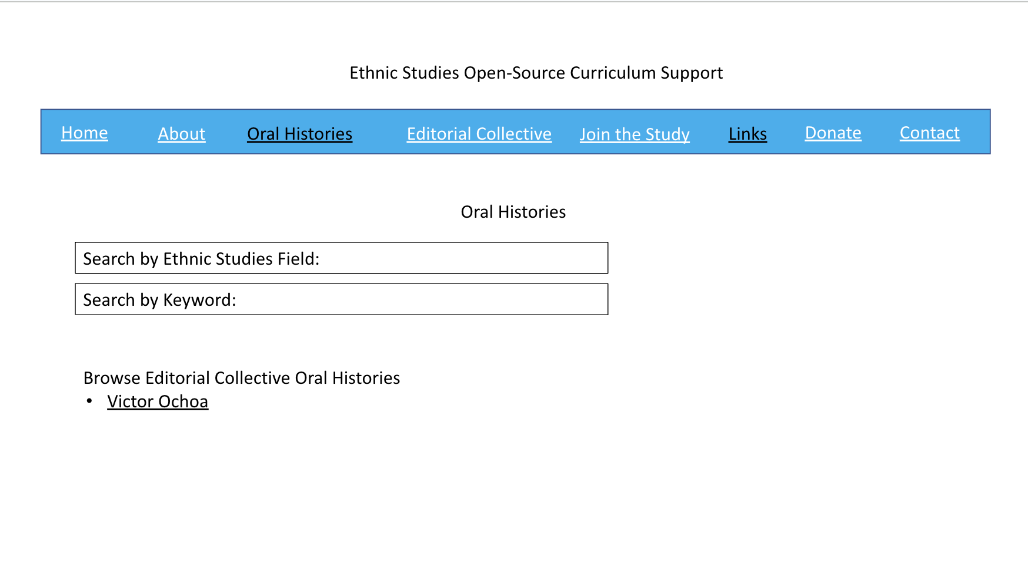
Notes:
Early mock-up of searchable oral history web repository

Slide 5
Notes:
The co-creation of support materials provides concrete points of collaborative and creative work.

Slide 6
Ethnic Studies Pedagogy
1
Importance of community responsive ES
“the cultural, political, social and economic spaces and places that shape student and family realities.” (Tintiango-Cublaes and Duncan-Andrade, 2021)
Notes:
Thus far we have learned much about supporting ethnic studies educators.
First, we learned that community responsive ethnic studies within the local context of the classroom and surrounding community is important. Teachers build local knowledge and relationships while students can engage ethnic studies in consistently relevant ways.

Slide 7
Ethnic Studies Pedagogy
2
Community nuances support complexities of ES
Racial and ethnic diversity
Intersectionality
Politics - attitudes about oppression and resistance
The global in the local
Notes:
Which racial and ethnic community narratives needed to be represented? Which narratives are available?
In San Diego, diversity and legacies of displacement, repression, and violence set the stage for engaging specific groups as well as comparative analysis between groups.
Complex layers of identity categories, in particular language, generation, citizenship status, as well as race, class and gender are prominent in the local narratives.
Communities are not monolithic in terms of views about justice/injustice, supporting or countering state or dominant forces, and pursuing freedom.
San Diego is a military border city and, aside from the narratives of Kumeyaay, Lusieño, Cahuilla, and Cupeño people, the narratives are narratives of migration and settlement.

Slide 8
Ethnic Studies Pedagogy
3
Support from local subject matter experts
Community knowledge bearers
Higher education scholars with local focus
Notes:
Subject matter experts are both higher education scholars with local area specialization, and also knowledge bearers within the community context itself. Teachers who are trained to collaborate with ethnic studies higher education and community knowledge bearers have significant support for engaging complexities of community responsiveness.

Slide 9
Ethnic Studies Pedagogy
4
Local oral histories guide community responsiveness
Notes:
To summarize, oral history has a unique accessibility. Building from community narratives in familiar language, beginning and advanced ethnic studies can all be supported. There is a structure for relationships and for working together. There is a value placed in people speaking on their own terms and naming their own experiences. There is the potential for familiarity and relatability, while also introducing students to see their familiar places in new ways.

Slide 10
Relationships
Curricular
Creativity
Knowledge
Notes:
The pedagogy of the Ethnic Studies Oral History Editorial Collective centers:
KNOWLEDGE-the content and methodologies of ethnic studies analysis
RELATIONSHIPS-directly working with subject matter experts at community and higher education levels
CURRICULAR CREATIVITY-creating dynamic and original curriculum in collaboration

Slide 11
Thank you!
Any questions?
You can find me at:
jessemills@sandiego.edu

