Slide 1

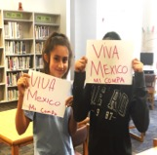
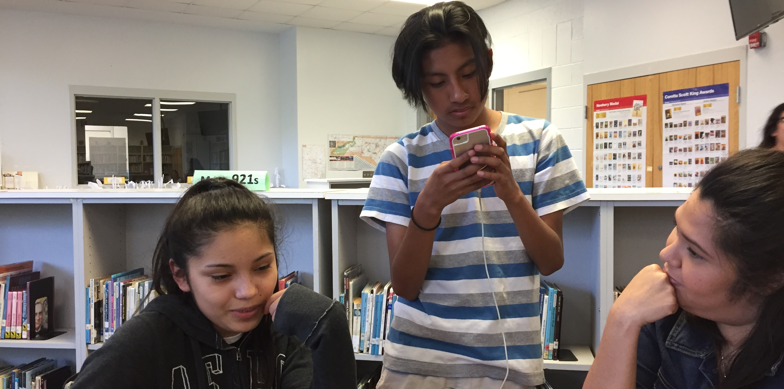
When Enthusiasm Leads Capacity:
Disciplinary Identity, Racial Narratives, & Professional Growth in the Context of Ethnic Studies Pedagogy
Michael Domínguez
Associate Professor
Chicana/Chicano Studies
San Diego State University
michael.dominguez@sdsu.edu
Notes:
Kumeyaay
Cultural tundra
Literacy as sanctuary
Not just feminist theory, but which PARTS of feminist theory…

Slide 2
A Core Question
How sincere are our commitments to the field of ethnic studies, its history, aims, & practices?

Slide 3
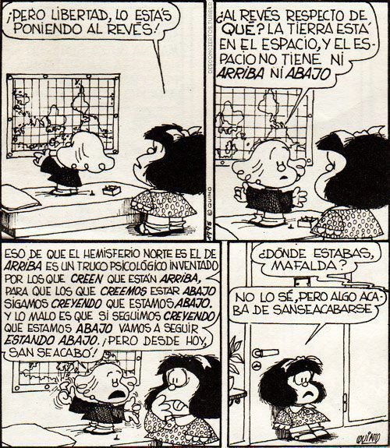
Ethnic Studies, not DEI
The liberal-multicultural ideals & pedagogies of multiculturalism & inclusion, “were conceived in power and dedicated to the proposition of inequality; they require not reform but revolution.”
    (Okihiro, 2016)
Ethnic Studies is the purposeful examination of race, identity, & power in the United States
The central commitment of ES pedagogy supports students in critically examining racial narratives, systemic patterns of racialized power & marginality, & exploring community agency & action
Notes:
Ethnic Studies is the purposeful examination of race, identity, & power in the United States
The central commitment of ES pedagogy supports students in critically examining racial narratives, systemic patterns of racialized power & marginality, & exploring community agency & action
This necessarily means centering a discipline-specific set of learning objectives

Slide 4
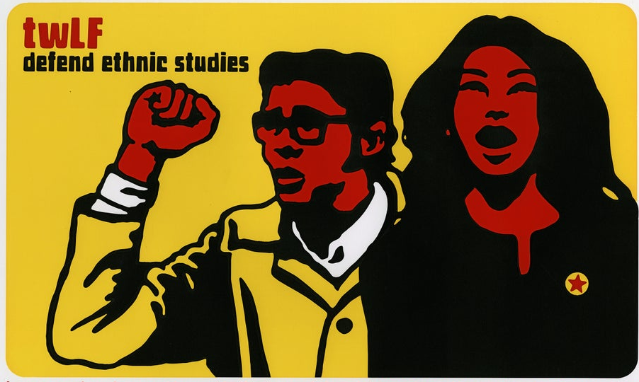
When Initiatives Falter
As with any research-based intervention or program, the success of Ethnic Studies hinges on fidelity
When good ideas….
    Are not clearly understood,
    Are subsumed or conflated with other efforts,
    Lack clear planning & coherent vision,
    Are managed without expertise & clarity, or,
    Become diluted by ideological tampering
…Their initial promise & potential (& student achievement impact) vanishes.
Four decades of efforts to democratize schools, increase cultural & racial diversity in curriculum, & reshape schooling outcomes have been consistently hampered by issues of fidelity & misappropriation
(See: Paris, 2012 & 2014; Ladson-Billings, 2004; Cabrera, et al., 2014)
Ethnic Studies is a unique field with a distinct history; as such, the consequences of misappropriation are high

Slide 5
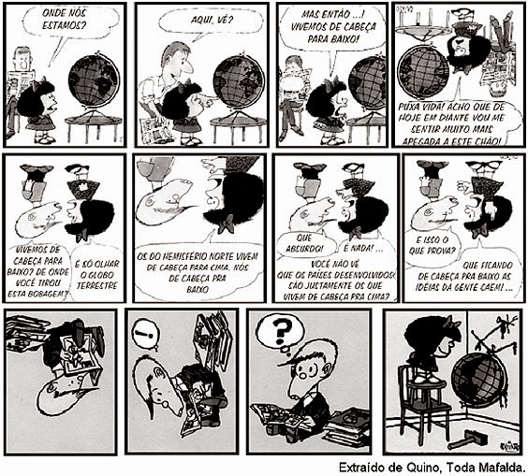
Context(s) & Methodology
Design-based Research (e.g Engeström; Gutierrez & Vossoughi) approach to supporting PLCs at multiple school sites
  School A: Predominantly white, affluent student body; perceived as a flagship, high performing school
  School B: Predominantly BIPoC student body; seen as a traditionally “underserved” school
3+ years of engaged support
  Professional development meetings; weekly & monthly PLC meetings; curriculum development support; classroom visits & coaching; co-teaching & student project co-design
Core Questions/Tasks:
  In what ways are new ethnic studies teachers understanding their transition & task?
  What challenges emerge for transitioning ethnic studies teachers, & what support is required?
Notes:
Now turn to methods, quickly
This began as a design experiment, which failed, but I’d be happy to discuss how that fell apart later…
What I work from is a critical ethnography, particularly leveraging story as ethnography, which allows us to...
Prioritizes participant experiences & moments as significant
Blend findings, analyses, & claims to shift what it means to ‘know’
It’s a Method that allows us to engage in decolonization, & disrupt What Mignolo calls the hubris of the zero-point, affirming:
“the epistemic rights of the racially devalued…[to] call into question the modern/colonial foundation of the control of knowledge…[and] focus on the knower rather than on the known” (Mignolo, 2009)
We want, like Mafalda here, to turn the globe upside down.
I’ll note quickly that this grows from a year of field notes and shadowing youth in a school, but my data analysis is still in process, and a limitation looming over this was the difficulty in collecting substantial interviews from the middle schoolers
That said, the research questions I began with – and to be honest they shifted some as you’ll see, were:
So I want to tell this through 2 stories, the first being that of Omar, and the Latinx boys of the school, whose daily lives were marked by physical isolation, and often discipline and punishment

Slide 6
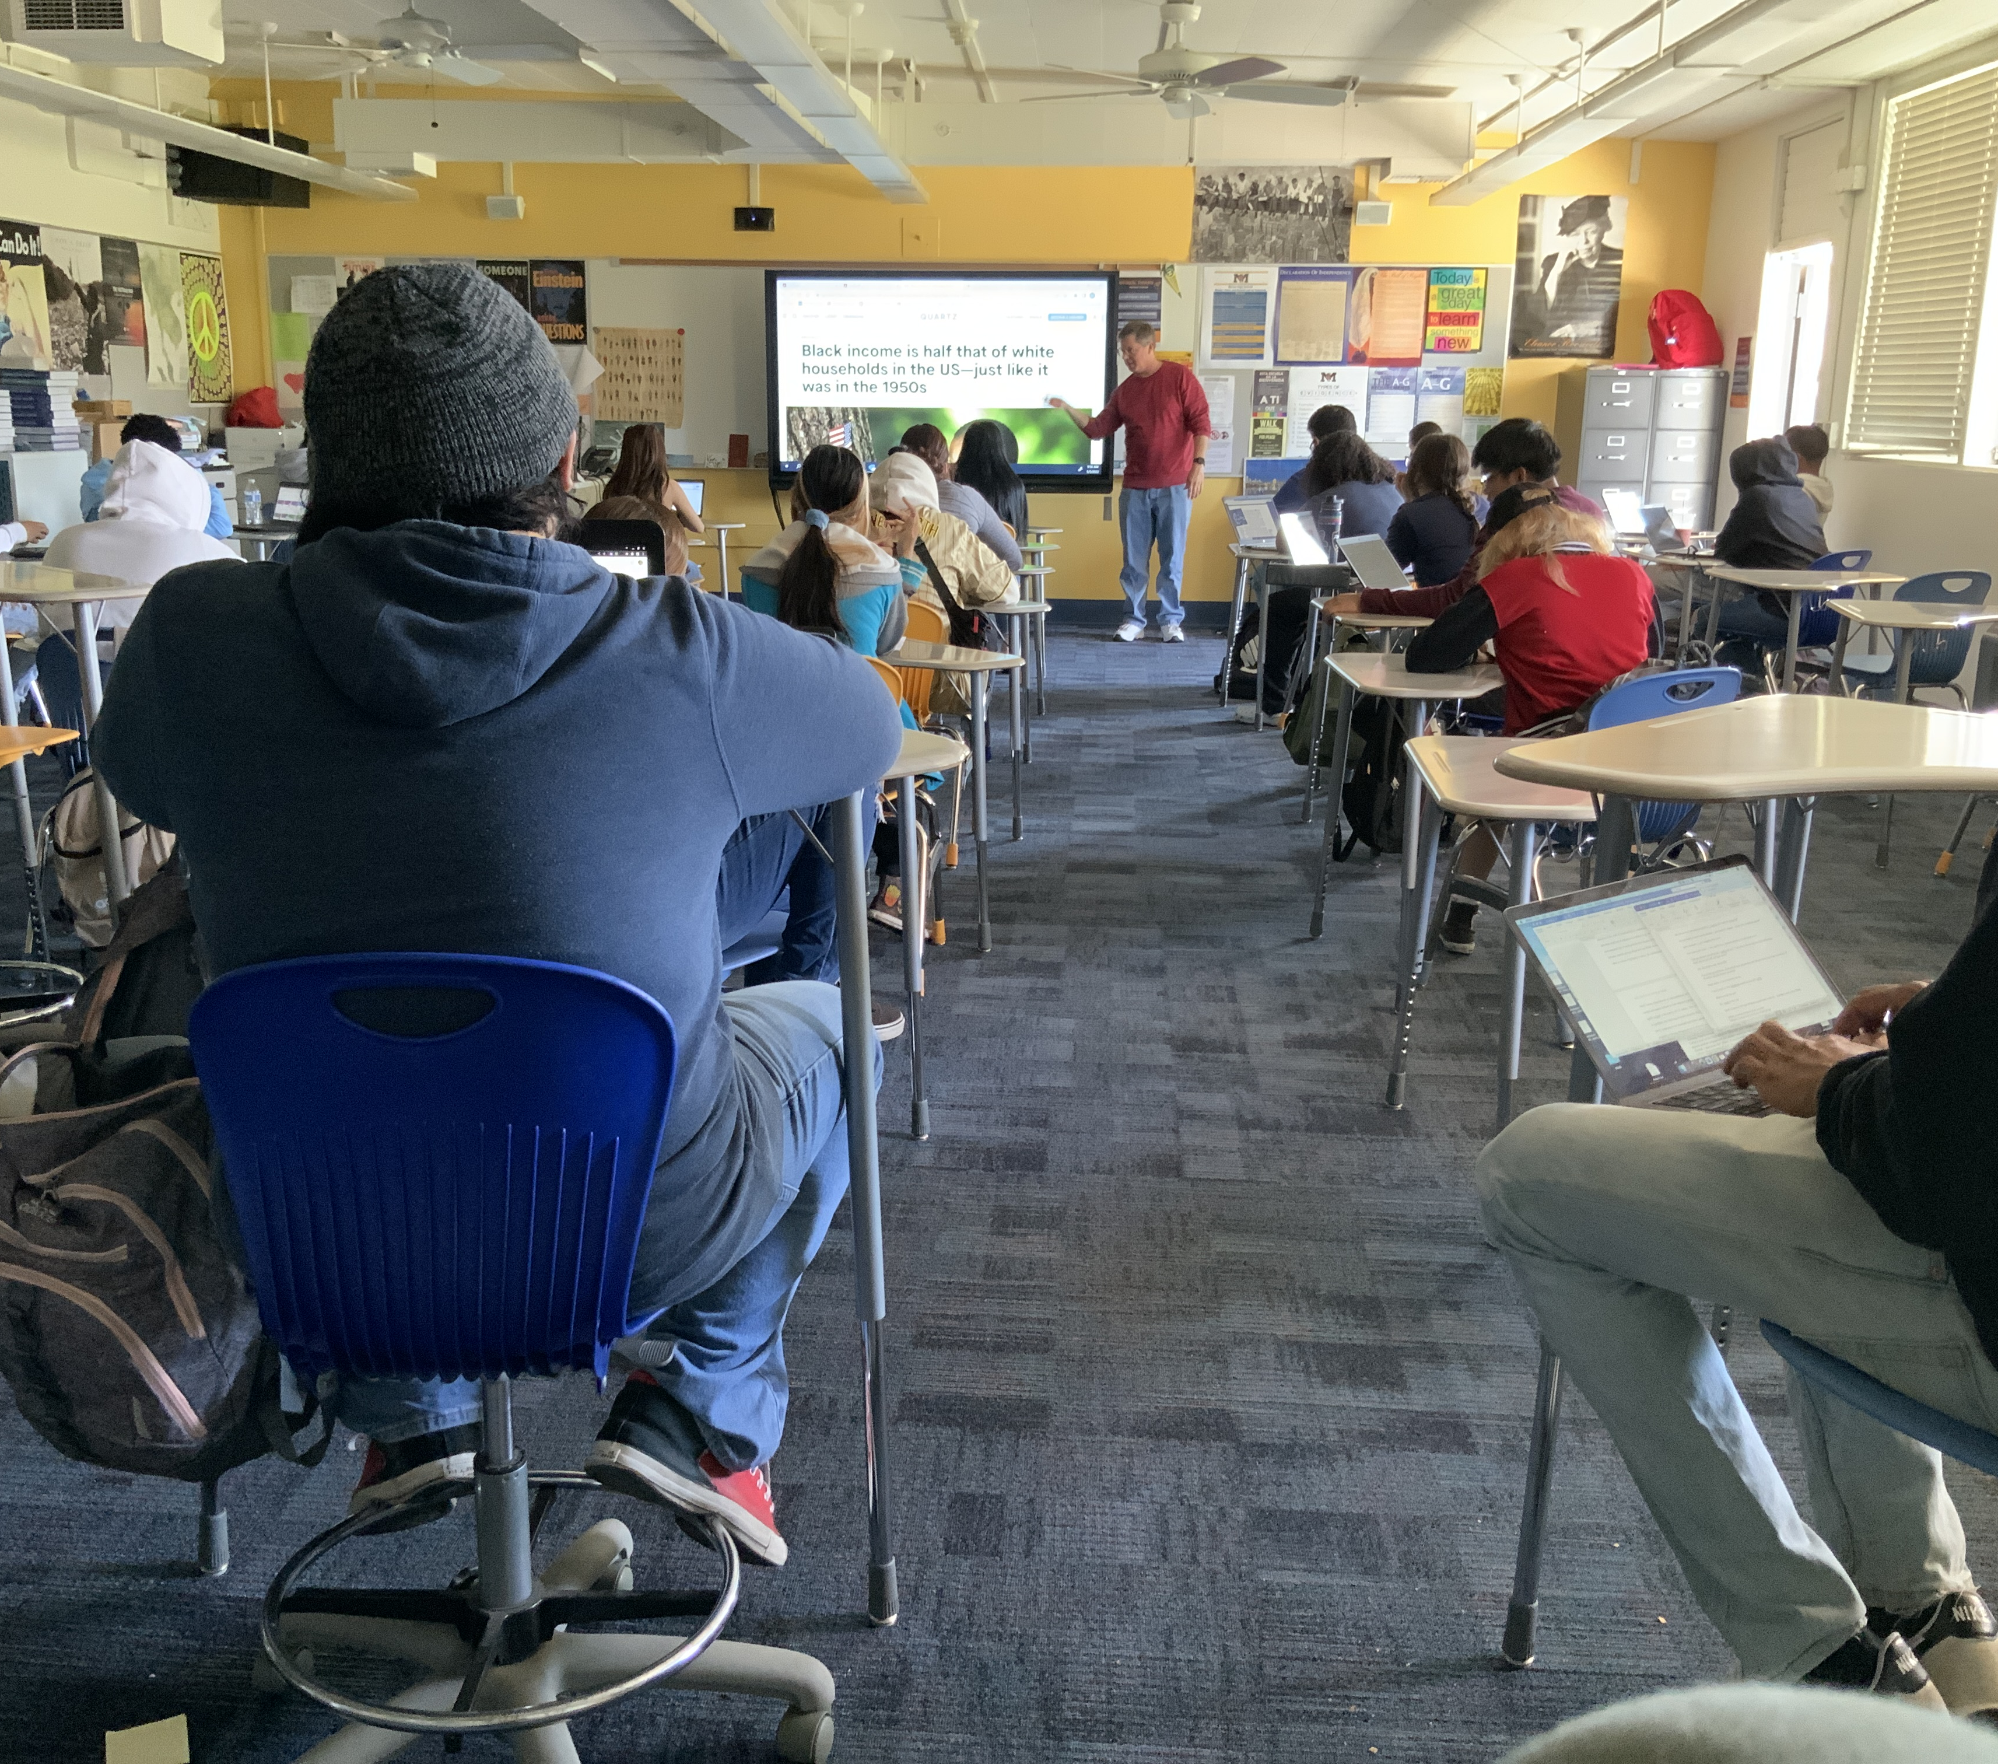
Disciplinary Inertia
When considering a thematic, rather than chronological approach to history instruction: “My brain doesn’t work like that.”
“We’ve always taught that. Why would we not teach that?”
“OK, so we’re just teaching our texts and materials like we always have…like it’s the literature leading, but just like, with sprinkling in these terms?”
“There’s some facts you gotta know…they gotta learn some history”

Slide 7
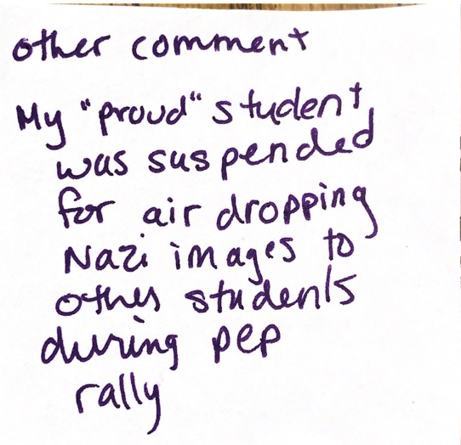
Racial Hesitancy
“Juniors are still kids…locked in their own little world of being seventeen ... I know last year students told me, used to tell me … ‘we deal with racism every day and now you get in, now you want it, you want us to learn about it here!?’”
“I’m scared of what’s going to happen talking about these topics if a student gets upset…at our school, whatever a parent says goes, and what if that means they want me out for teaching [race, racism, etc.]? Who is going to protect us?”
“I’m spinning my wheels in terms of making my lessons effective in terms to reaching students…helping them see the lives of others that they think they already know since they’ve learned enough about segregation and racism [through social media]…I’m struggling with dimension and relevance for them right now…we’re just not getting into nuance”

Slide 8
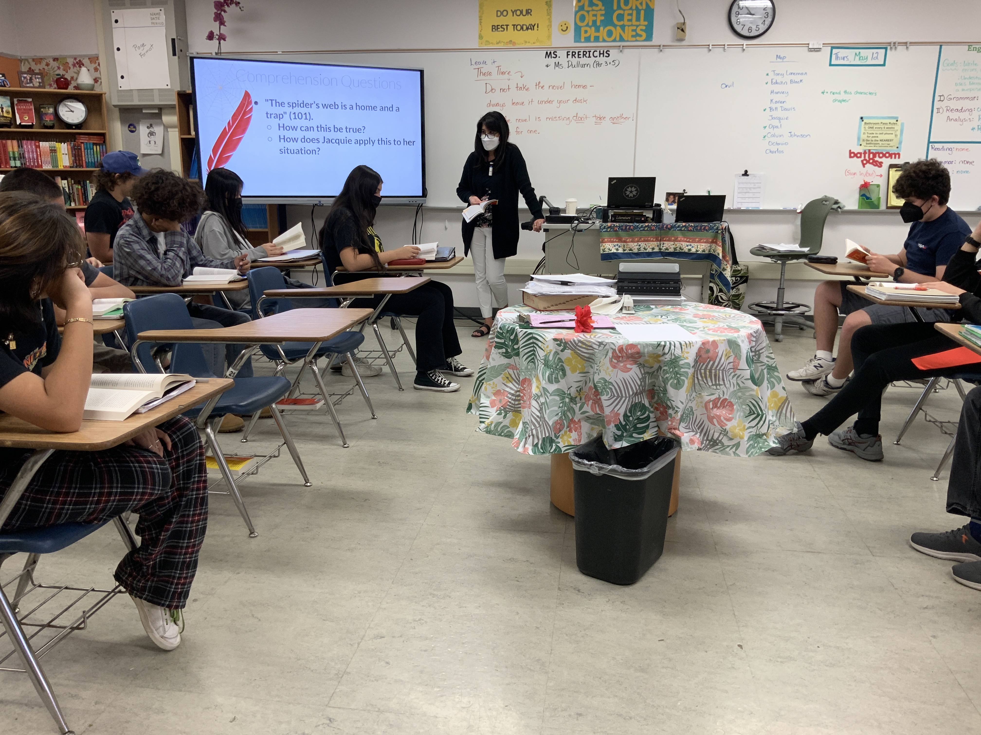
Longitudinal, Collegial Support
“When we first started this, I was so nervous to push into the concepts – I kept falling back into the English of it, characterization, not racialization, because that’s what was comfortable….I’m more confident with it now, but it was a shift”
“This is the issue with doing this—we’ve been working on this for 3 years and we’re still struggling with understanding it together. You need to get the concepts yourself, and then figure out how to translate it to the students”

Slide 9
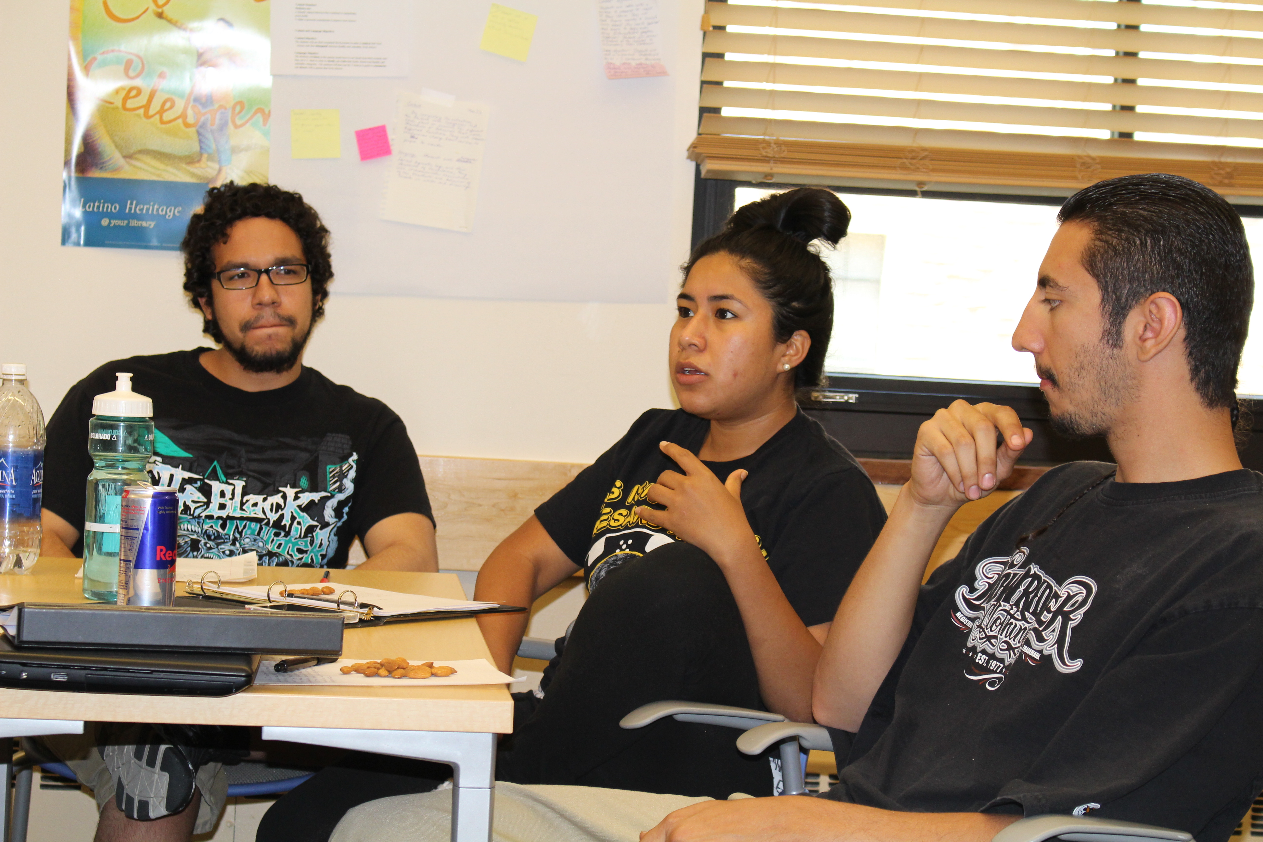
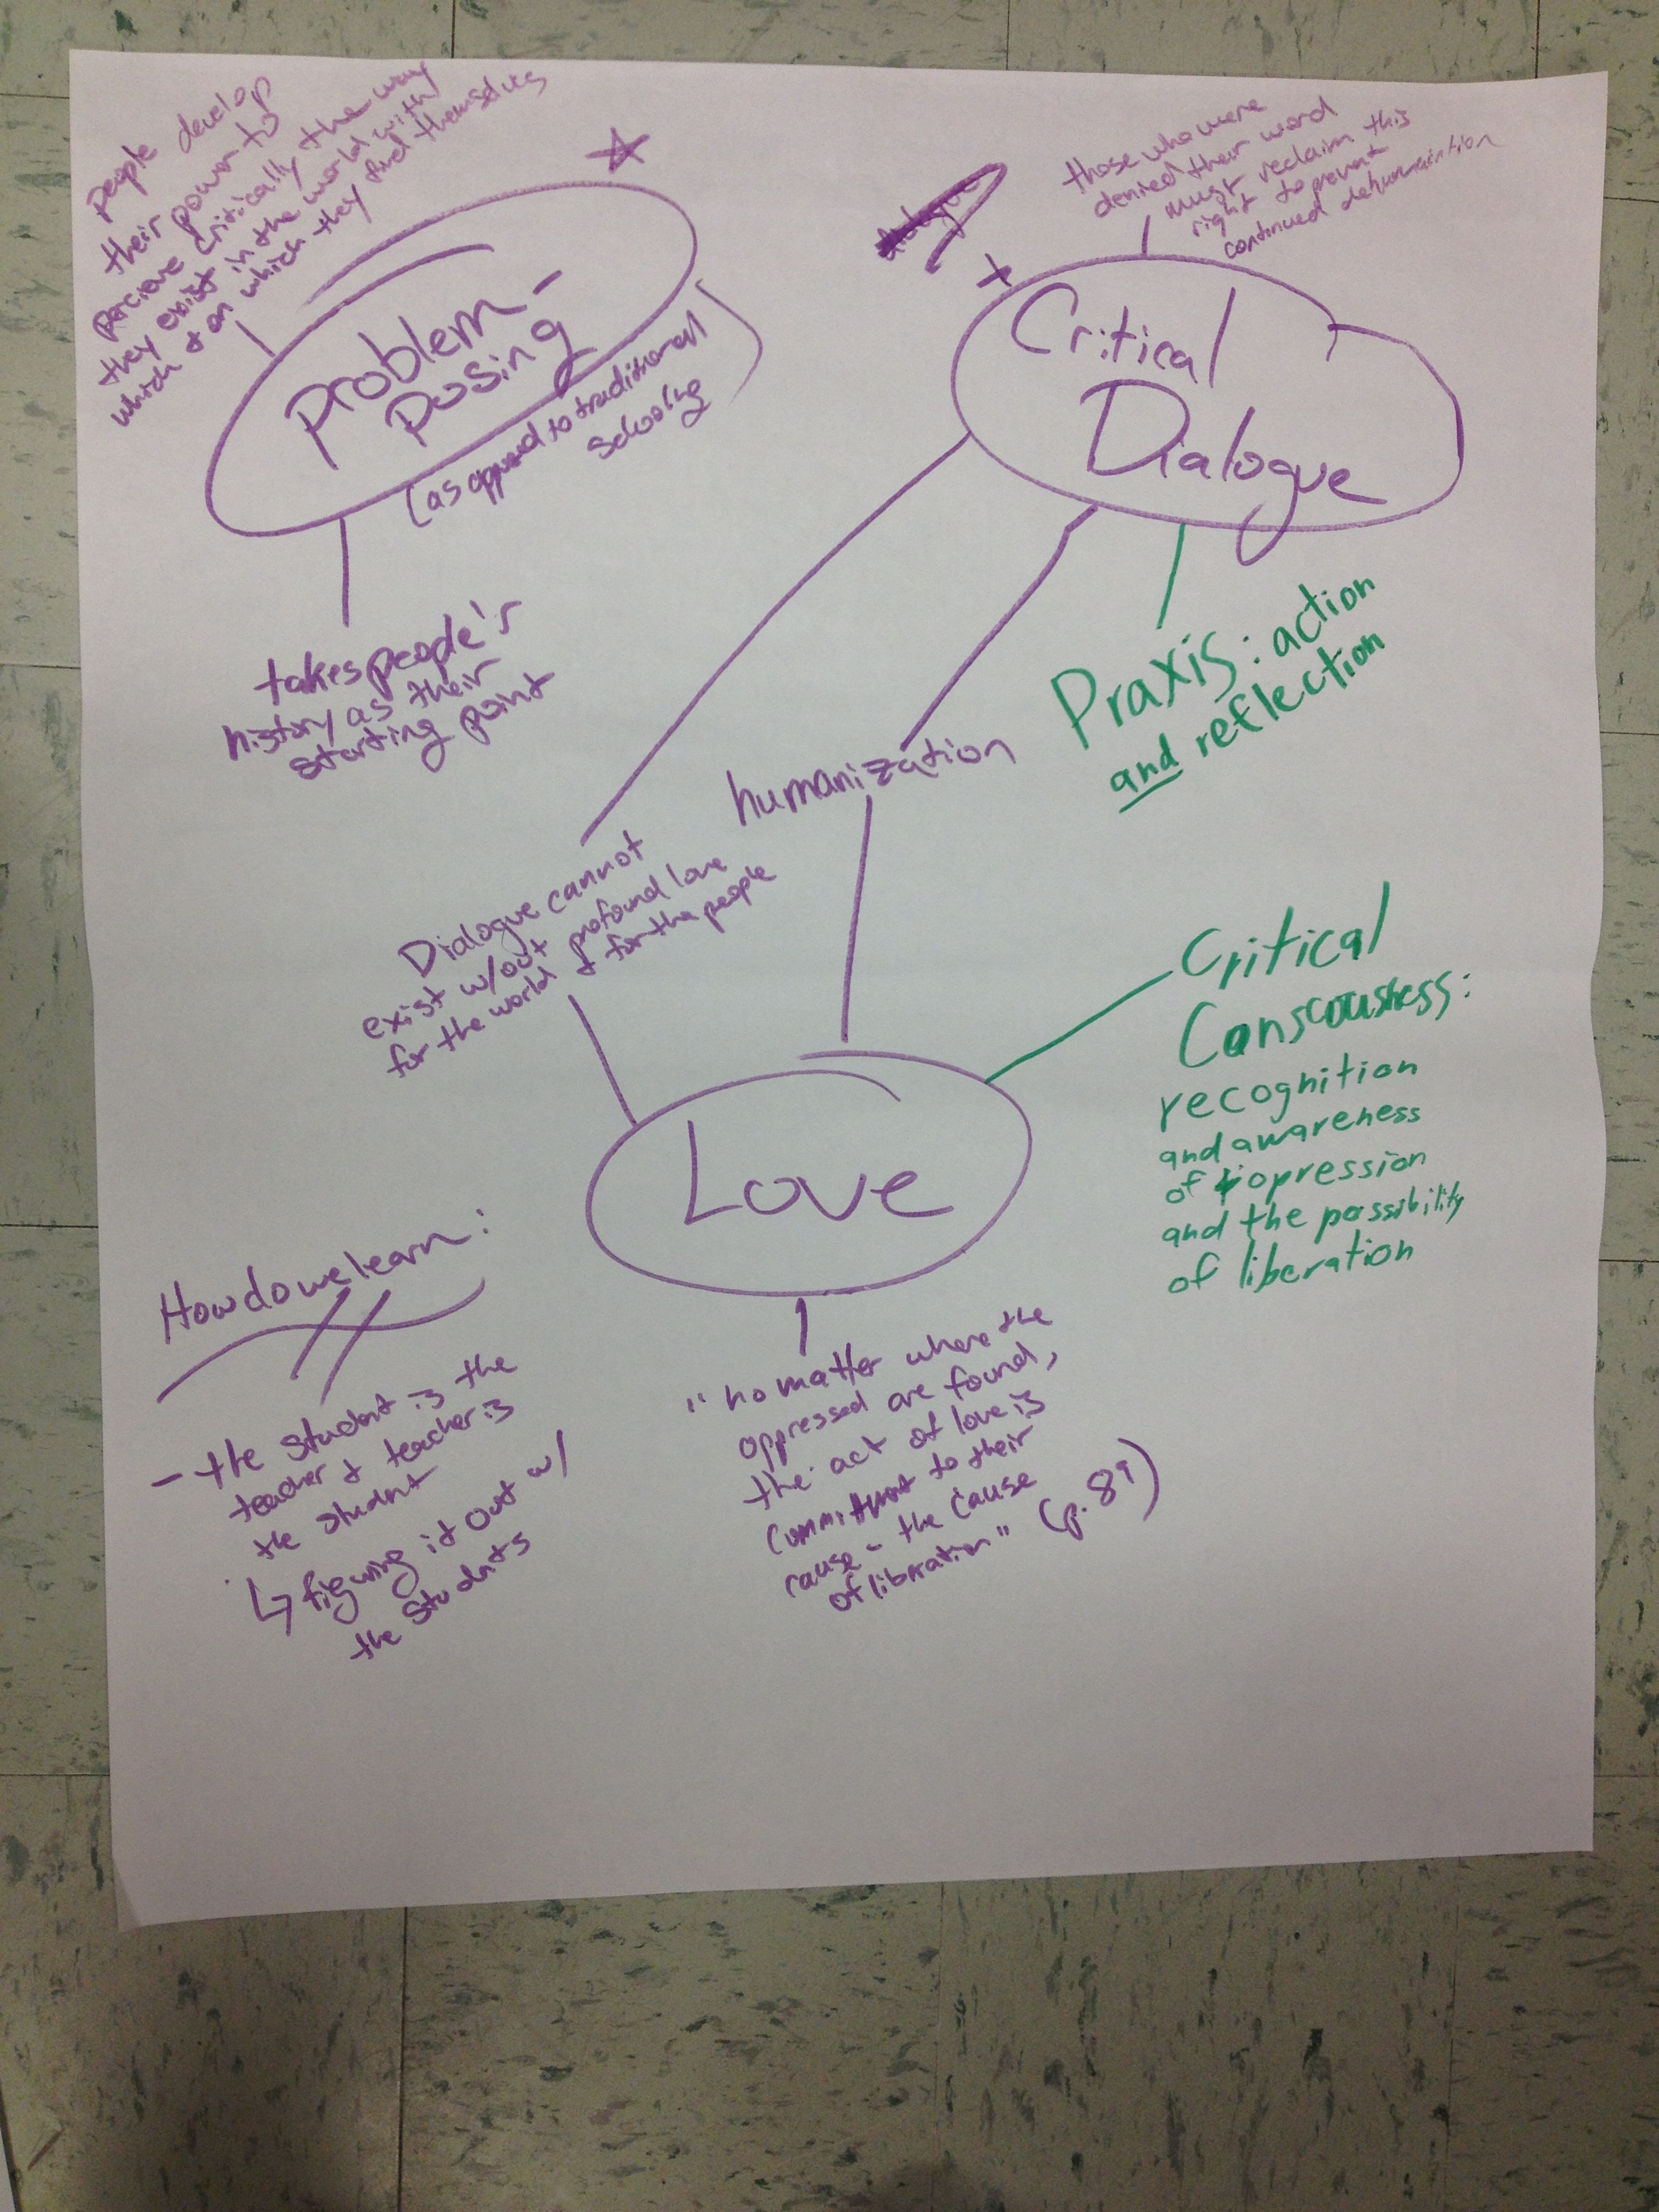
Transforming Praxis
Purpose built Ethnic Studies methods course
  Deep pedagogical & disciplinary knowledge
  Attention & focus on ideological development & reflection
  Collective intellectual mapping activities—ample time delineating racial positionality & pedagogical philosophy
  Curriculum building, modification, & lesson practice with ethnic studies learning objectives at the center
  Opportunities for rehearsal of disciplinary skill in ethnic studies—e.g. talking about race, identity, power

Slide 10
Rehearsing the (Pedagogical) Revolution
This approach to rehearsal moves the ethnic studies objectives & skillsets to the center

Slide 11
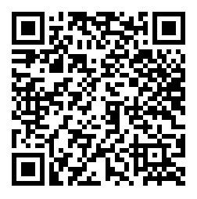
Disciplinary Specificity & Ethnic Studies Fidelity
Observations from our work
To be done well, ethnic studies must be seen as more than a DEI fad
Ethnic studies teaching necessarily means centering a discipline-specific set of learning objectives
Navigating race, identity, & power in the classroom requires purposeful practice, & longitudinal learning
Ethnic studies departments & expertise should not be cut out of, or peripheral to, imagining how to prepare K-12 ethnic studies teachers

Slide 12
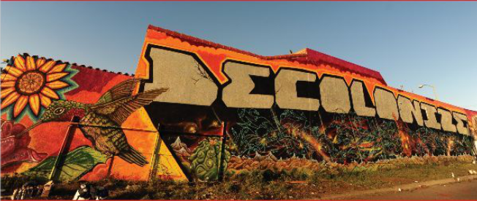
Key Questions for Teacher Educators in a Landscape of Ethnic Studies Proliferation
Teacher educators/TE programs grappling earnestly with the challenge of preparing ethnic studies teachers should consider…
  What will fidelity mean to us in supporting ethnic studies expansion?
  How much do we value the expertise of ethnic studies departments? What efforts have we made to collaborate & ensure ethnic studies teachers (and teacher educators) have actually taken ethnic studies courses?
  Do our training approaches layer ethnic studies in as a DEI effort, or challenge educators to re-think their disciplinary identities?
  How are we grappling with the reality that teaching race, identity, & power may not be within the dispositional skillsets or positionality of all teachers?
Notes:
To conclude, This isnt just about recognition or making Latinx youth into ‘good’ students; its about shifting the pedagogy and invitations that are offered, how the epistemic structure of the school works, the ways it’s ideologies around things like ‘mindset’ and ‘grit’ position hist. marginalized youth.
Omar, Sara, Marco, Viridiana – all these students have amazing gifts, and are using them to navigate and ensure they have some sort of agency and discourse of their own. But their cleverness, creativity and ingenuity need not be in opposition or liminal to school. The schools need to change themselves.
It does require we toruble the zero-point, question the norms and practices, and actively confront assumptions that have long been held as static in the south, and other places where the NLD is unfolding
That means priotritizing a process of Ontological Healing (Sanchez, et al., 2015) in our work with youth & educators, and
Identifying & disrupting the ways that, perhaps unintentionally, veneers of curricular, physical, & cultural inclusion are obscuring insidious, colonial limits to the Epistemic Space Latinx youth & families are permitted

Slide 13

michael.dominguez@sdsu.edu
Thank You
SDSU Collaborative for K-12 Ethnic Studies
Notes:
How Does it Feel to Be a Problem – Moustafa Bayoumi
Terrorist Assemblages – Jasbir Puar

