Slide 1
CCTE Policy Session
Fall 2023 CCTE
Friday October 20, 3:00 - 4:00 p.m.
Second Policy Session

Slide 2
Agenda
Overview of the CCTE Policy Committee
National and AACTE Update: Kimberly White-Smith, CCTE’s Vice President for AACTE and Dean, University of San Diego
Developing CCTE’s Advocacy: Topics and Talking Points for SPAN 2024

Slide 3
Overview of CCTE Policy Committee
Co-Chairs:
Pia Wong (Sacramento State)
Nicol Howard (University of Redlands)
Cynthia Grutzik (San Francisco State)
Charge from CCTE Bylaws:
The committee shall develop recommendations regarding policies that affect teacher education at the state and national levels, propose those recommendations to the Board for consideration and action, and implement decisions of the Board with regard to issues of policy.
The committee shall conduct such workshops and conference sessions about policy as are appropriate to the themes and focuses of the semi-annual conferences of the Council. The committee chair shall work with the conference chairs in proposing and sponsoring such sessions on a regular basis.
The committee shall carry out other tasks regarding policy issues as are defined and specified by the President and Board of Directors.

Slide 4
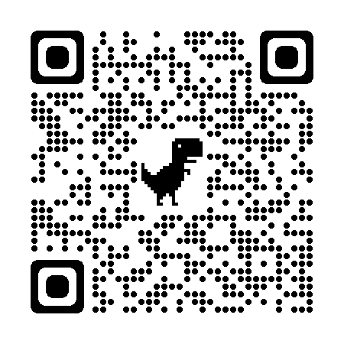
AACTE Update
Dr. Kimberly White-Smith
CCTE Vice President for AACTE
Dean, University of San Diego

Slide 5
Developing CCTE’s Advocacy
TAKING A NEW APPROACH:
TOPICS AND TALKING POINTS FOR SPAN 2024
Building consensus within CCTE around specific topics in Educator Preparation:
Creating Dialogue Groups
Exploring each topic from multiple angles
Bringing evidence, stories, experiences
Developing clear talking points together
Legislative Visits at SPAN to share talking points
Followed by debriefing and next steps

Slide 6
From Topics to
Talking Points
What do we want policy makers/shapers to know about….
Topic 1: Building and Maintaining the Teacher
Pathway (recruitment, retention, financing, etc.)
Topic 2: Supporting Equity-oriented Teaching
(from pre-service through induction and beyond)
Topic 3: Advancing Ethnic Studies courses/framework
Topic 4: Institutionalizing the Critical Role of the
Mentor Teacher

Slide 7
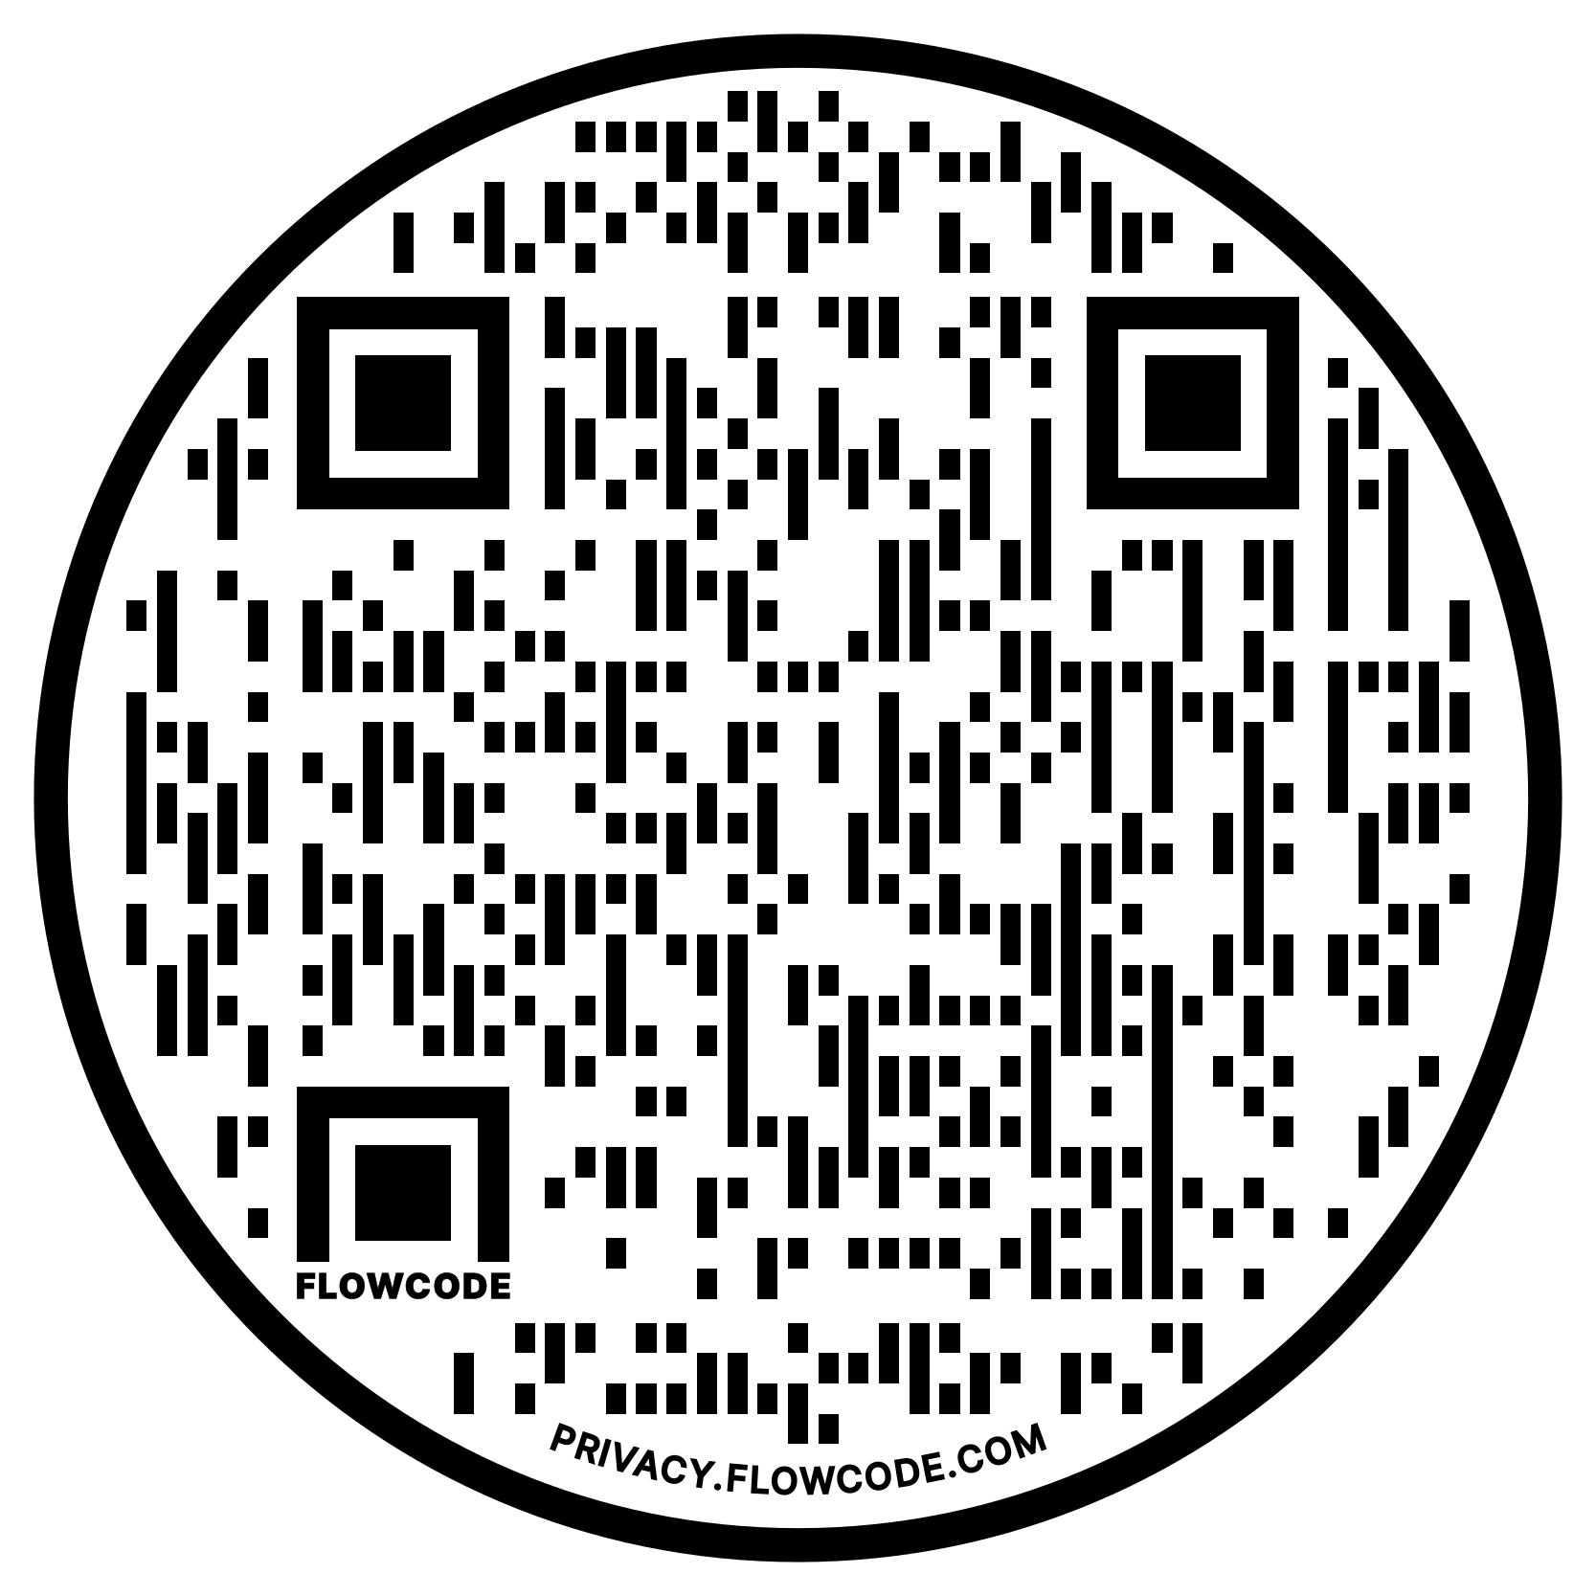
Group Work at Your Tables:
Talk with your colleagues about the different topics.
Building/Maintaining the Teacher Pathway
Supporting equity-oriented teaching (from pre-service through induction and beyond)
Advancing Ethnic Studies
Institutionalizing the Critical Role of the Mentor Teacher
Take time to enter in your individual information, using the QR code provided.

Slide 8
Three Meetings to Shape Our Talking Points
Meeting 1 October (today): Policy Committee
Discuss consensus-building for our organization - how do we create CCTE Talking Points?
Divide into groups around topics, each with 2 Leads
Each group discusses a topic (see previous slide)
Meeting 2: Bring stories, work in breakout groups
Conversation to develop consensus around topics
Draft Talking Points for each topic
Meeting 3 February: Finalizing Talking Points and Evidence
Double check evidence
Practice Talking Points
Meetings: On zoom, from 4-5 pm on Monday, Nov 6th, 2023 and February 5th, 2024

Slide 9
Looking forward to SPAN 2024
March 11-12
With kudos to schedule wizard, Sarah Johnson, we look forward to meeting with these policy makers/their staff:
Assembly Ed Cmte: Al Muratsuchi (Ch), Megan Dahle (VCh), Juan Carillo, Josh Hoover, Alex Lee, Kevin McCarty, Sharon Quirk-Silva
Senate Ed Cmte: Josh Newman (Ch), Rosalicie Ochoa Bogh (VCh), David Cortese, Steven Glazer, Mike McGuire, Lola Smallwood-Cuevas, Scott Wilk
Higher Ed Cmte: Mike Fong (Ch), Tri Ta (VCh), Dawn Addis, Joaquin Arambula, Jesse Gabriel, Jaqui Irwin, Evan Low, Liz Ortega, Miguel Santiago, Greg Wallace, Akilah Weber
Ed Finance: David Alvarez, Sabrina Cervantes, Mike Fong, Philip Ting, Vince Fong, Jon Laird, David Min

Slide 10
Future Meetings to Refine Talking Points
Via Zoom:
Monday, November 6th, 4:00 - 5:00 pm
Monday, February 5th, 4:00 - 5:00 pm

