Slide 1
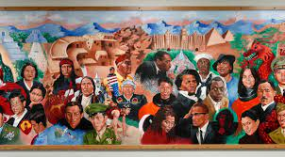
Welcome to the
CCTE Fall 2023
Conference: The Ethnic Studies Moment in California Public Education
Preparing the Field for Historic Change

Slide 2
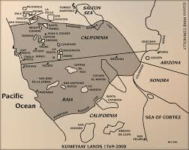
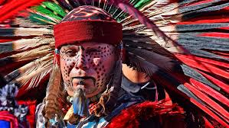
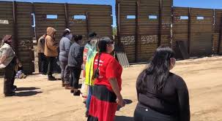
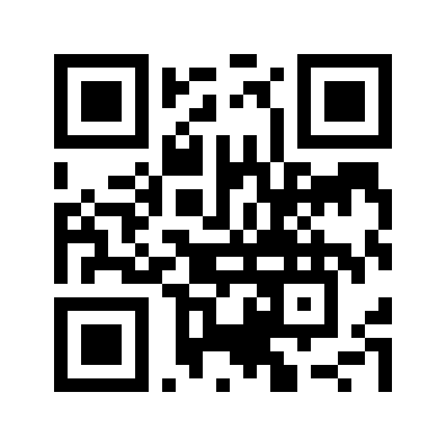
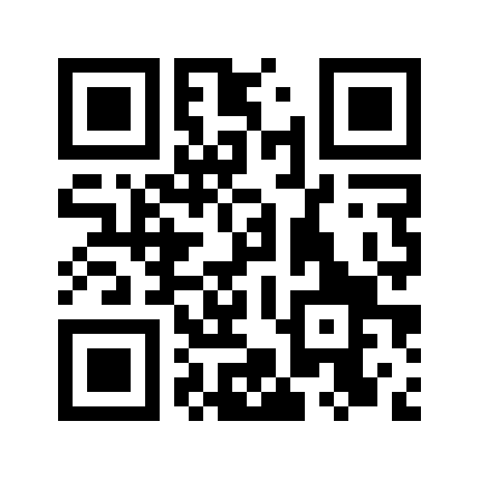
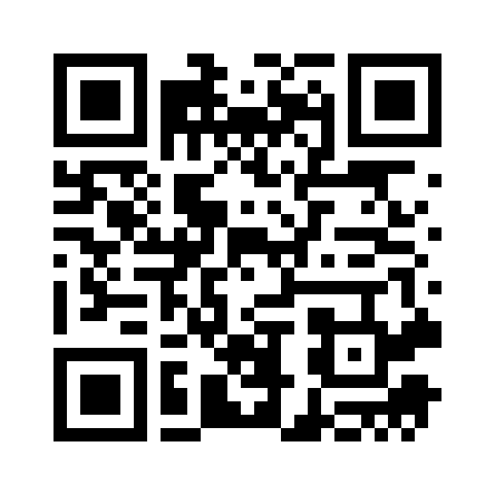
Acknowledging the Kumeyaay Indigenous Lands & People
Notes:
I would like to begin the conference with a statement acknowledging the lands that those of us who are at the conference in person are on. CCTE acknowledges that this conference space is on the traditional and unceded territory of the Kumeyaay (Koom-ee-aye) Nation.
We extend our respect and gratitude to the Koom-ee-aye people who have lived on and cared for this land since time immemorial. The Kumyaay are a people whose traditional lifeways intertwine with a worldview of earth and sky in a community of living beings. This land is part of a relationship that has nourished, healed, protected and embraced the Kumeyaay people to the present day. It is part of a world view founded in the harmony of the cycles of the sky and balance in the forces of life.The Kumeyaay people continue to reclaim the rights to their land in the face of unlawful occupation (most recently as they stood against the construction of a border wall separating their tribal lands), the rights to teaching of indigenous histories, and the importance of healing intergenerational trauma from occupation, forced assimilation and erasure. This conference in many ways takes inspiration from the indigenous knowledge of the Kumeyaay and other tribal nations.
The QR codes that you see on the slide will take you to resources to learn more about the Kumeyaay nation as well as ways that you can give back to the land and to tribal communities through the American Indian College Fund.
I want to thank CCTE Communications Committee Member Dr. Michele McConnell for providing several resources for this land acknowledgment, including the resources to give back to the land and community, and to acknowledge Michael Connolly Miskwish, a Kumeyaay historian and researcher and lecturer of American Indian Studies at SDSU who wrote the SDSU land acknowledgment from which some of today’s land acknowledgment is drawn.

Slide 3
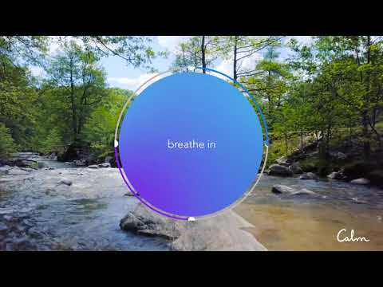
Please take a moment to be present
Notes:
Next, I’d like for us to acknowledge our bodies, our breath, and this present community. In a world that consistently pushes us to move faster and produce more, I’d invite each of us to take a moment to slow down and to take in this moment, and then take some moments for collective breath. As we attend to our own breaths, we do so in the collective. This can be a symbol for us to think about our individual work as part of a greater collective, a theme that I hope you’ll come back to throughout this conference.
Thank you for taking the time to breathe with me.

Slide 4
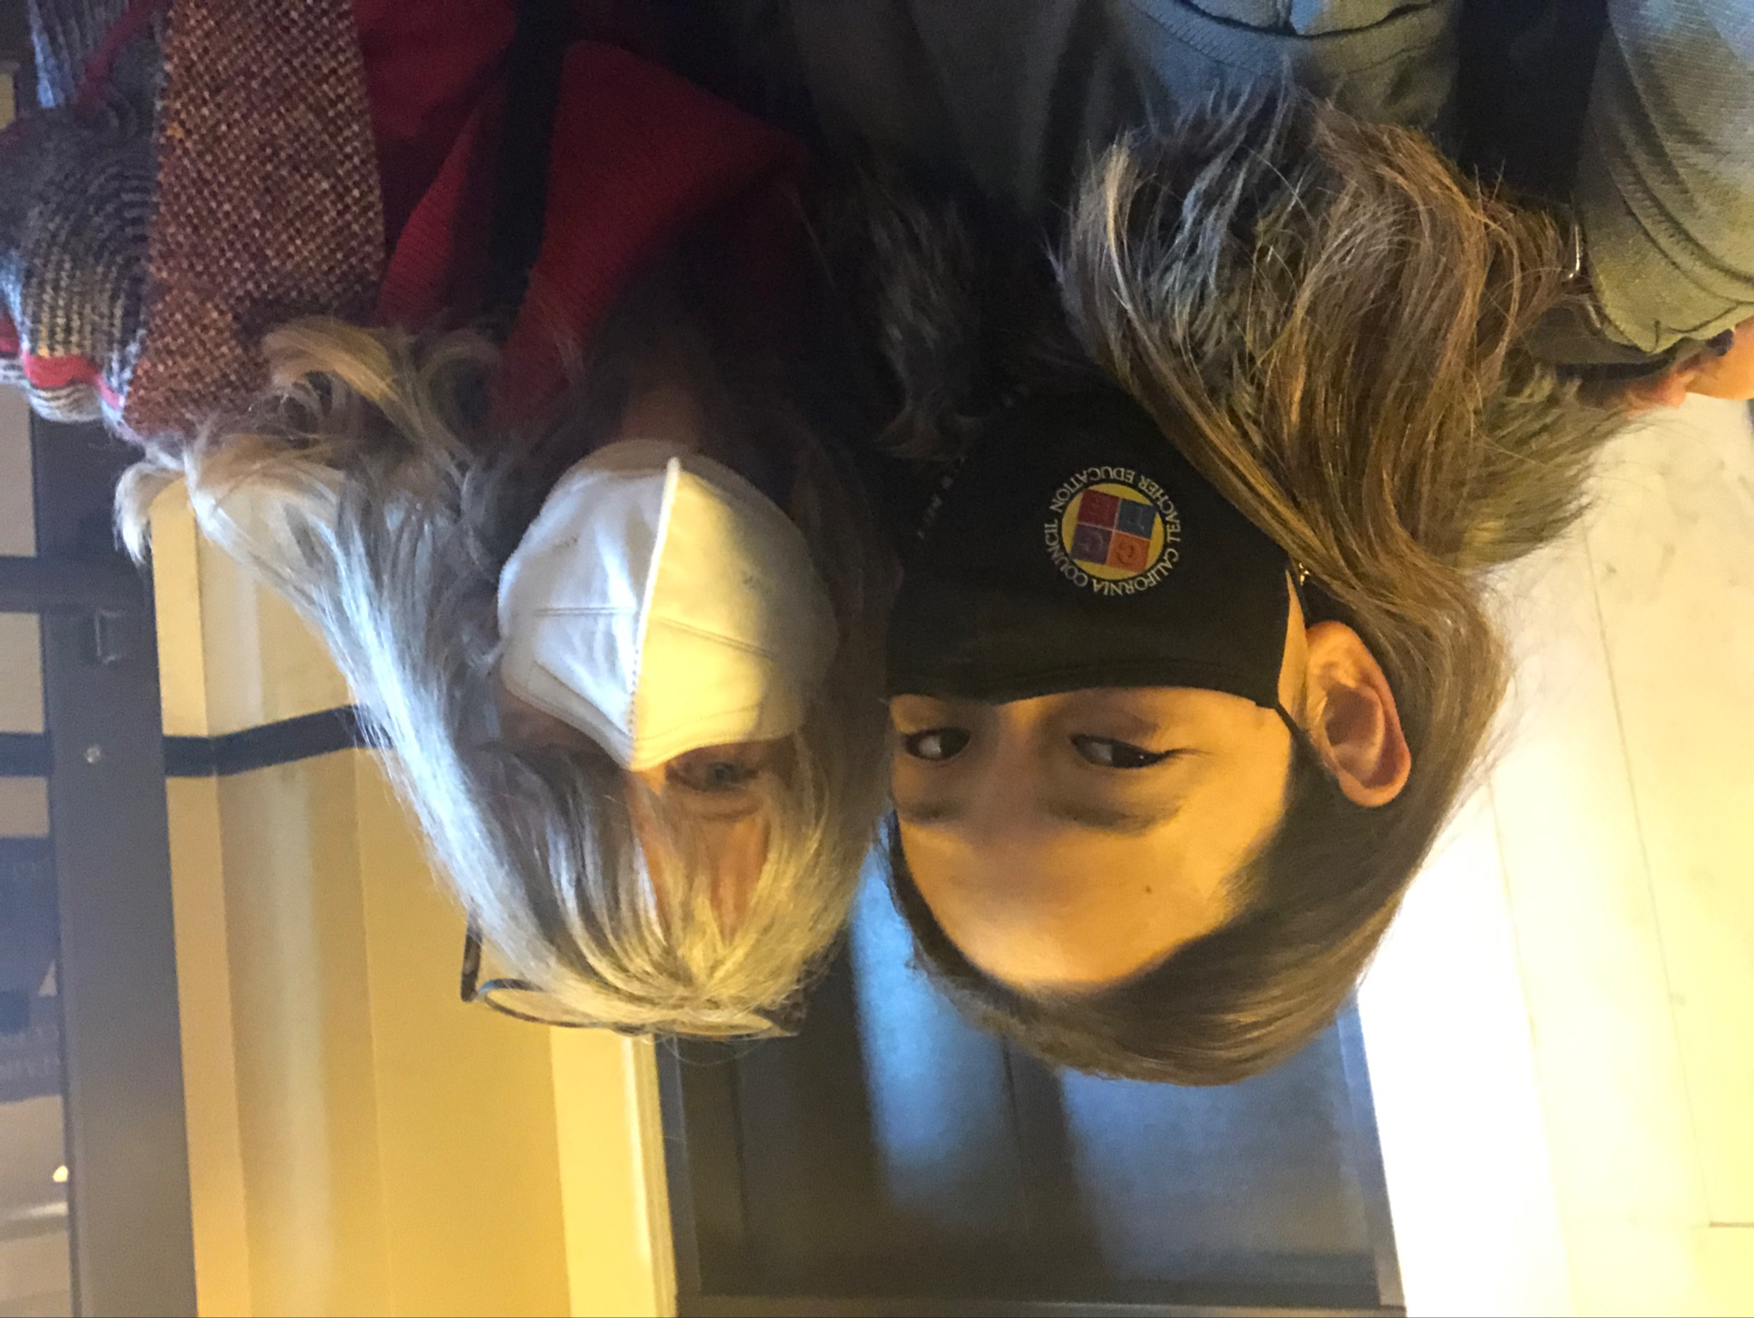
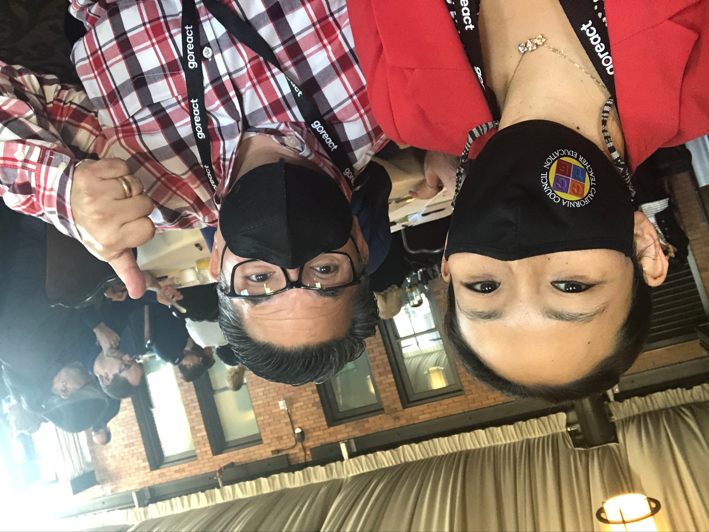
CCTE recommends you wear a mask to keep everyone safe, particularly our immunocompromised colleagues
Notes:
As part of honoring the community, we acknowledge that as pandemic moves to endemic, we continue to look after one another. We encourage you to wear a mask when indoors during the conference.

Slide 5
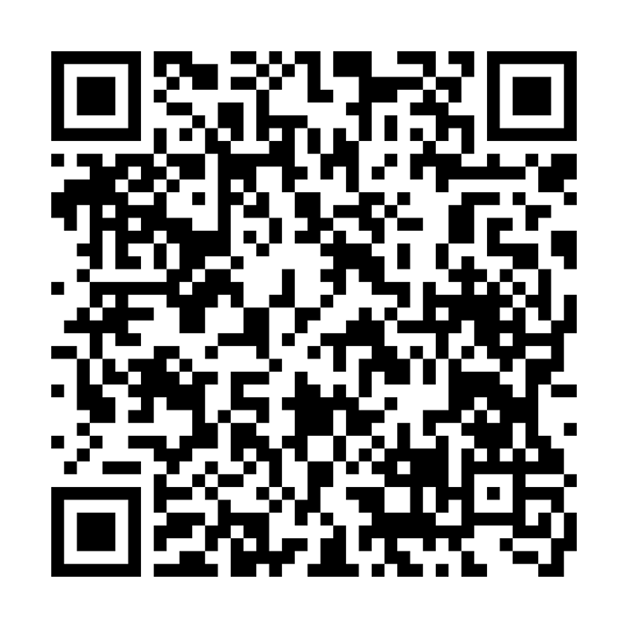
Conference Directory
Continue Community & Connections Post-Conference

Slide 6
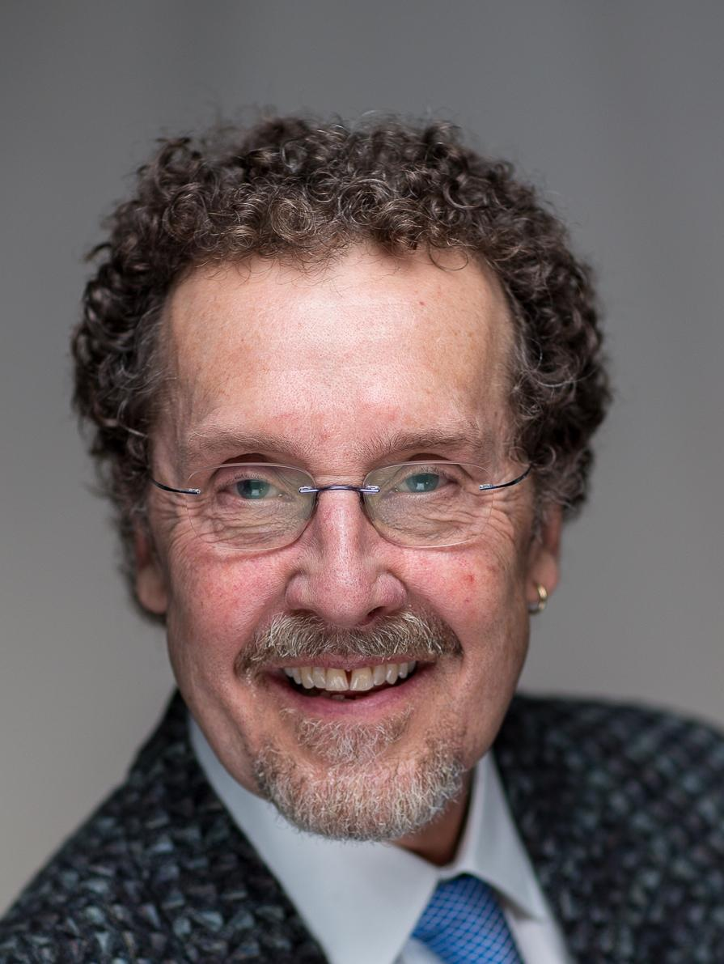
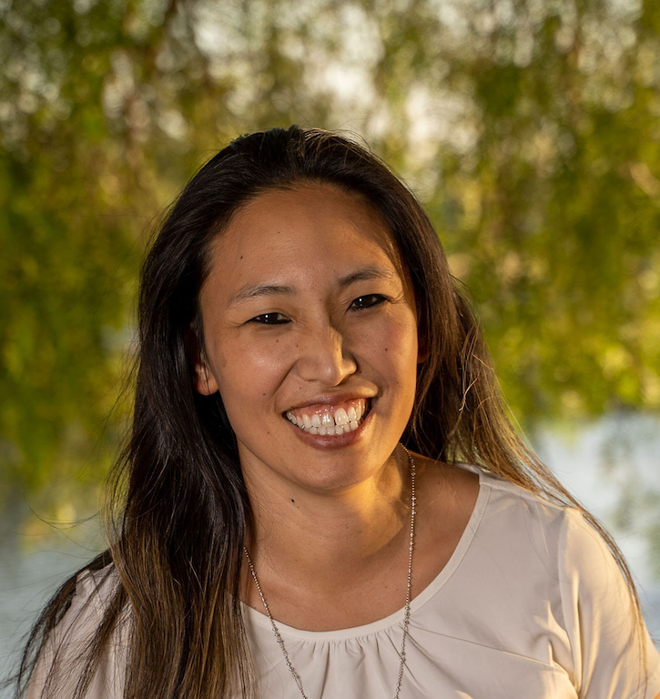
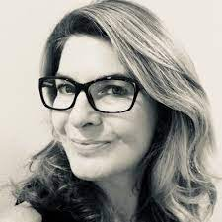
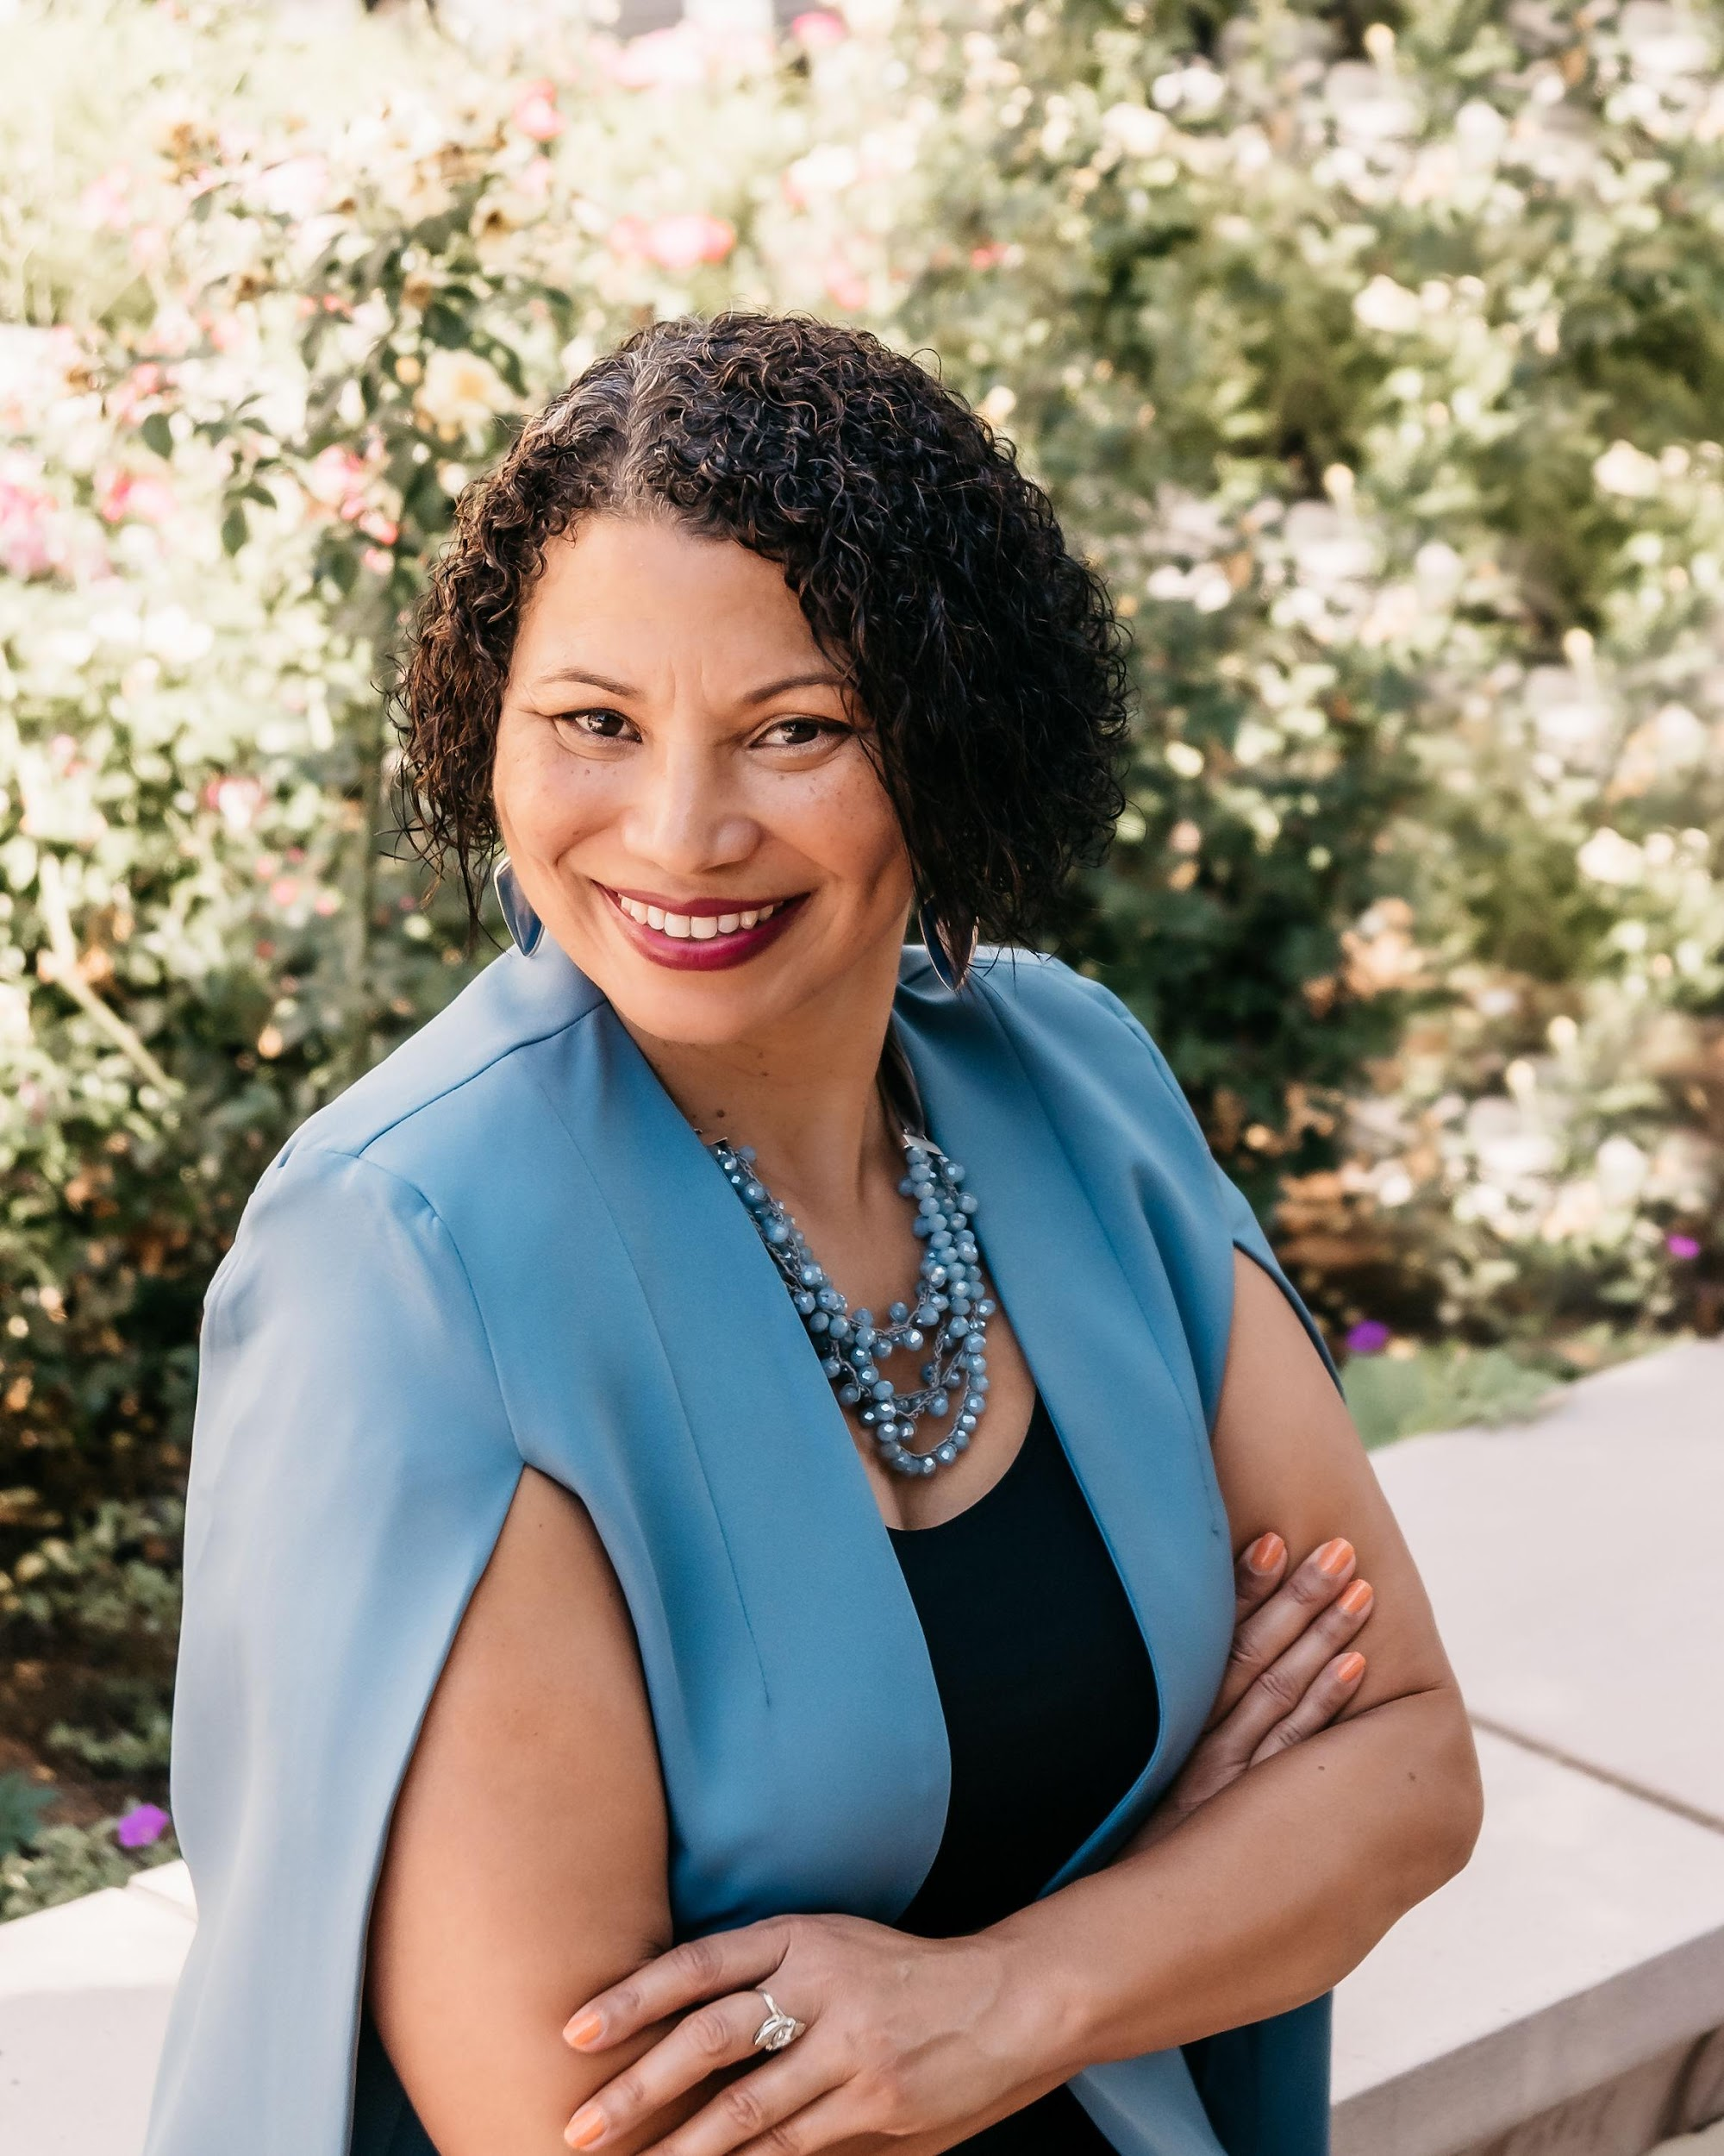
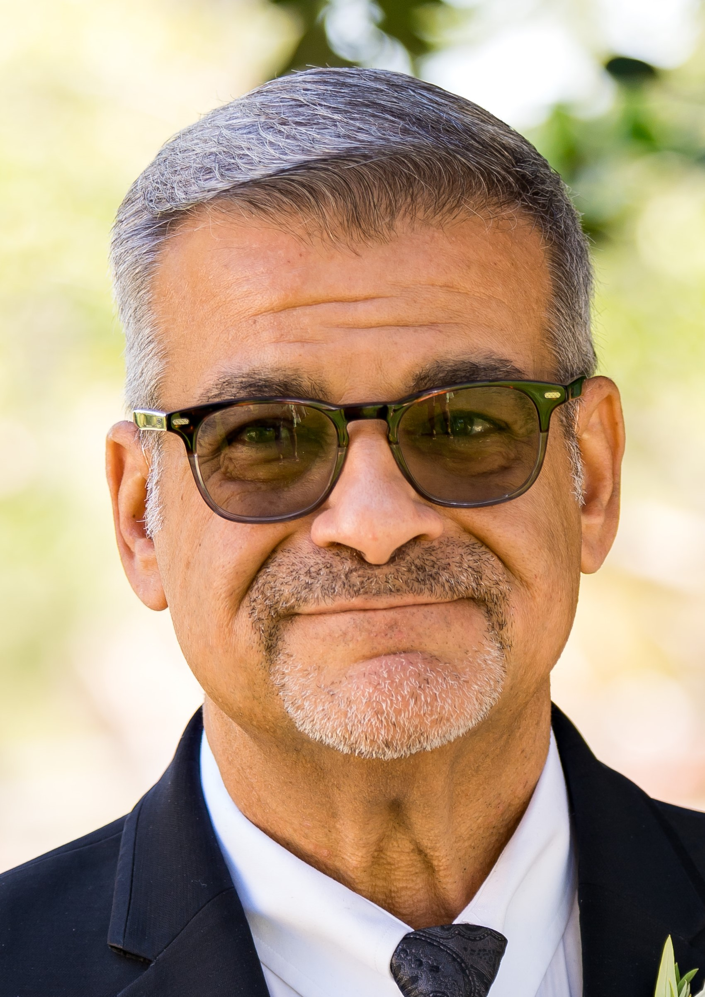
CCTE Officers
Eric Engdahl-
Past President
Betina Hsieh- President
Karen Escalante-
President Elect
Kimberly White-Smith-
VP AACTE
Michael Cosenza -
VP ATE
Notes:
I’d next like to introduce the current CCTE Officers who are pictured on this slide

Slide 7
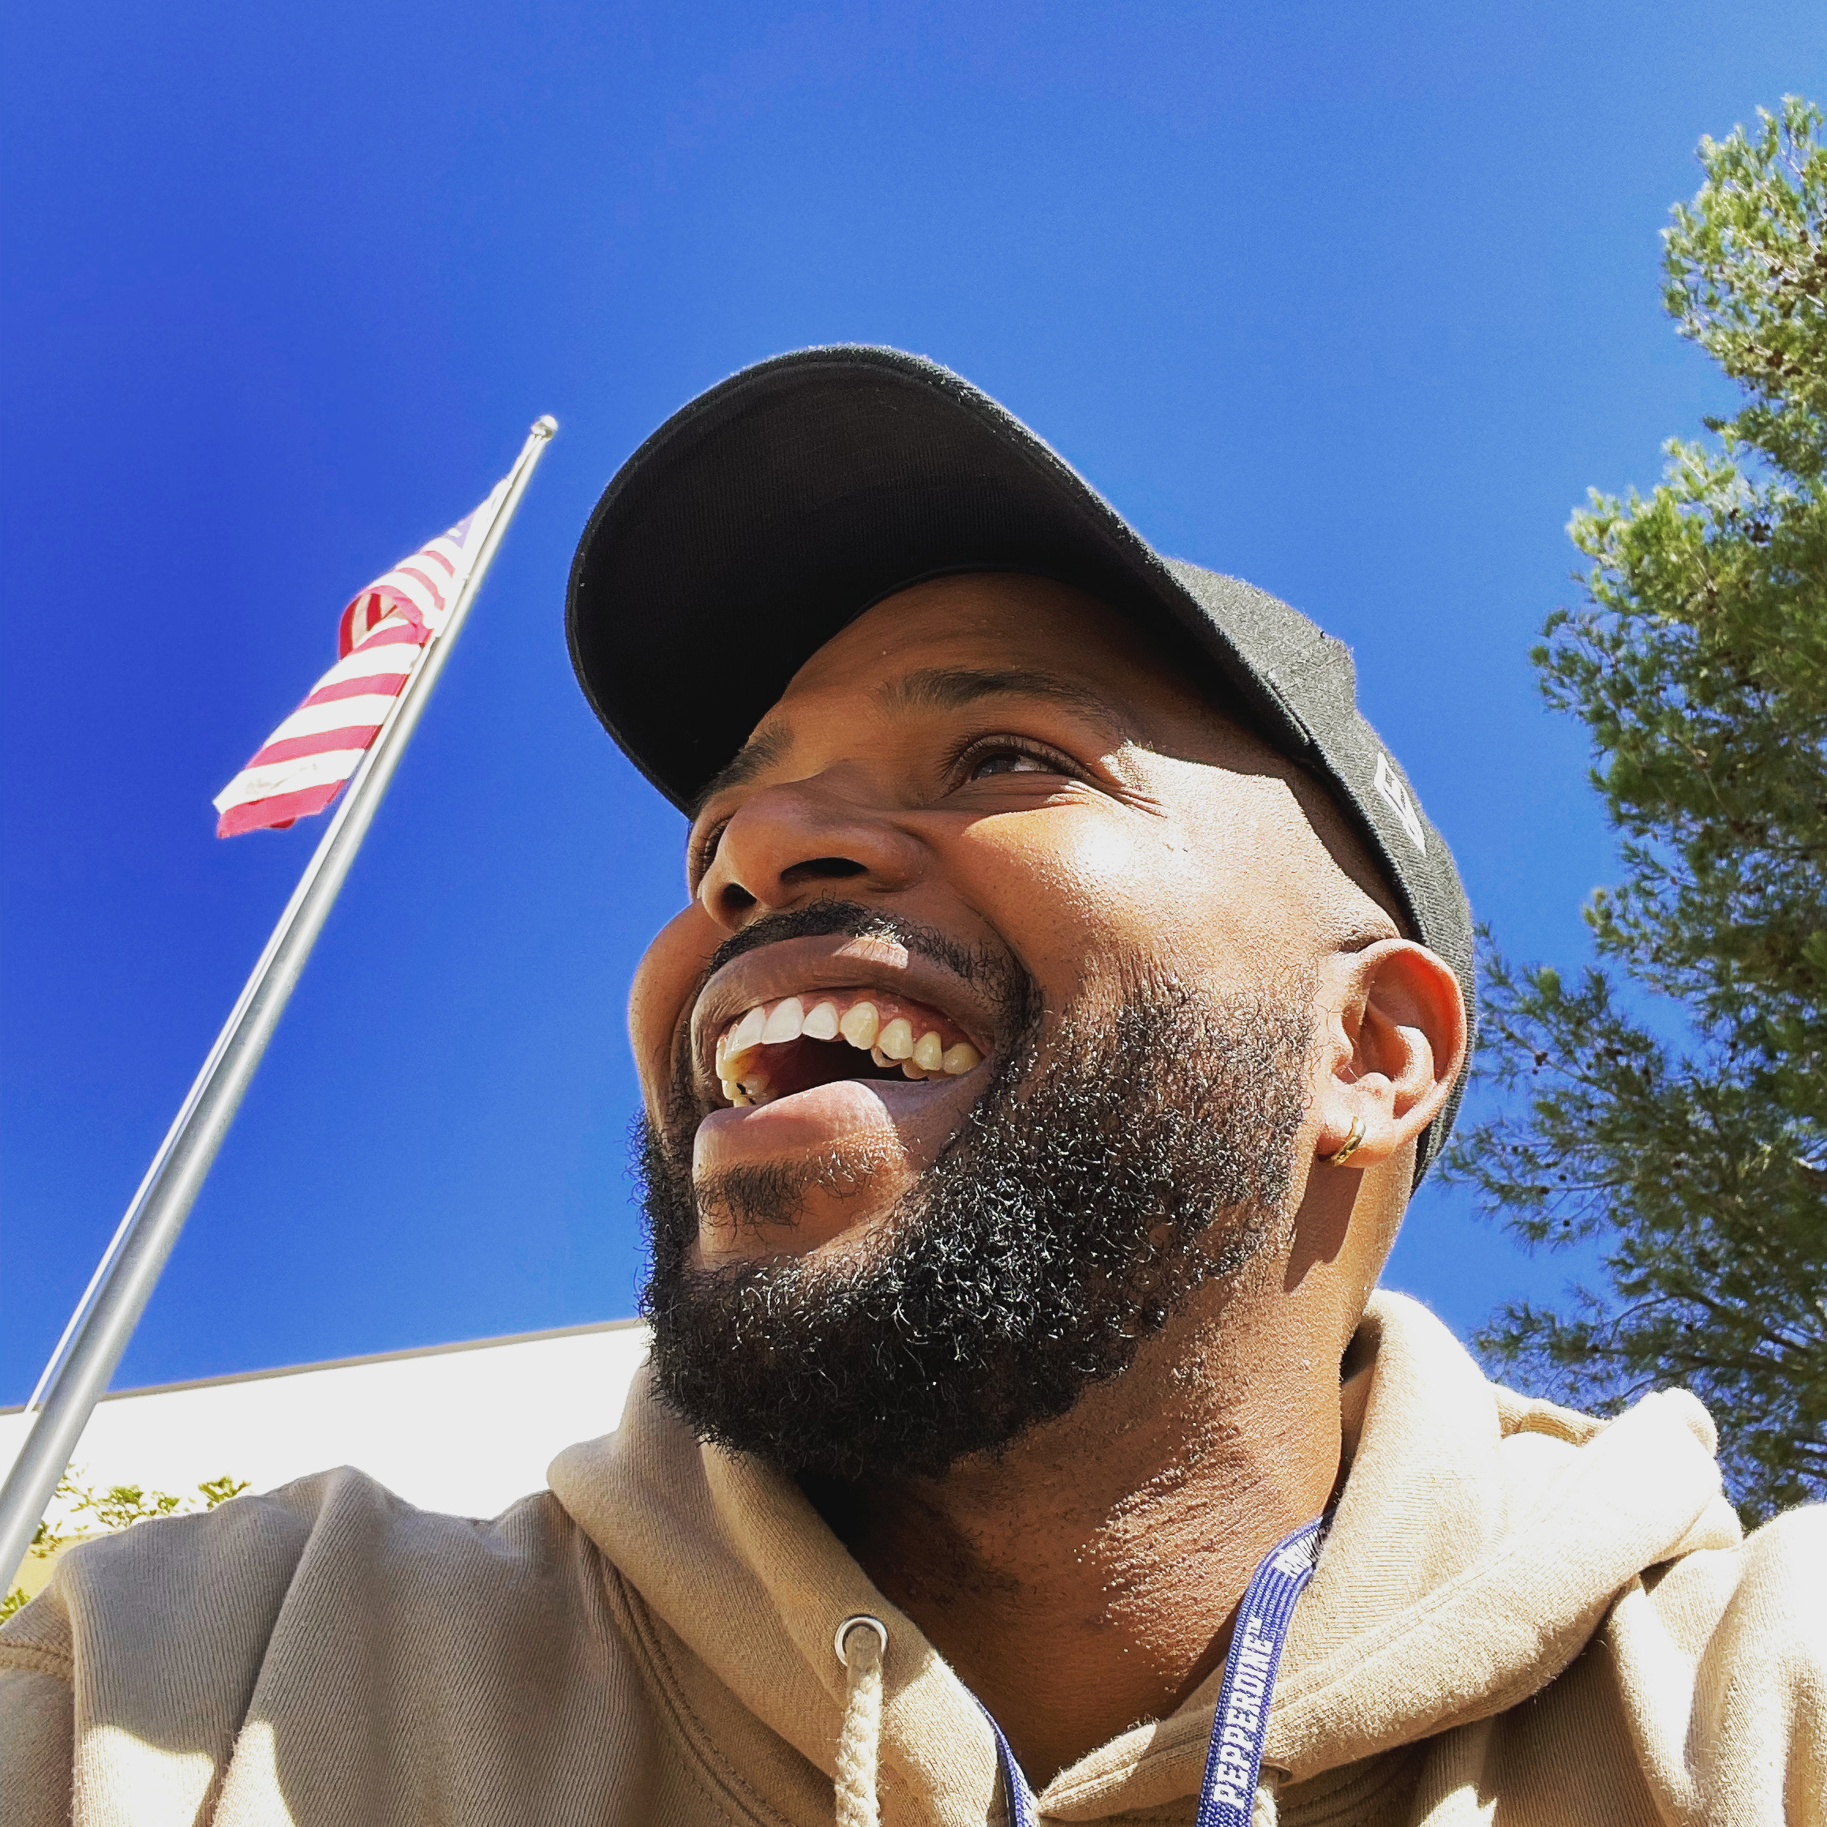
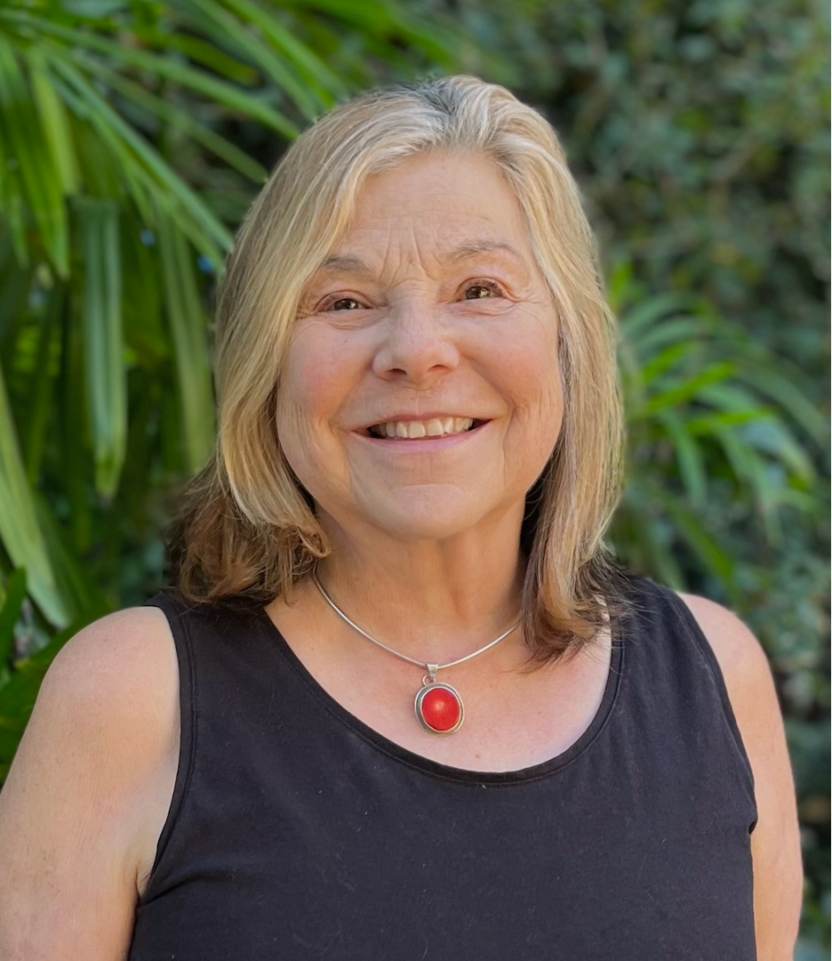
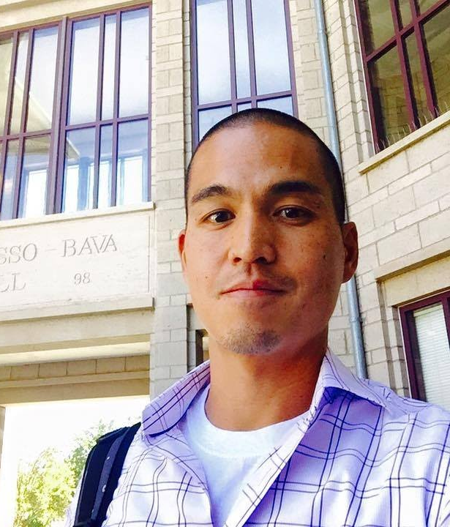
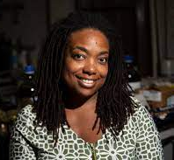
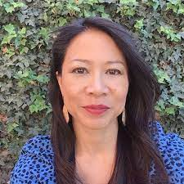
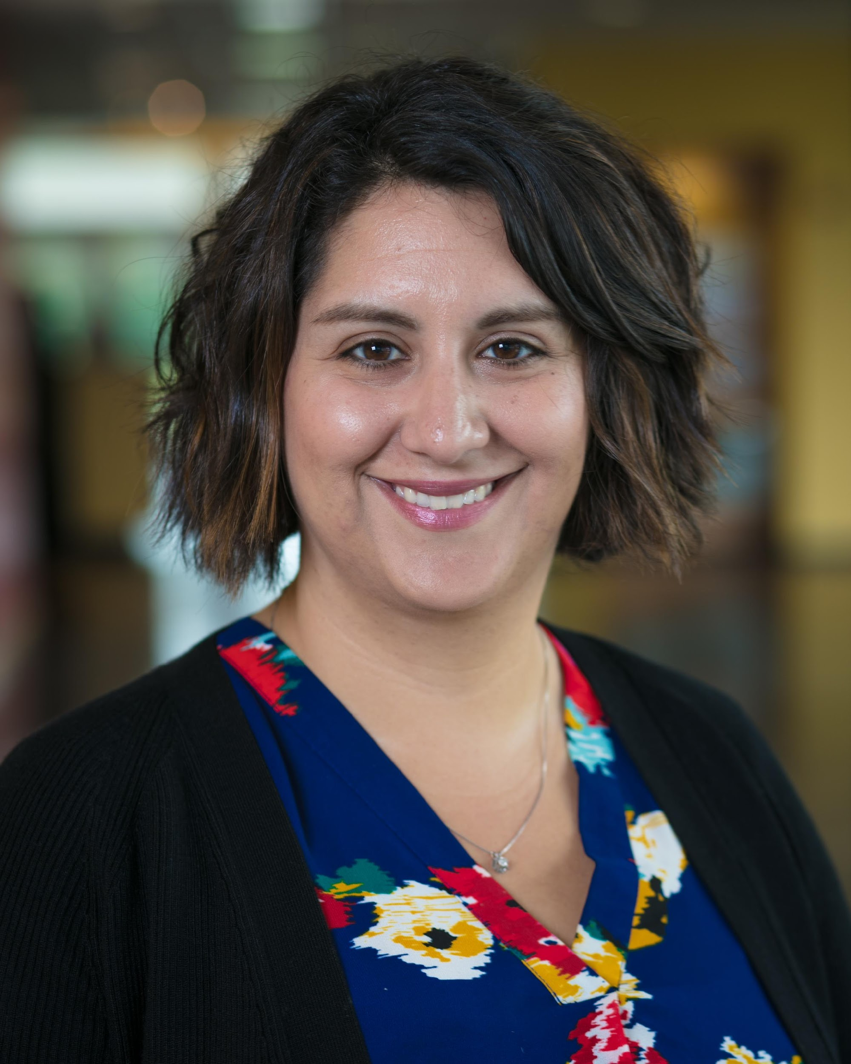
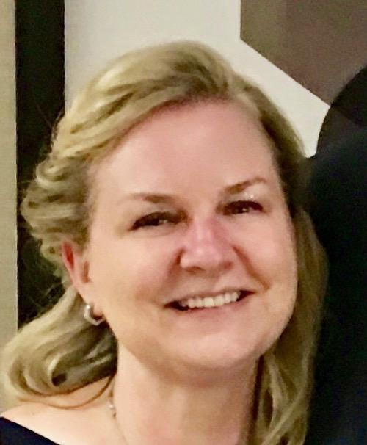
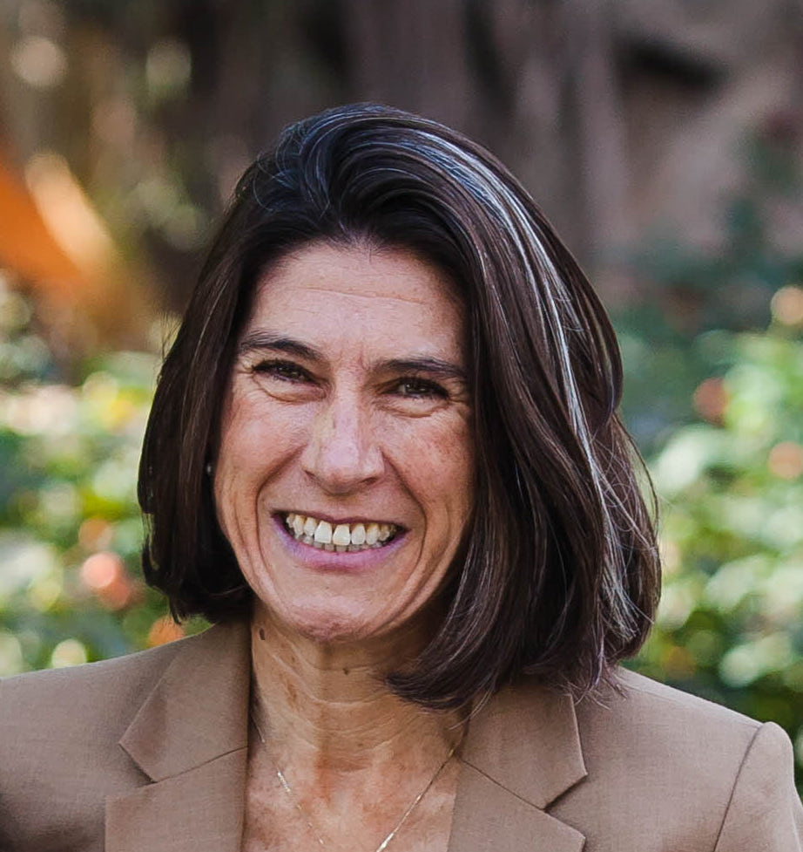
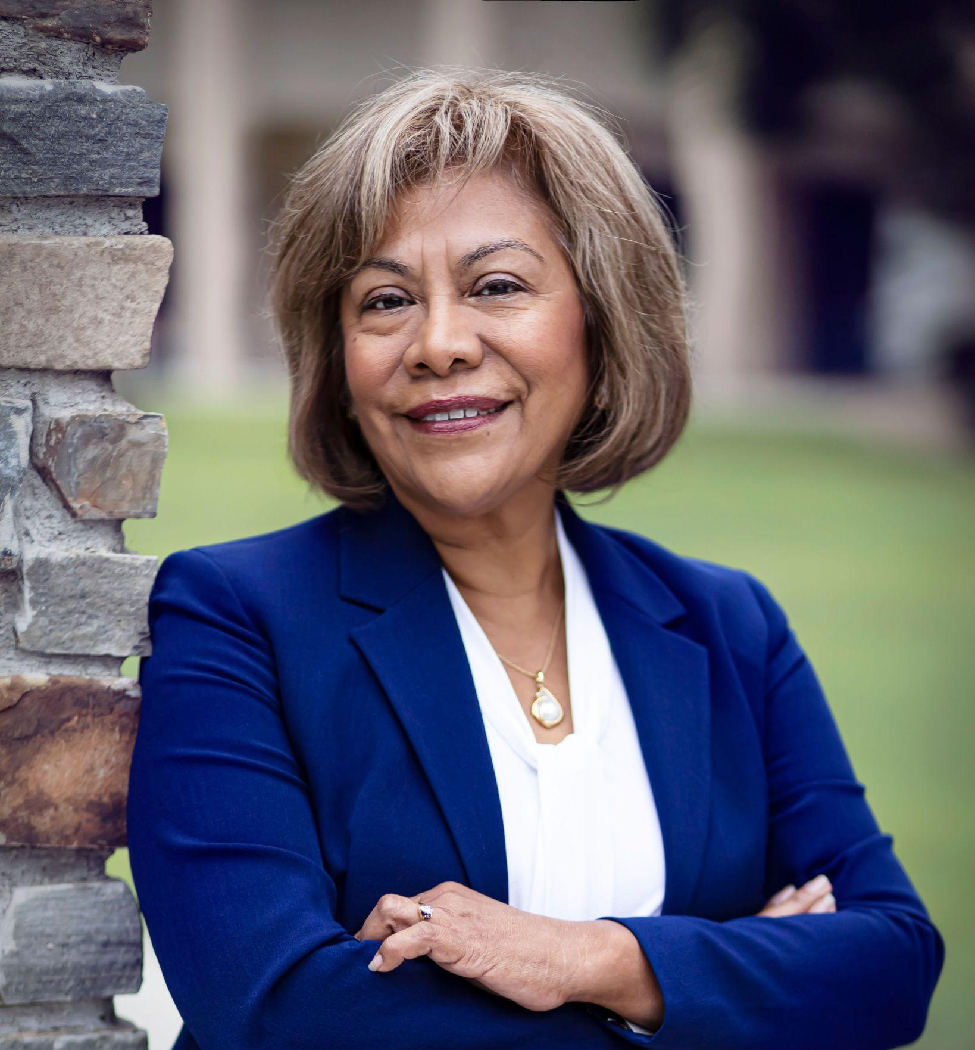
CCTE Board of Directors
Terrelle Sales
Anita Flemington
Daniel Soodjinda
Antoinette Linton
Nat Hansuvadha
Shadi Roshandel
Kara Ireland D’Ambrosio
Juliet Wahleithner
Reyna Garcia Ramos
Notes:
Also Acknowledge our CCTE Committee Chairs:
Awards Committee – Shadi Roshandel (attending virtually)
Communications Committee – Sarah Johnson
JEDI Committee – Eric Engdahl (attending virtually)
Membership Committee – Deborah Hamm & Mona Thompson
PD4MT Committee – Virginia Kennedy & Melissa Meetze-Hall
Nominations & Elections Committee – Eric Engdahl (attending virtually)
Policy Committee – Cynthia Grutzik, Nicol Howard, & Pia Wong
Research Committee – Kimiya Maghzi & Marni Fisher

Slide 8
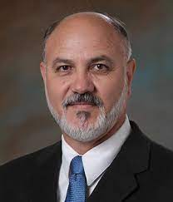
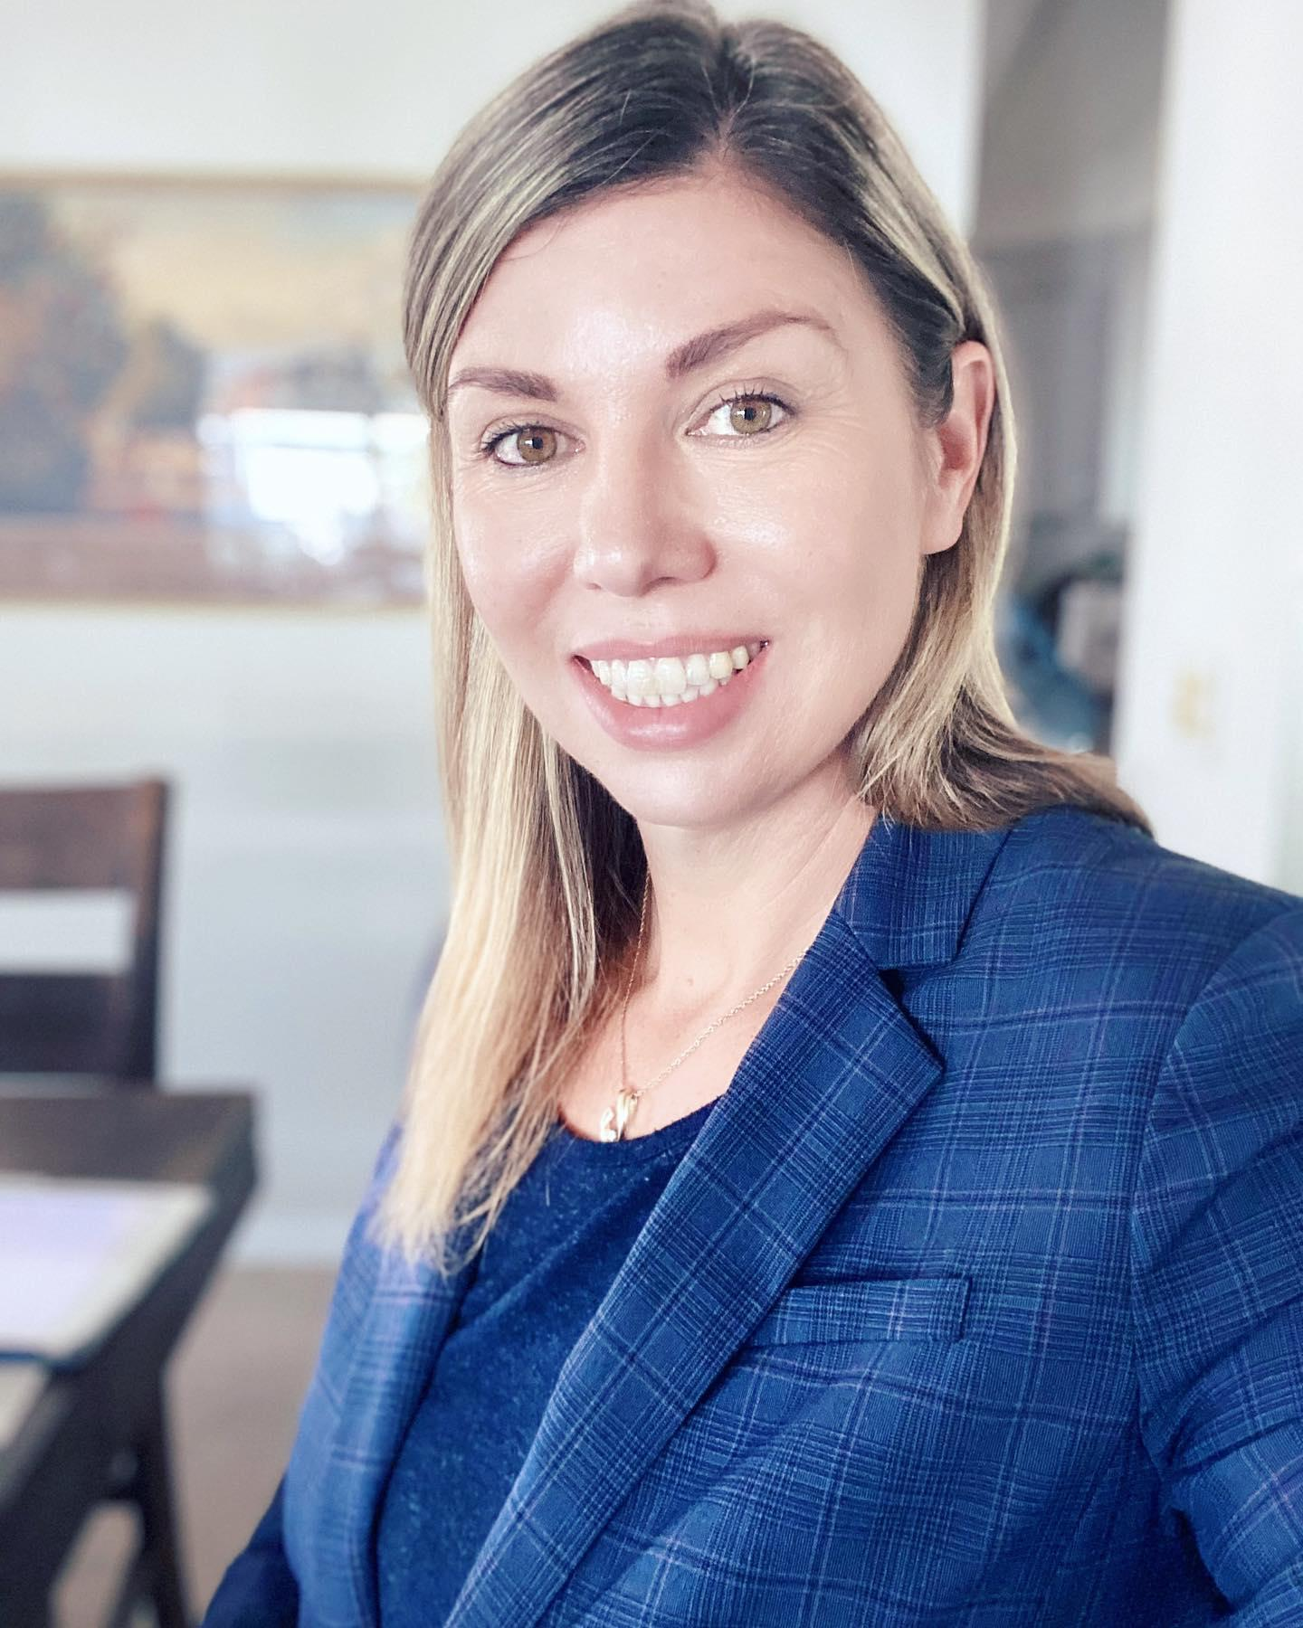
CCTE Publications/ Editors
Reyes Quezada
TEQ Editor
Allison Smith
ITE Editor
Terrelle Sales
CCNews Editor

Slide 9
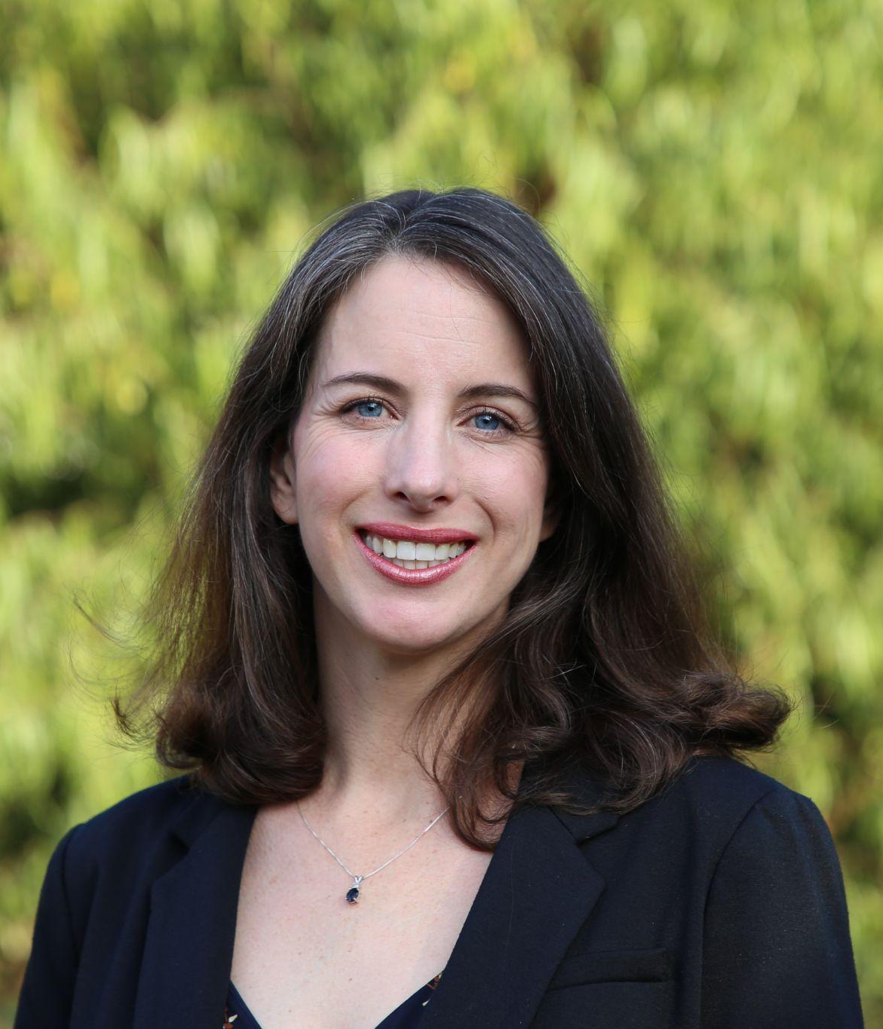
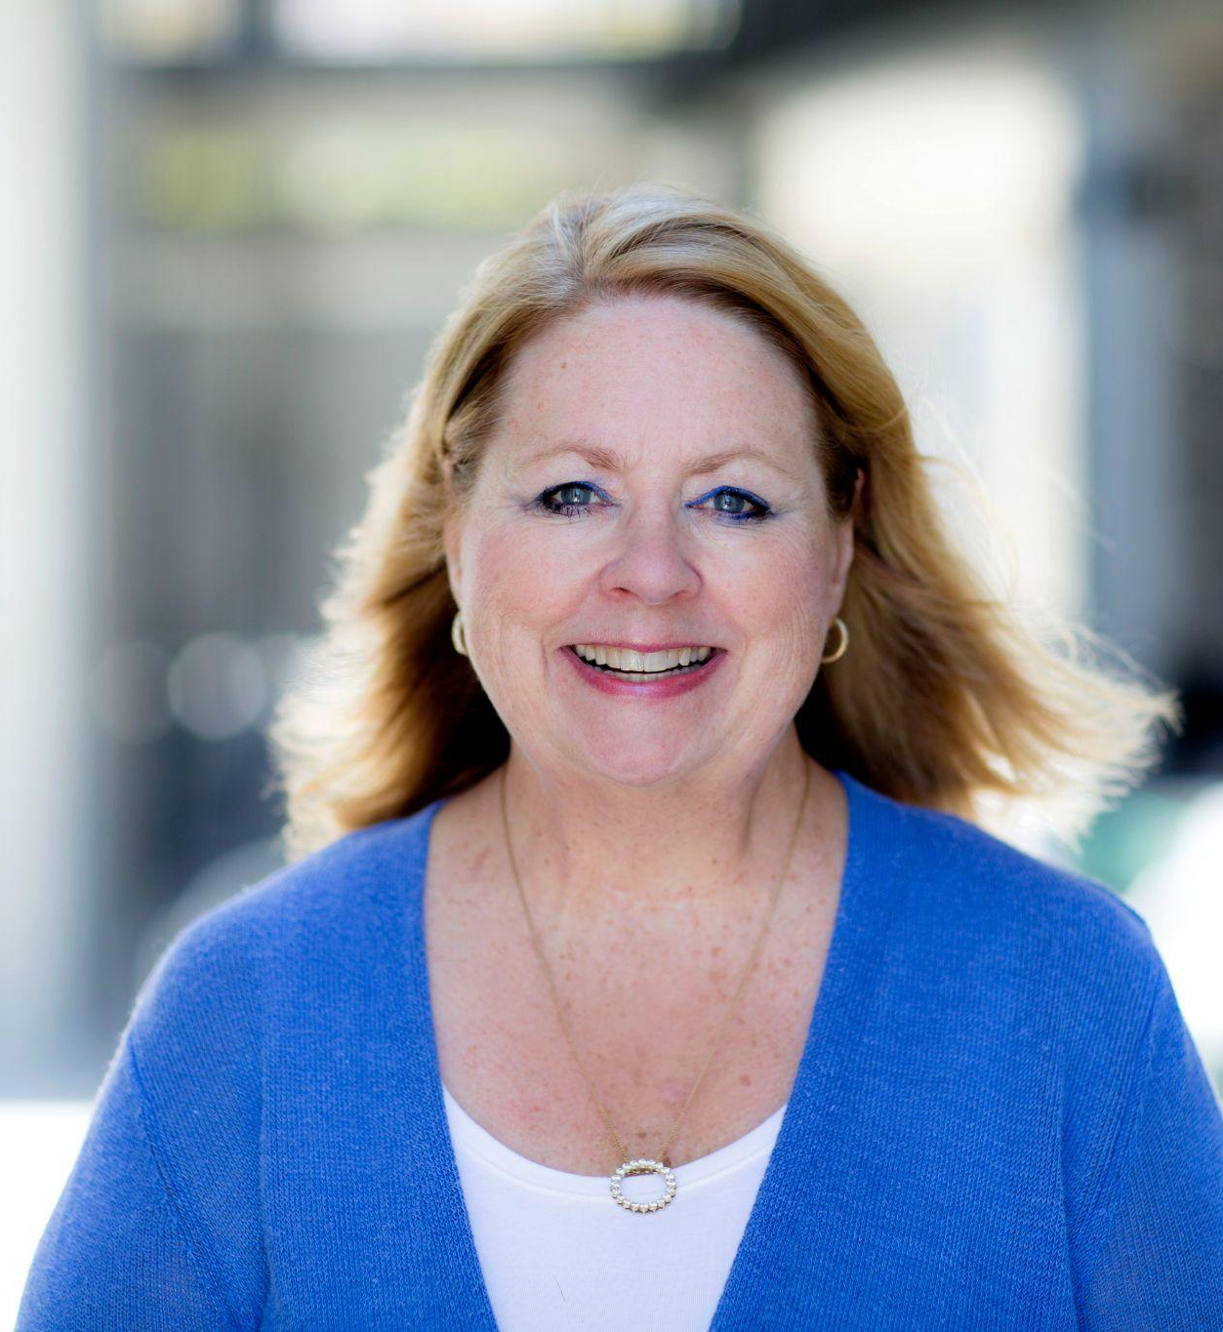
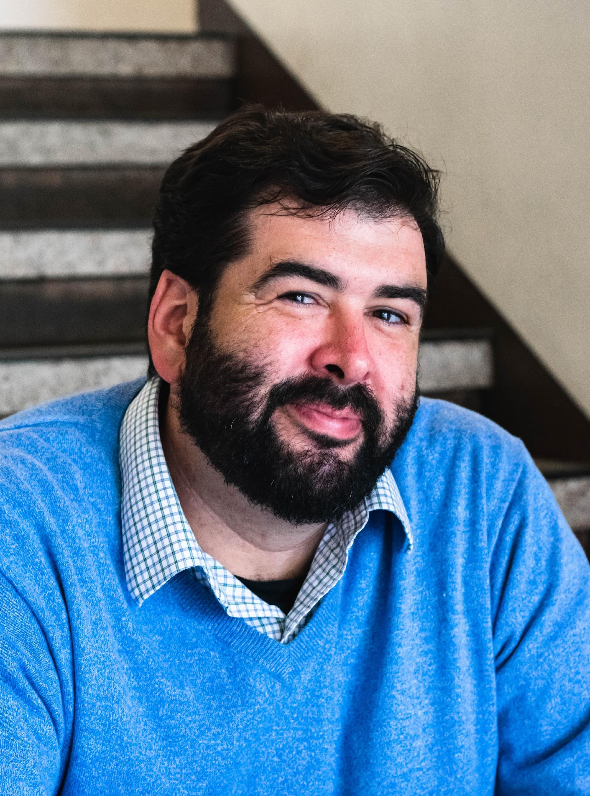
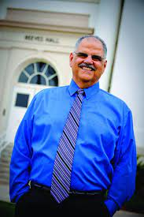
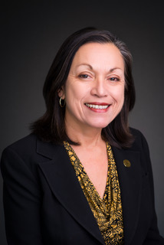
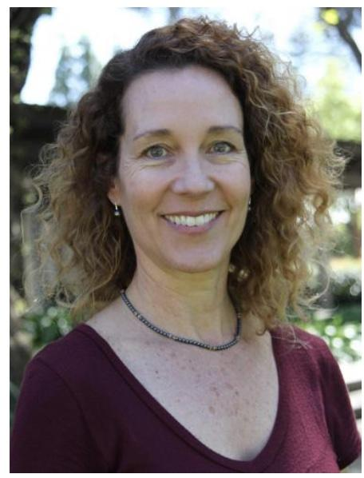
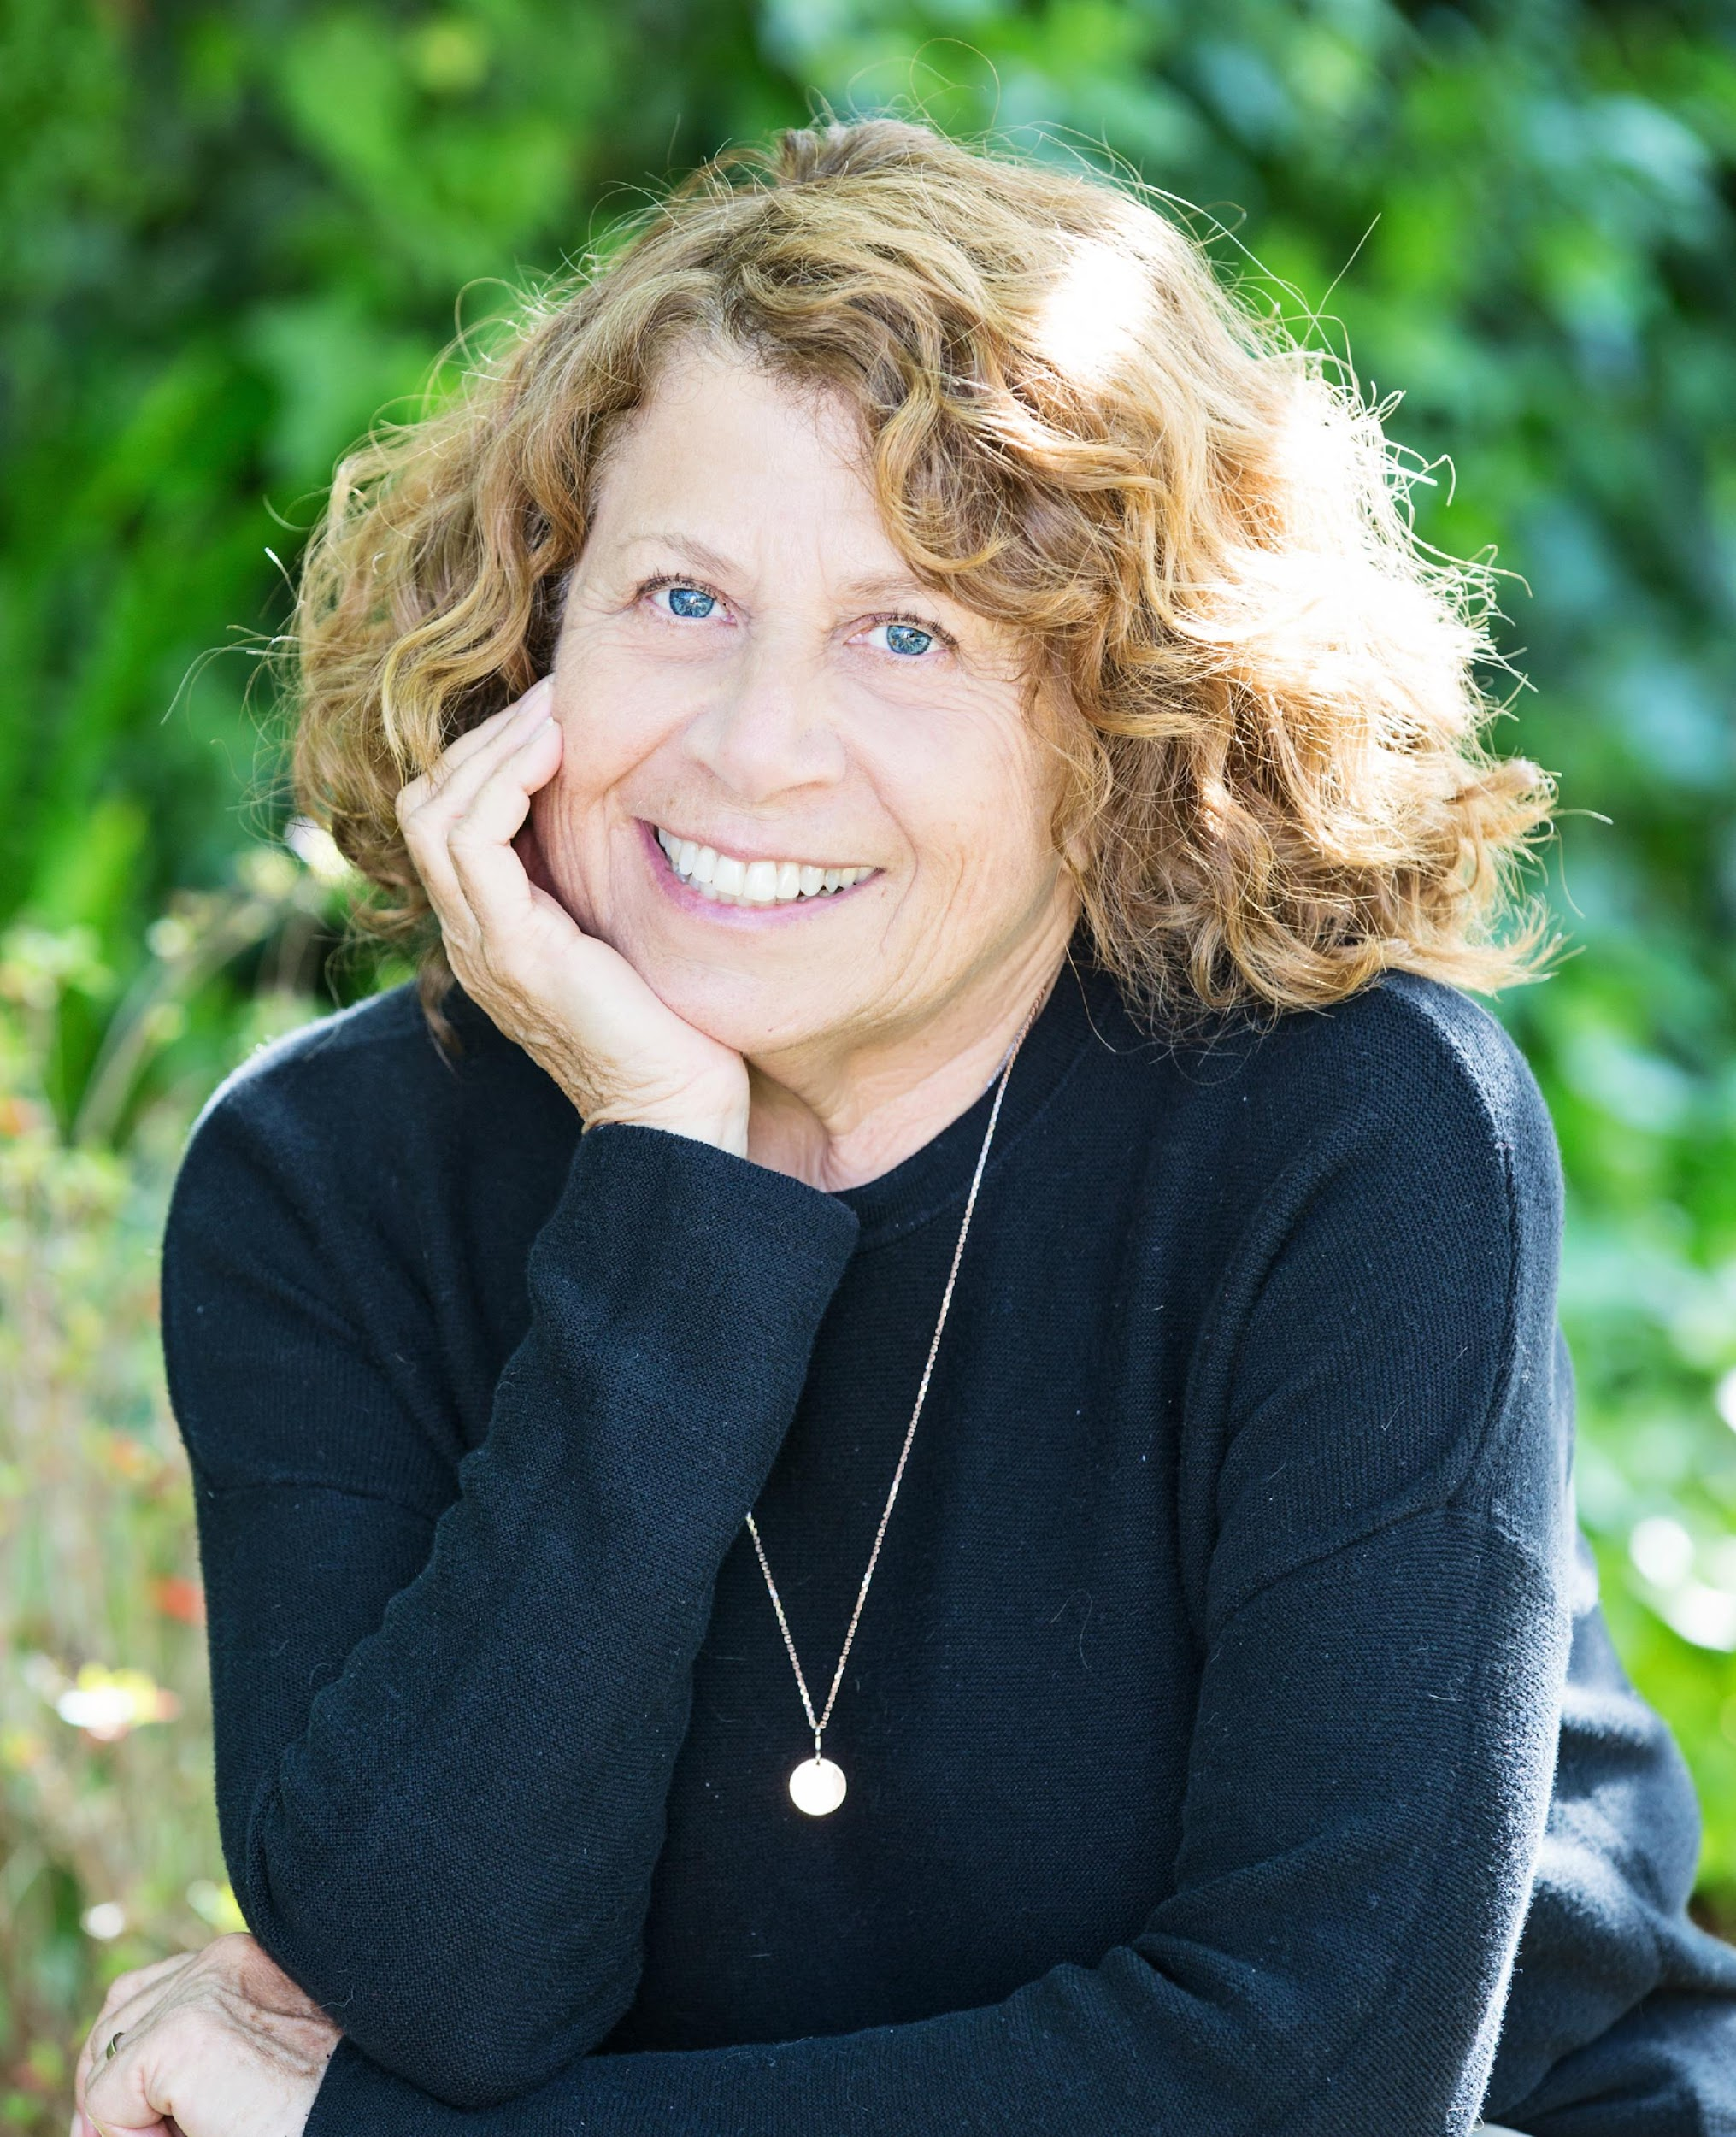
CCTE Associated Organizations Leaders
Megan Kaplinsky
ACCCTEP
Deborah Erickson
AICCU-ED
Nat Hansuvadha
CAPSE/TED
Eduardo Munoz-Munoz
CABTE
Don Cardinal & Marquita Grenot-Scheyer
CAIS
Lisa Sullivan
STENT
Nancy Markowitz
CRTWC
Notes:
Also acknowledge CARE-ED – Ruchi Rangnath, Executive Director & Brian Charest, CARE-ED liaison to the CCTE Board
CASUP – Keith Derrick, President

Slide 10
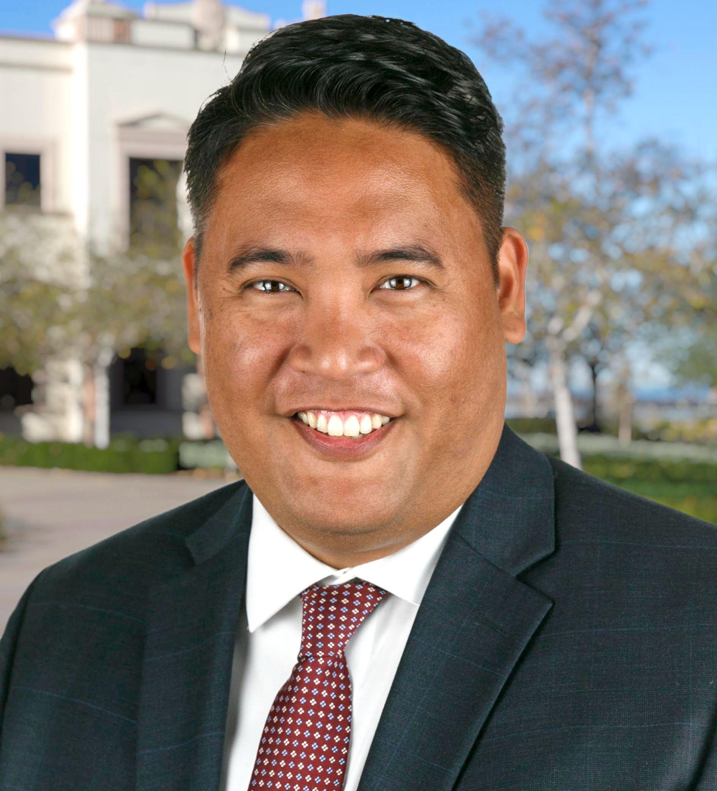
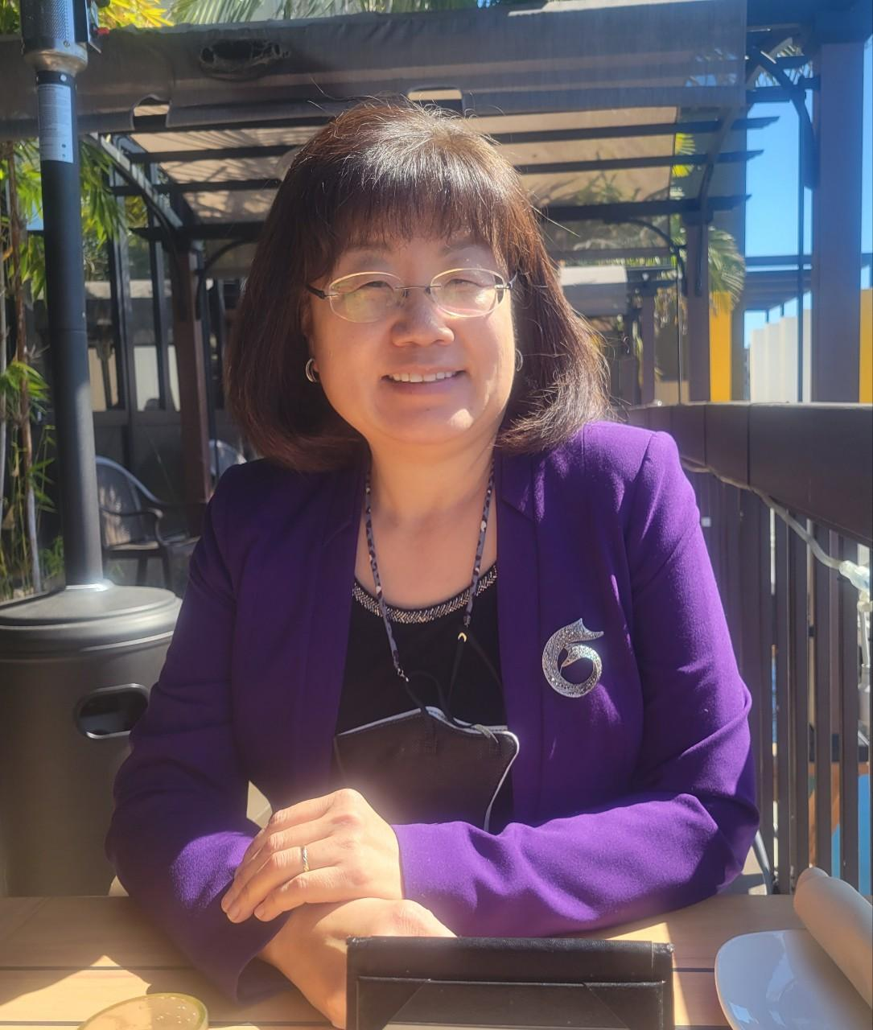
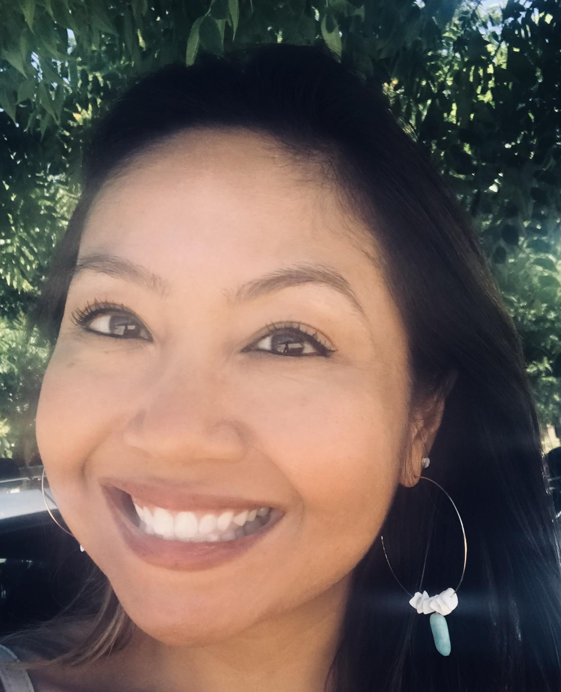
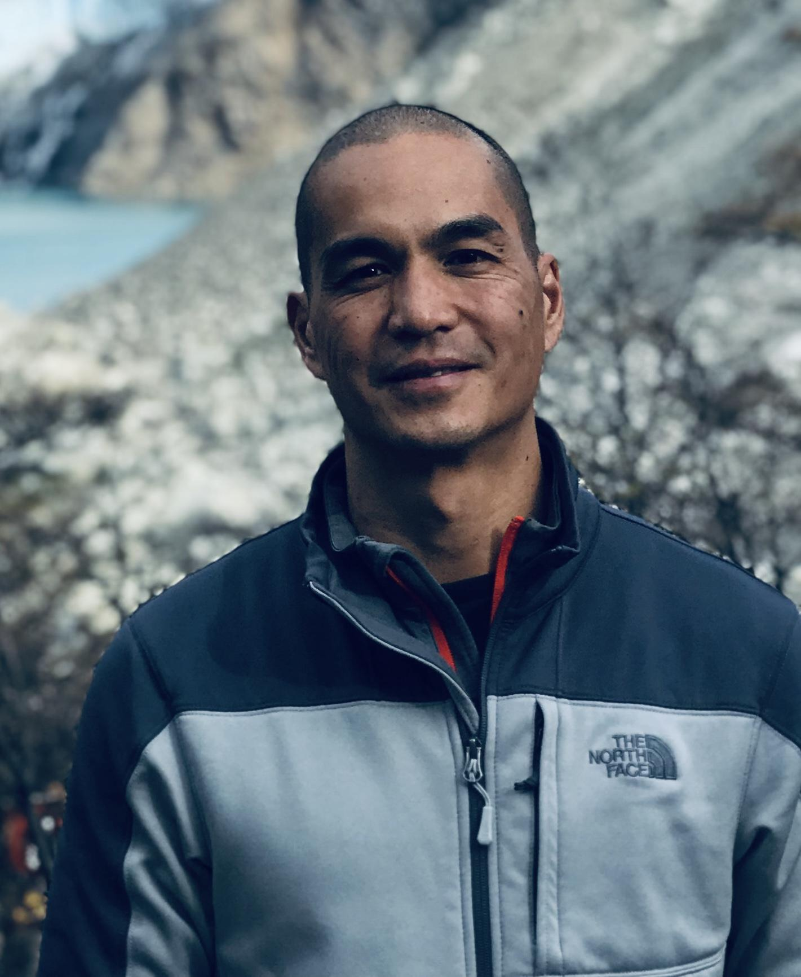
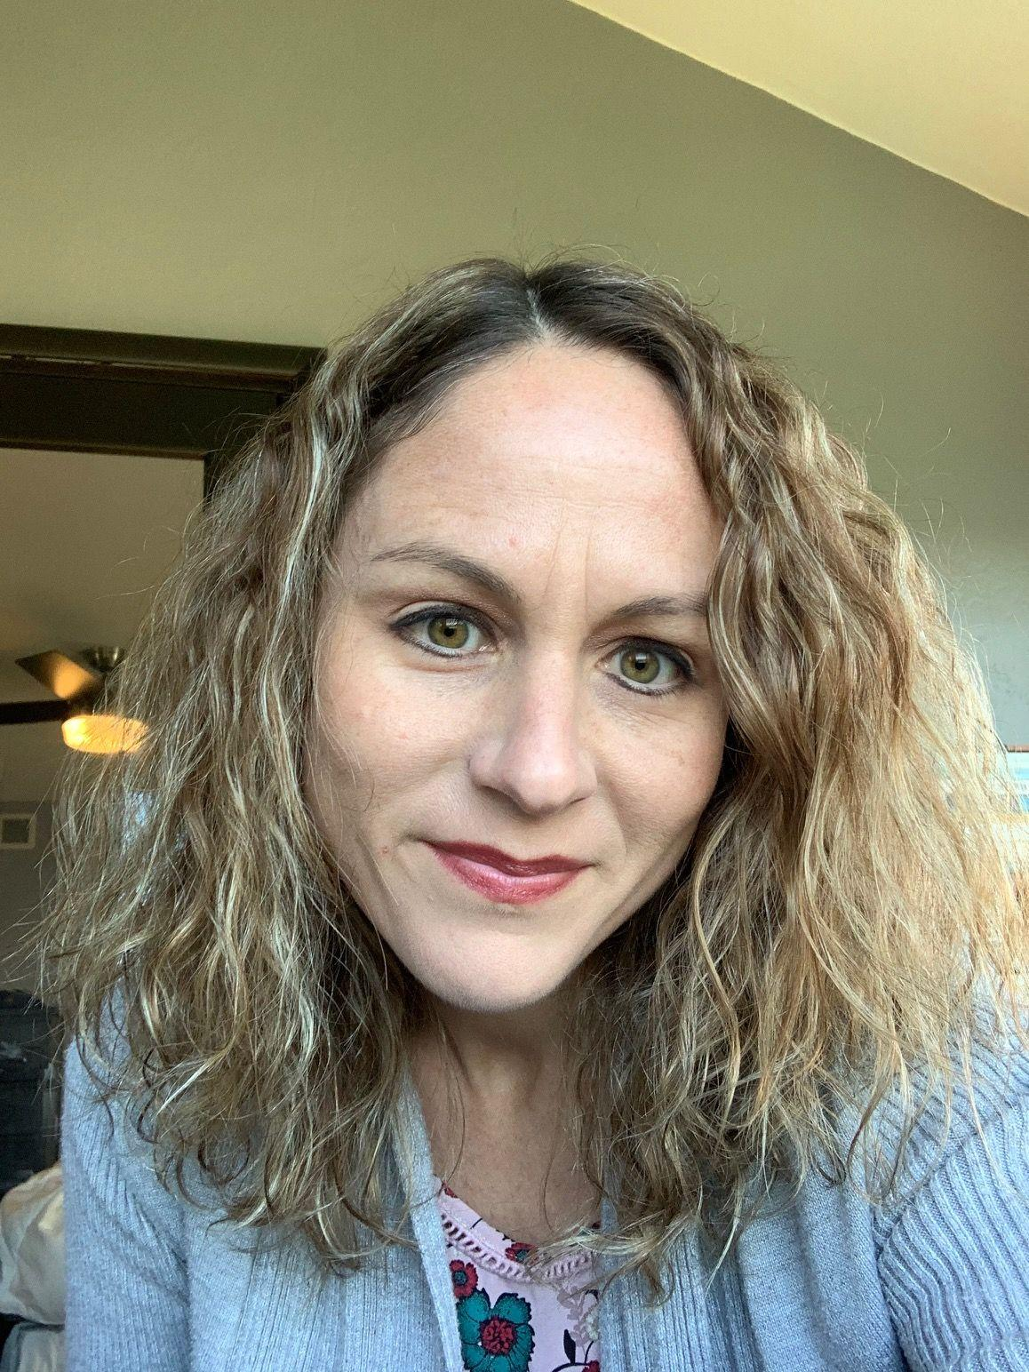
CCTE Fall Conference Committee
Reyes Quezada
Conference Chair
James Fabionar
Conference Co-Chair
Grace Cho
Betina Hsieh
Kelly Léon
Jennifer Manglicmot
Daniel Soodjinda
Karen Escalante

Slide 11
CCTE Fall Conference Sponsors
Office of Educator & Leadership Programs
CSU Chancellor’s Office
Shireen Pavri, Assistant Vice Chancellor
Charter College of Education
CSULA
Mitchell Fryling, Dean
Graduate School of Education
SF State
Cynthia Grutzik, Dean
School of Leadership and Education Sciences
University of San Diego
Kimberly White-Smith, Dean
California State University, Sacramento
Sasha Sidorkin, Dean
Notes:
We’d like to acknowledge our CCTE Fall Conference Sponsors and the leadership of these institutions, listed here

Slide 12
CCTE Fall Conference Exhibitors
Notes:
These are our fall conference exhibitors. I’d like to encourage you to visit each of them

Slide 13
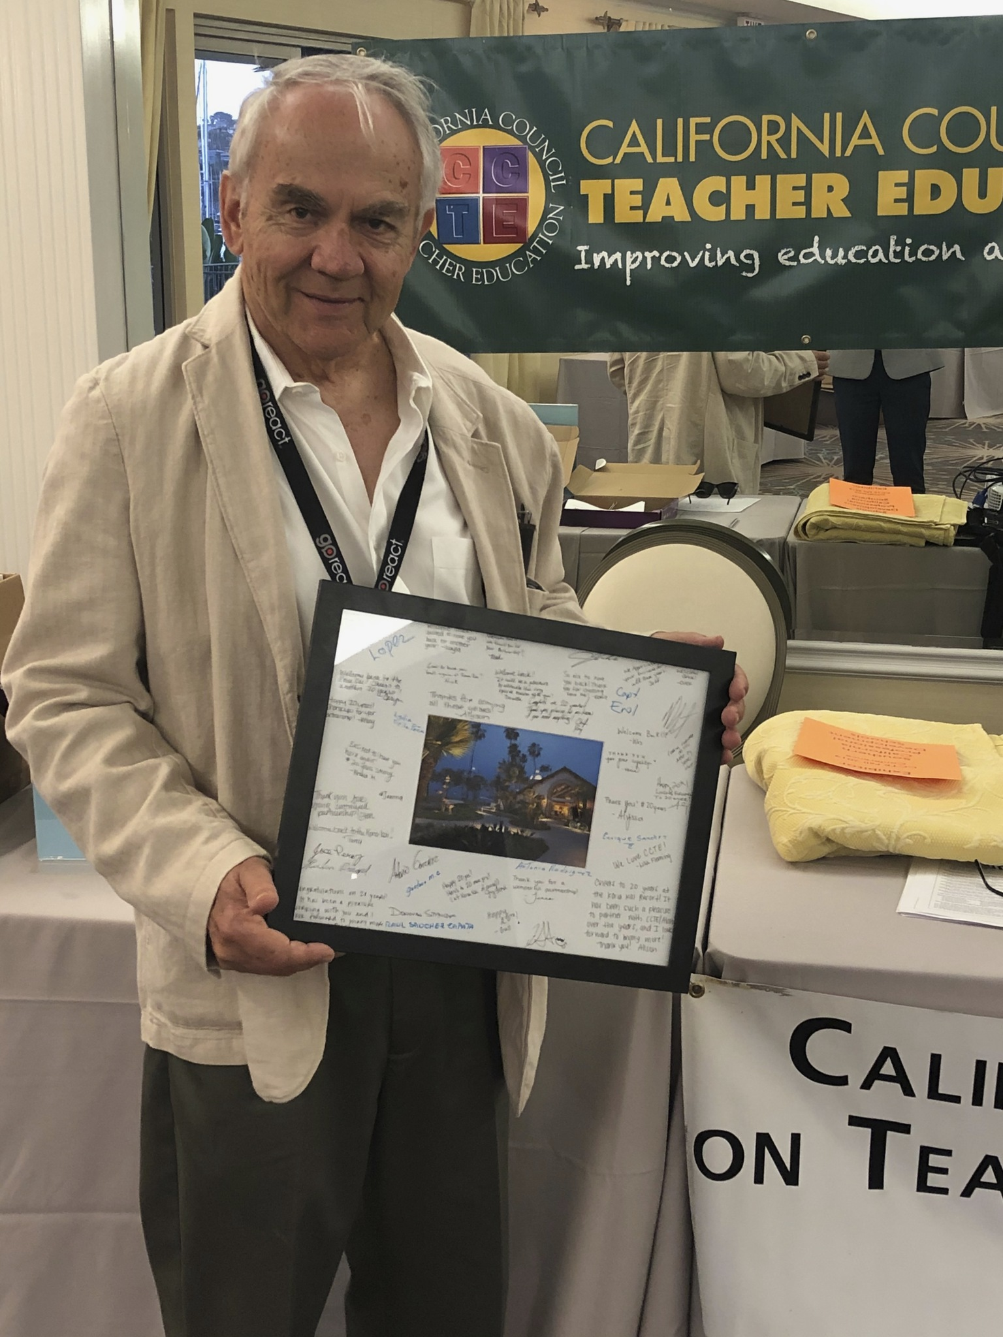
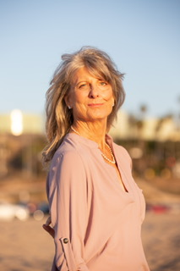
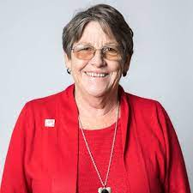
CCTE Staff
Alan Jones
Executive Secretary
Monica Boomgard
Co-Assistant Executive Secretary
Deborah Hamm
Co-Assistant Executive Secretary
Notes:
Also thank Yesenia Jorgensen and Kona Kai staff

Slide 14
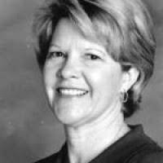
Graduate Student Support Program
Virginia Kennedy
Deborah Hamm

Slide 15
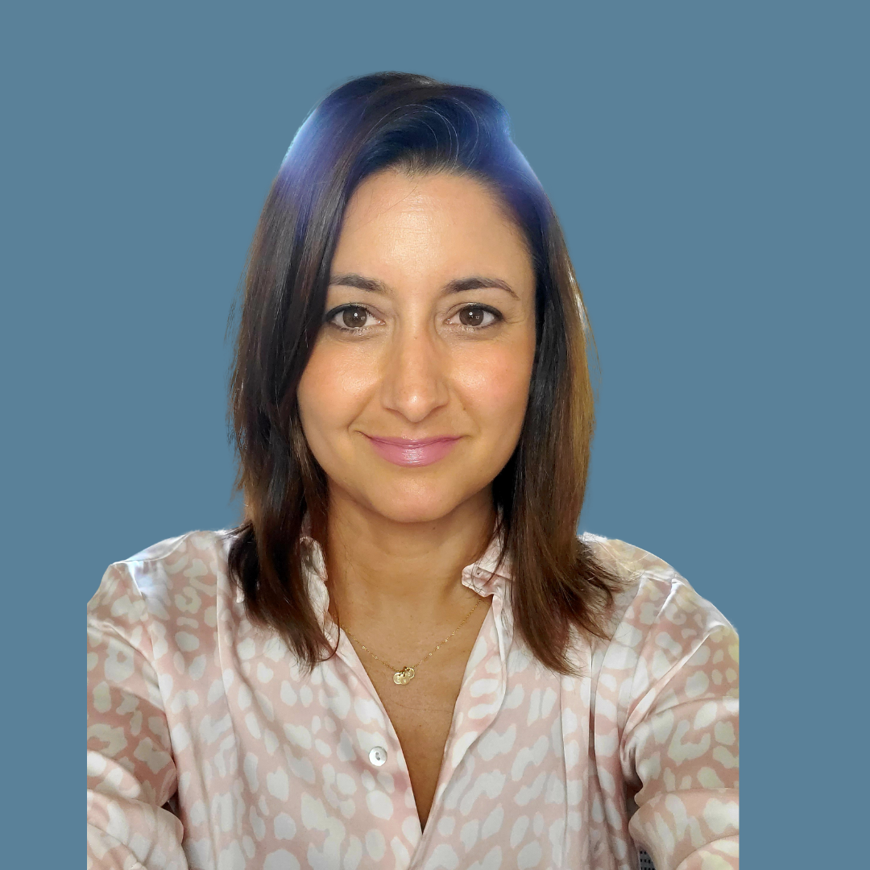
Faculty Support/ Aspiring & New Faculty of Color Support Program
Heather Michel
Terrelle Sales

Slide 16
Directory
https://bit.ly/cctefall23directory

Slide 17
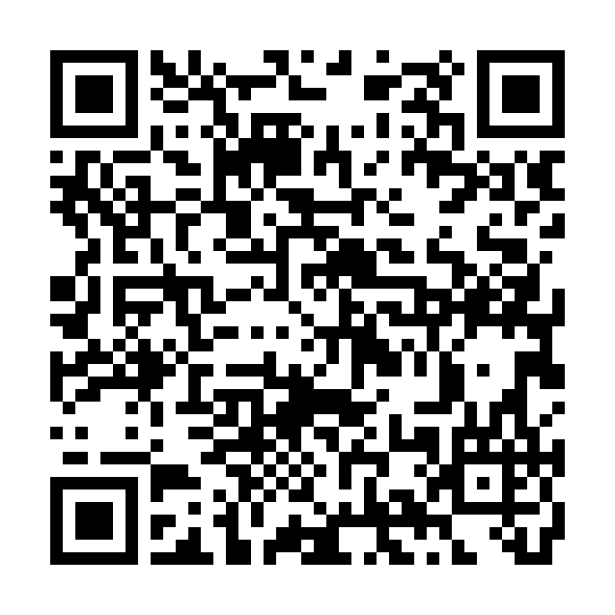
Day 1 Reflection
https://bit.ly/cctefall23connecting

Slide 18
CCTE Conference Theme
The Ethnic Studies Moment in California Public Education
Preparing the Field for Historic Change

Slide 19
Please take a moment to be present

Slide 20
Thank you for joining us! We look forward to seeing you at SPAN March 11-12, 2024
Notes:
Evaluation

